Slide 1
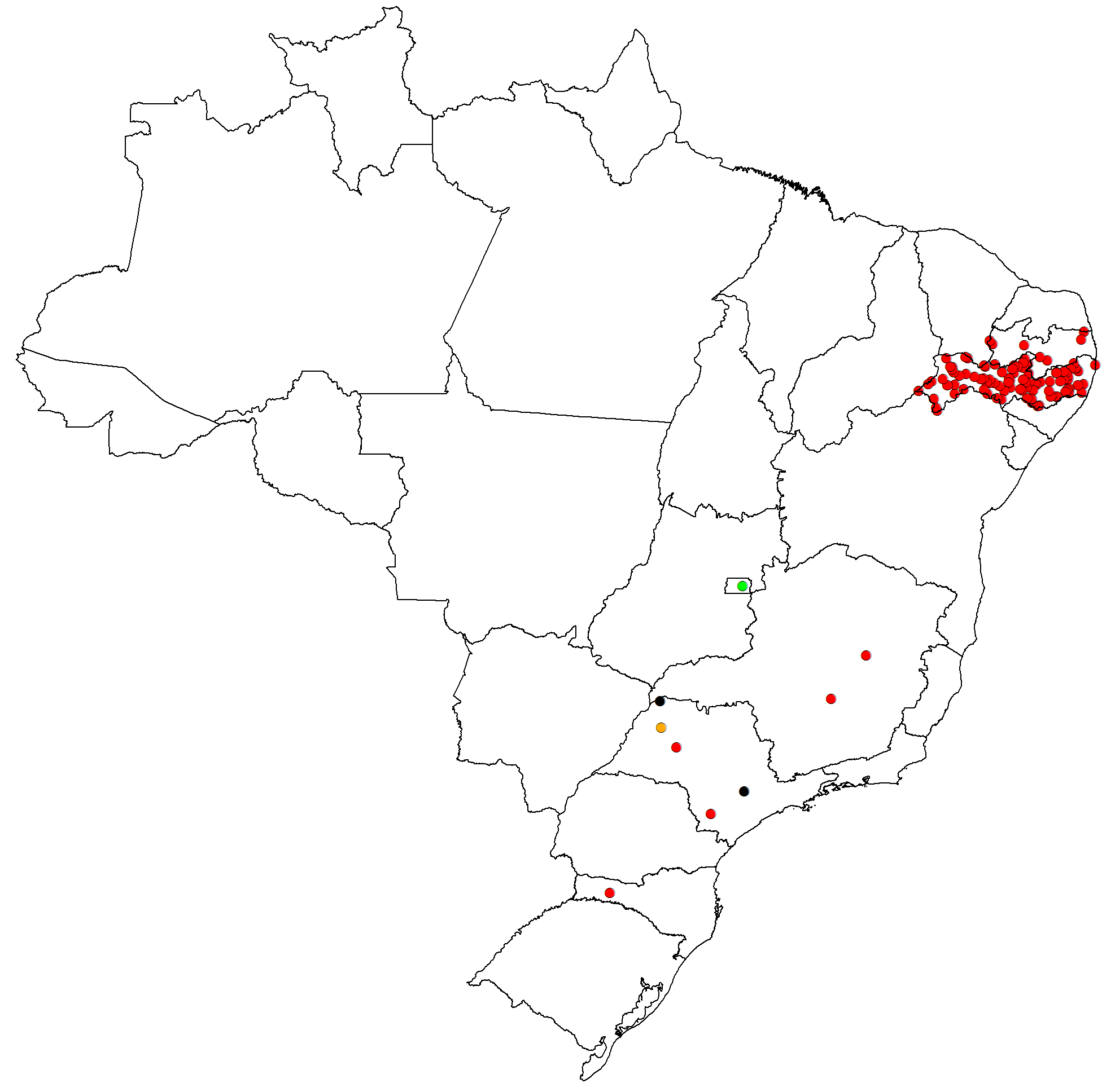
Distribution of confirmed measles cases and genotypes, Brazil, 2013*
Legend
D8 genotype
D4 genotype
B3 genotype
unknown genotype
Confirmed measles cases in Brazil, 2013*
States | N° of confirmed cases | Genotype
São Paulo | 5 | D8 (2); D4 (1), unknown (2)
Mato Grosso del Sur | 2 | D8
Santa Catarina | 1 | D8
Pernambuco | 98 | D8
Paraíba | 7 | D8
Distrito Federal | 1 | B3
Total Brazil | 114 | D8, D4 and B3
1 dot = 1 case
*Data updated on 8 October 2013
Source: Country report to PAHO

