Slide 1
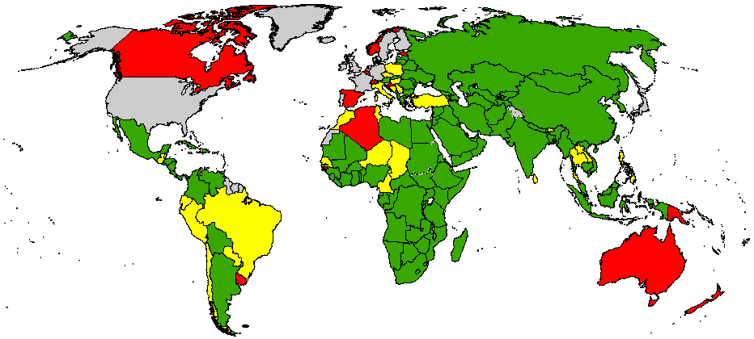
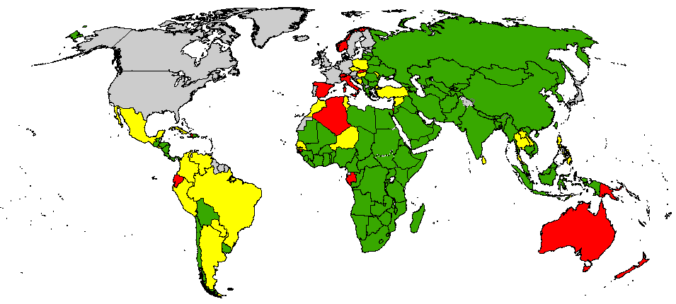
Adequate Stool Collection Percentage
Dec. 2011 – Nov. 2012
Dec. 2012 – Nov. 2013
< 60%
60% - 79.99%
> 80%
No AFP Surveillance/data
The boundaries and names shown and the designations used on this map do not imply the expression of any opinion whatsoever on the part of the World Health Organization concerning the legal status of any country, territory, city or area or of its authorities, or concerning the delimitation of its frontiers or boundaries. Dotted lines on maps represent approximate border lines for which there may not yet be full agreement.
© WHO 2014. All rights reserved
Data in WHO/HQ as of 14 Jan 2014

