Slide 1
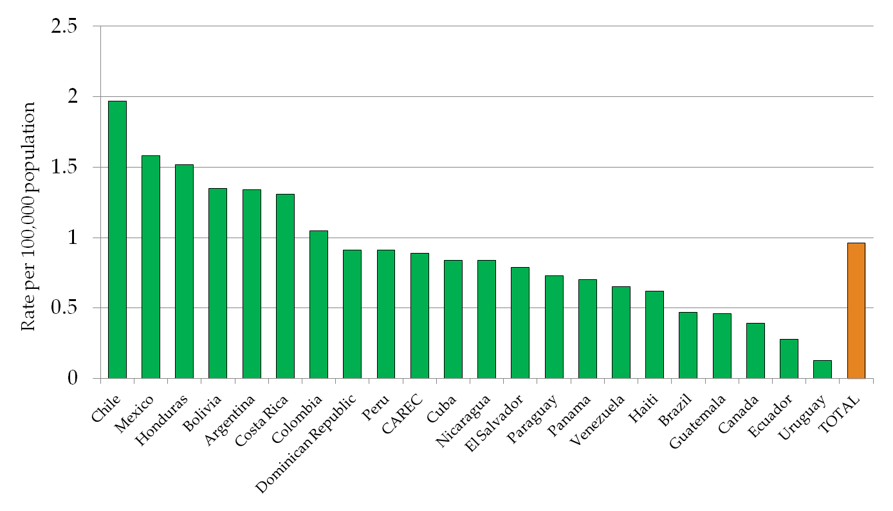
Acute Flaccid Paralysis Rate per 100,000 children <15 years of Age, The Americas, 2013*
Source: ISIS, PESS and countries reports.
* Data as of 3 January 2014.

