Slide 1
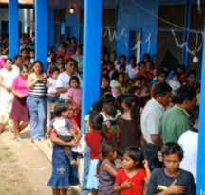
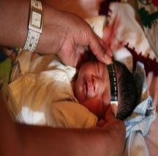
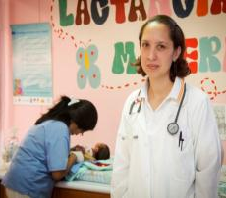
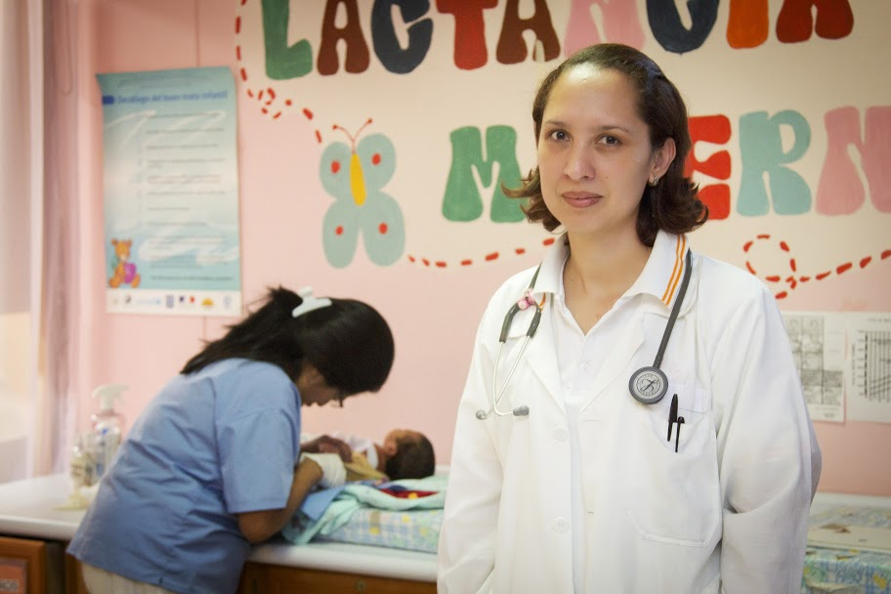
3 December 2013
UNIVERSAL HEALTH COVERAGE
Building a path forward in the Region of the Americas
Dr. Carissa F. Etienne
Director PAHO/WHO

Slide 2
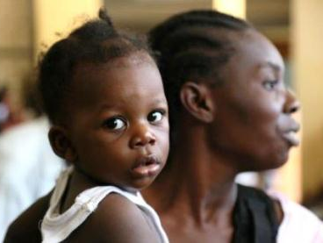
UHC: a powerful concept in evolution
“UHC is to ensure all people have access to needed services (prevention, promotion, curative, rehabilitation, and palliative care) with sufficient quality to be effective and without exposing individuals to financial hardship.
UHC provides renewed focus on access to the Social Determinants of Health, and the engagement of other sectors and civil society to promote health and well-being”
PRINCIPLES OF UHC
Universality
Equity
Right to health
Solidarity
Notes:
World Health Assembly Resolution 58.33, 2005
Urged countries to develop health financing systems to:
Ensure all people have access to needed services
Diminish the risk of financial ruin linked to paying for care
Defined this as achieving Universal Coverage: coverage of health services; financial risk protection; for all.
World Health Report, 2010
Provide all people with access to needed health services (including prevention, promotion, treatment and rehabilitation) of sufficient quality to be effective
…Without exposing users to financial hardship
Health services: prevention, promotion, treatment, rehabilitation – not just treatment
Coverage with services of good quality
Universal Health Coverage (UHC) for MDG and sustainable development dialogue

Slide 3
What UHC is not…..
UHC is not only about treatment
UHC is not only about financial protection
UHC is not a strategy which excludes priority health programs
UHC is not about ensuring a minimum package of health services
UHC is not about privatizing the health system, nor is there a unique health system model through which UHC can be achieved
Notes:
Is not just financial protection (but will ensure financial protection)
Is certainly not limited to UHI (even if UHI may under certain conditions help to move towards UHC)
Is not just a way to cover only the poorest and the most vulnerable (but they will be protected by UHC)
Is not a strategy to privatize health systems (even if under strong regulation private sector may play an important role in UHC, for instance, in delivering quality health care)

Slide 4
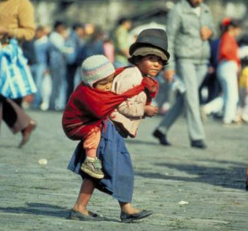
Inequalities & Health
Inequality in LAC: The great challenge.
Inequality also impacts health conditions.
Inequality is a barrier for development.
Improving health care has strong redistributive impact.

Slide 5
Towards UHC: Three Dimensions
Policy Choices
Notes:
5

Slide 6
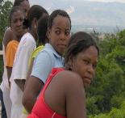
Social Determinants of Health
Addressing the Social Determinants of Health: An Essential Factor in Breaking the Cycle of Inequity
Ethnicity, class status, and social exclusion
Place of residence- urban vs. rural
Woman’s level of education
Family and peer influences
Income of family
National legal and policy environments
Cultural and religious values and traditions
Access to affordable and high quality health services
Gender Norms

Slide 7
REQUIREMENTS for UHC
Resilient Health Systems
Social Protection
Social Participation
Political Will
Notes:
Universality and Equity in health constitute major challenges for our region, given the unmet needs of vulnerable and at-risk populations. Ex: women and children.
Right to Health: 34 states in the Region have committed themselves to ensuring the right to highest attainable standard in health through international human rights treaties; and 19 countries in the Region have provisions in their constitutions that guarantee access to health care for everyone in their jurisdictions.
UHC is built on the principle of solidarity, pooling and rational/efficient use of resources.

Slide 8
Resilient Health Systems
Governance
Organization of care
Human resources
Health financing
Health information systems
Access to technology including medicines
Health Services Delivery
Notes:
Universality and Equity in health constitute major challenges for our region, given the unmet needs of vulnerable and at-risk populations. Ex: women and children.
Right to Health: 34 states in the Region have committed themselves to ensuring the right to highest attainable standard in health through international human rights treaties; and 19 countries in the Region have provisions in their constitutions that guarantee access to health care for everyone in their jurisdictions.
UHC is built on the principle of solidarity, pooling and rational/efficient use of resources.

Slide 9
Universal health coverage
Key Messages
UHC is based on the principles of the right to health, equity and solidarity
UHC is much more than financial protection.
UHC focuses efforts to reach the unreached - including women and children.
Strong political will is needed to engage on UHC.
Fees at the moment of seeking health care should be eliminated.

Slide 10
Building knowledge on strengthening health Systems from Social Security experiences
MAIN ISSUES:
Health services management
Quality services development
Human Resources and leadership for health
People-centered models of care
Networking and integration of health services with other individual and family social benefits.
Notes:
EXAMPLES:
People and Family Centered Models of Care: Peru, Ecuador, with the adoption of evidence based guidelines for Maternal and Child Healthcare.
Intercultural models of services in Bolivia and Canada taking into consideration the needs of indigenous populations.

Slide 11
“Each country needs to find its own way to UHC based on its own particular historic, social, and economic context, promoting a larger social dialogue.
Every country can do something to move towards UHC”
Dr. C. F. Etienne, Jamaica, June 2013
Notes:
Because of efficiency and equity consideration, it seems important to dissociate the individual’s contribution to finance the health system from the moment they seek healthcare
No country has made significant progress towards SPH without strong political will… with concrete expressions of its fiscal priorities
Private sector has to be considered in building up UHC but strong regulation has to be deployed along with expansion of public health expenditures to 5-6% of GDP

