Slide 1
Process for the Promotion of Child Feeding (ProPAN)
December 12, 2012
Notes:
La Seguridad Alimentaria representa el acceso de todas las personas en todo momento a los alimentos necesarios para llevar una vida activa y sana.
Representa la capacidad de las familias para obtener, ya sea produciendo o comprando, los alimentos suficientes para cubrir las necesidades dietéticas de sus miembros.
La Seguridad Alimentaria es un factor de desarrollo económico, de bienestar emocional y psicológico y por su contrario la Inseguridad Alimentaria conlleva grandes pérdidas de productividad y crecimiento económico imposibilitado debido a la insuficiencia en el desarrollo físico e intelectual del capital humano, disminución del rendimiento laboral, de los ingresos obtenidos, de la capacidad cognitiva y de los resultados escolares.
Además la Inseguridad Alimentaria tiene como consecuencias la dependencia de las importaciones de alimentos (nivel nacional o regional), problemas nutricionales de uno o más miembros de la familia (nivel familiar), y el incremento de la morbilidad y la mortalidad. La Inseguridad Alimentaria puede conducir así a una asignación incorrecta de recursos escasos y a la pérdida (venta) de bienes de producción.

Slide 2
ProPAN: Why, what and for whom?
Gap in the area of quantitative dietary assessment, program design, implementation and evaluation
A step-by-step tool to:
identify nutritional, feeding and dietary problems
determine why these problems occur
design and evaluate an intervention based on the problems identified
Aimed at Ministries of Health, NGOs and international organizations interested in improving IYCN

Slide 3
Background
ProPAN includes both breastfeeding (BF) and complementary feeding (CF)
Relative emphasis is on CF because information on assessment and programming most lacking
First released in 2003
Version 2.0 developed after a two-year collaborative effort

Slide 4
What’s new?
New and improved software (Epi Info™ 3.5.4)
Global food composition table
Calculates the WHO/UNICEF Indicators for Assessing Infant and Young Child Feeding Practices
Incorporates WHO Child Growth Standards, MUAC and z-scores and prevalence estimates for undernutrition and overweight/obesity
Generates output to be used in WHO’s Optifood software

Slide 5
What else is new?
Questions on HIV/AIDS and infant feeding
Assessment for responsive feeding and identification of iron-rich and iron-fortified foods
Assessment tools and proposed interventions target both caregivers and gatekeepers (e.g. health workers)
Includes information and examples on how to integrate recommendations into existing delivery platforms (e.g. primary health care, hospitals, etc)
Translations available in French (in addition to Spanish)

Slide 6
“Ideal BF Practices”
All infants are breastfed within the first hour of birth
All infants are not fed with prelacteal feeds
All infants are fed colostrum
All infants and young children are breastfed on demand, during the day and night
All infants are exclusively breastfed for the first 6 months
No children are weaned before 24 months of age

Slide 7
“Ideal CF Practices”
7. All infants are fed semi-solid CFs beginning at 6 months of age
8. All infants and young children meet recommended daily energy requirements
9. All infants and young children fed nutrient- and energy-dense foods
10. All infants and young children are fed recommended number of meals daily
11. All infants and young children fed meat, fish or poultry daily
12. All infants and young children are responsively fed

Slide 8
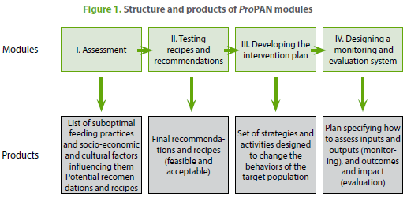
Modules of the ProPAN manual

Slide 9
Methods of Module I: Assessment
Quantitative methods → software outputs
Caregiver survey: BF, CF, socioeconomic status (SES), communication, HIV/AIDS and infant feeding, responsive feeding
24-hour dietary recall and anthropometry
Market survey
Qualitative methods
Opportunistic observation
Semi-structured interview
Food attributes
Integration of data, analysis of practices and formulation of potential recommendations

Slide 10
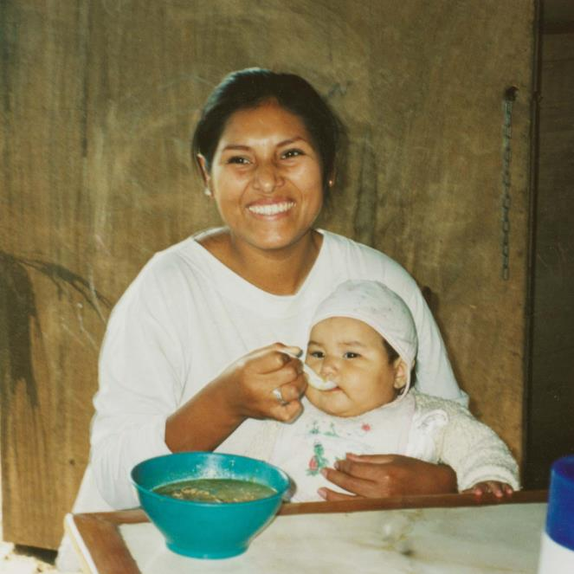
Products of Module I: Assessment
Problems with diet, feeding practices and growth
Context of practices
Potential recommendations to address problems
Photo credit: Helena Pachón

Slide 11
Methods of Module II: Testing of Recommendations & Recipes
Trials of Recommendations
1-week home/health center trials and feasibility
Creation of new or modified recipes and/or adoption of new behaviors
Groups of caregivers and children, recipe preparation and acceptability
Photo credit: Helena Pachón

Slide 12
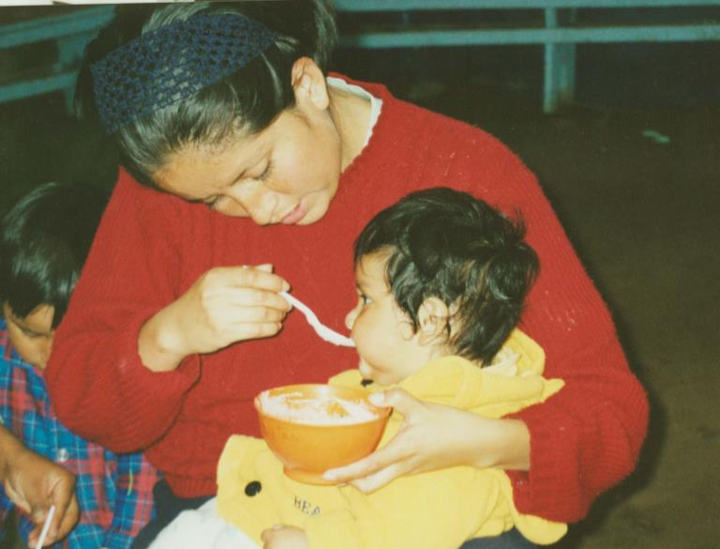
Products of Module II: Testing of Recommendations & Recipes
Feasible and acceptable recommendations
Nutritious recipes and/or behaviors with a greater chance of being adopted
Photo credit: Helena Pachón

Slide 13
Methods of Module III: Developing the Intervention Plan
Review research results
List possible intervention strategies
Choose among intervention strategies
Design the intervention plan

Slide 14
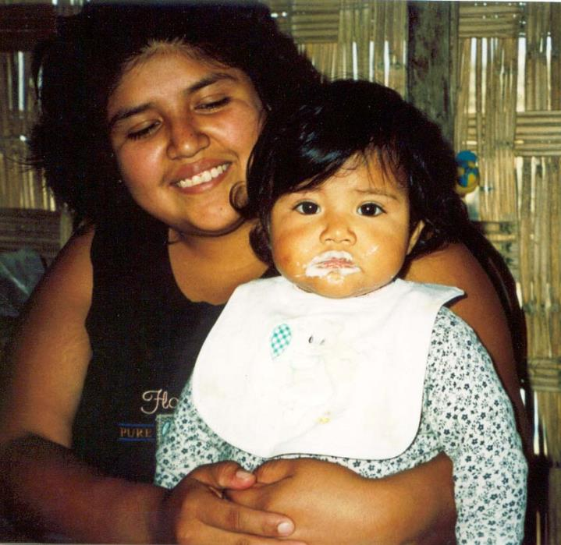
Products of Module III: Developing the Intervention Plan
Detailed and Complete Intervention Plan
Strategies
Activities
Personnel
Materials
Implementation timeline
Photo credit: Helena Pachón

Slide 15
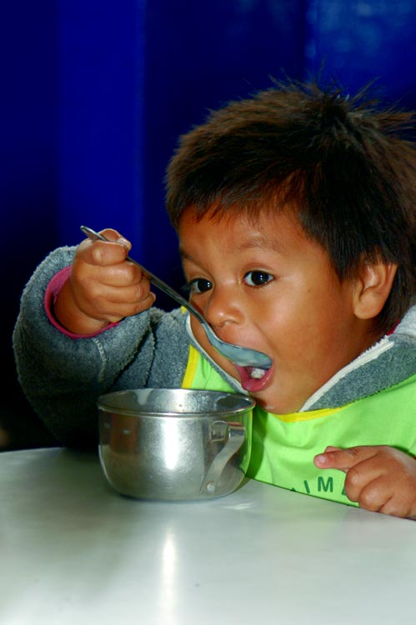
Methods of Module IV: Designing a Monitoring & Evaluation System
Specify objectives
Identify inputs, outputs, results, impact and benefits
Design monitoring and evaluation system

Slide 16
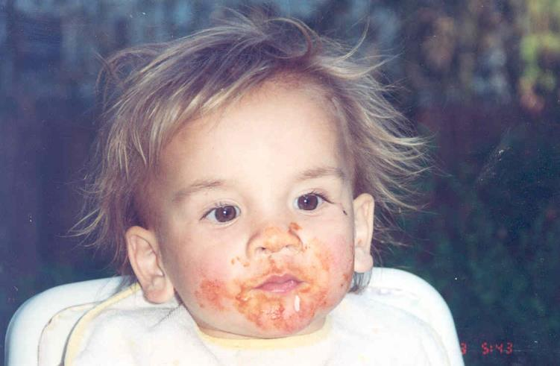
Products of Module IV: Designing a Monitoring & Evaluation System
Comprehensive Monitoring and Evaluation Plan
Program Impact Pathway (PIP)
Indicators
Sampling
Activities
Timeline
Photo credit: Jan Pappalardo

Slide 17
Software Walk-through (quick version)
Main menu page
Entering data
Data analysis
Sample Output
Advanced Utilities
Creating a new survey
Modifying a survey
Food Composition Table
Video Tutorial - online

Slide 18
Main Page

Slide 19
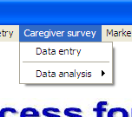
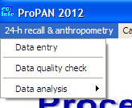
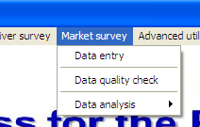
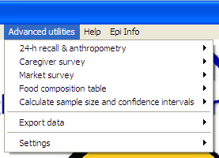
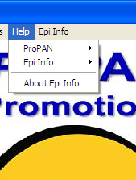
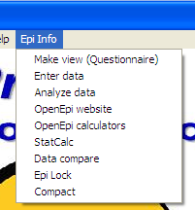
Main Menu

Slide 20
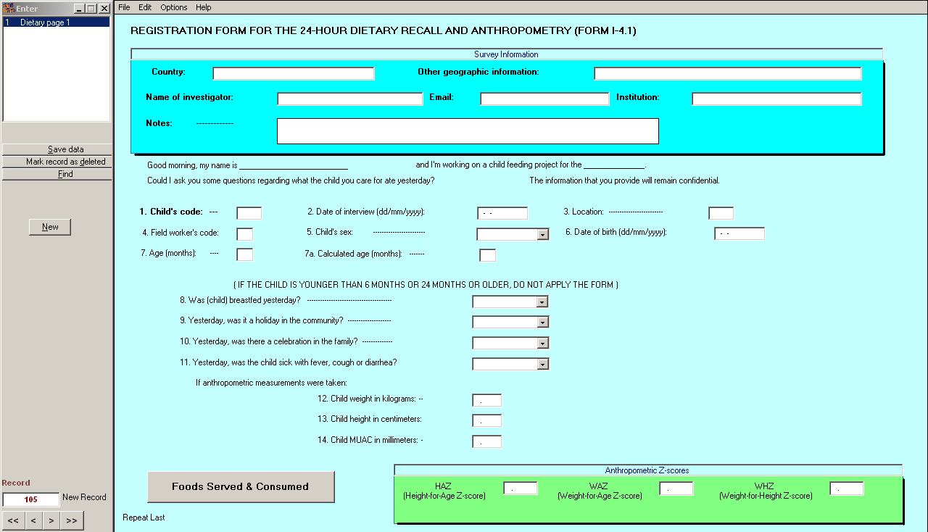
Entering Data

Slide 21
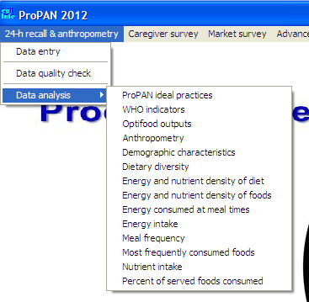
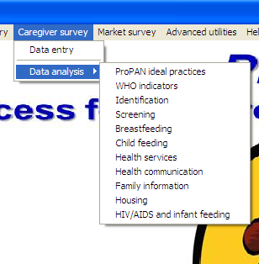
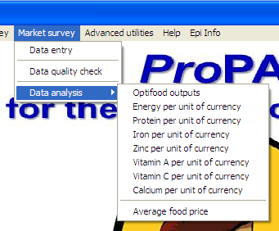
Data Analysis

Slide 22
Sample Output
ProPAN Caregiver Survey
ProPAN Ideal Practices
Description | Numerator | Denominator | Percent | 95% CI (Lower, Upper)
1. Breastfed within first hour | 19 | 32 | 59.4 | (42.4, 76.4)
2. Not fed anything other than breastmilk | 10 | 23 | 43.5 | (23.2, 63.8)
3. Fed colostrum | 27 | 32 | 84.4 | (71.8, 97.0)
4. Breastfed on demand | 3 | 5 | 60.0 | (17.1, 100.0)
5. Exclusively breastfed | 1 | 3 | 33.3 | (00.0, 86.6)
6. Breastfed at least 2 years | 3 | 3 | 100.0 | (100.0, 100.0)
7. Initiated CF at 6 months | 5 | 19 | 25.0 | (06.0, 44.0)
11. Responsively fed | 5 | 15 | 33.3 | (09.4, 57.2)
12. Fed as recommended during and after illness | 1 | 28 | 03.6 | (00.0, 10.5)

Slide 23
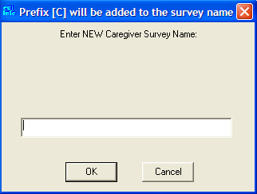
Advanced Utilities – Creating a New Survey

Slide 24
Advanced Utilities – Modifying a Survey

Slide 25
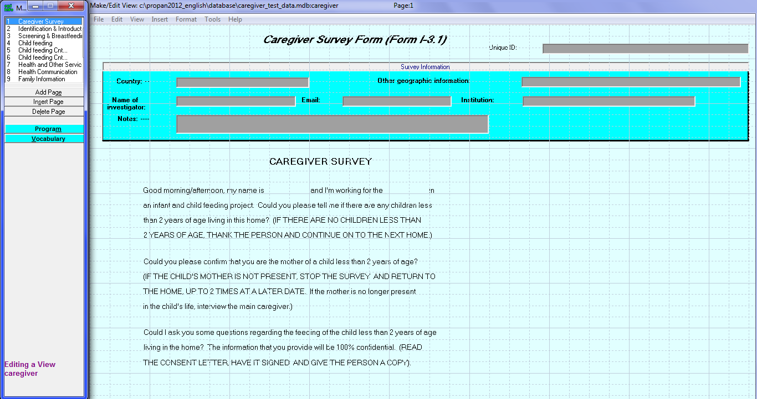
Advanced Utilities – Modifying a Survey

Slide 26
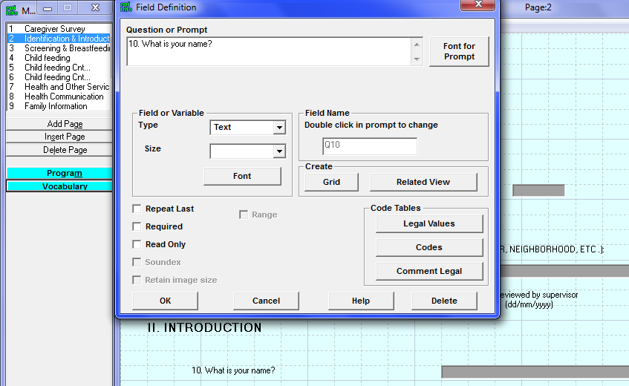
Advanced Utilities – Modifying a Survey

Slide 27
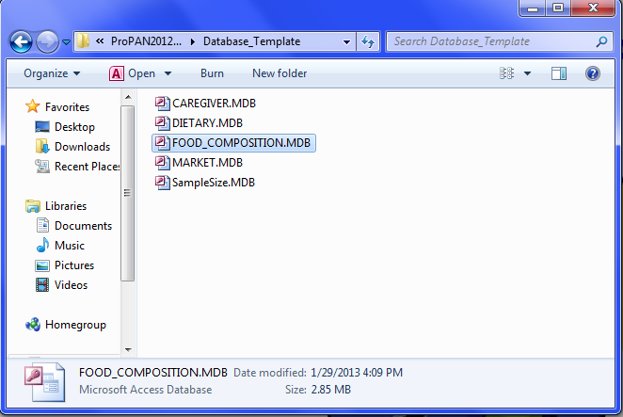
Advanced Utilities – Food Composition Table

Slide 28
Advanced Utilities – Food Composition Table

Slide 29
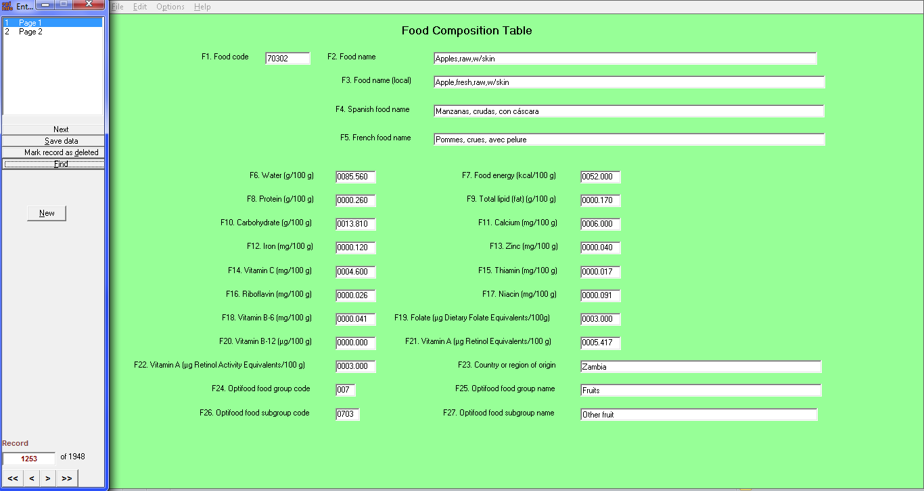
Advanced Utilities – Food Composition Table

Slide 30
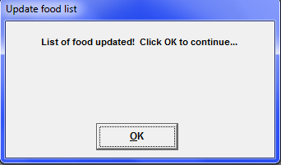
Advanced Utilities – Food Composition Table

Slide 31
Advantages
Presents a systematic method for identifying, ranking and selecting recommendations that are practical, feasible, and acceptable
Offers guidelines on how to convert data into an implementable intervention or program
Provides electronic format for data entry and software for standardized output
Modules can be used independently of each other
Can be used to train in nutrition research methods

Slide 32
Challenges
Resource-intensive when used in its totality
Requires a multi-disciplinary team
Larger system changes are often necessary to facilitate desired behavior changes
Software modifications require a skilled Epi Info user

Slide 33
Where ProPAN has been used
Bangladesh | Jamaica | Peru
Bolivia | Kenya | Uruguay
Brazil | Lao PDR | Uganda
Cambodia | Malawi | Viet Nam
Ecuador | Mexico | Tanzania
Honduras | Panama

Slide 34
Website: www.paho.org/ProPAN
Freely available in English, Spanish, and French

Slide 35
ProPAN Team
Chessa Lutter, PAHO/WHO
Roger Mir, CDC
Helena Pachón, Emory University Rollins School of Public Health
Kevin Sullivan, Emory University Rollins School of Public Health
Edith Cheung, UNICEF
Hilary Creed de Kanashiro, Instituto de Investigación Nutricional, Peru
SM Khurshid Alam, Recruiting Minds
Anita Panjwani, Emory University Rollins School of Public Health
Cintia Lombardi, PAHO/WHO
Funded in part by the Global Alliance for Improved Nutrition (GAIN); in kind contribution received from CDC and the FANTA Project

