Slide 1
Impact: promoting the dissemination & utilization of research findings
45th Session of the ACHR/CAIS
Hamilton, Canada
October 17 – 19, 2012
Tomás Pantoja, Evelina Chapman

Slide 2
Even though using research in health decision-making is an appealing idea…

Slide 3
Challenges in linking research to policy
Research competes with many other factors in the policymaking process
Research isn’t valued as an information input [General climate for research use]
Research isn’t relevant [Production]
Research isn’t easy to use [Translation]
Research isn’t communicated effectively [Push]
Research isn’t available when policymakers need it and in a form that they can use [Facilitating pull]
Policymakers lack mechanisms to prompt them to use research in policymaking [Pull]
Policymakers lack fora where policy challenges can be discussed with key stakeholders [Exchange]

Slide 4
The translation challenge
‘…strategies to bolster understanding of the essential links between research, policy, and action need to be developed, implemented and evaluated.’ (PAHO Policy on research for health)
‘The translation goal is to strengthen links between research, policy and practice’ (WHO strategy on research for health)

Slide 6
Capacity building
Bogotá, Colombia – June 2012
Santiago, Chile – May 2012

Slide 7
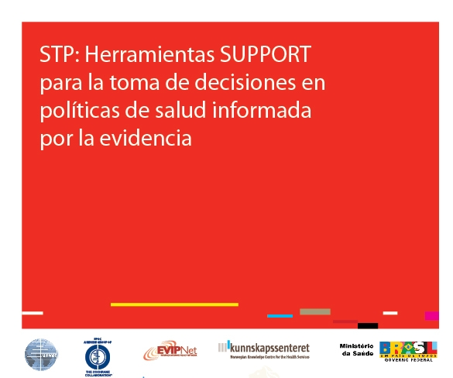
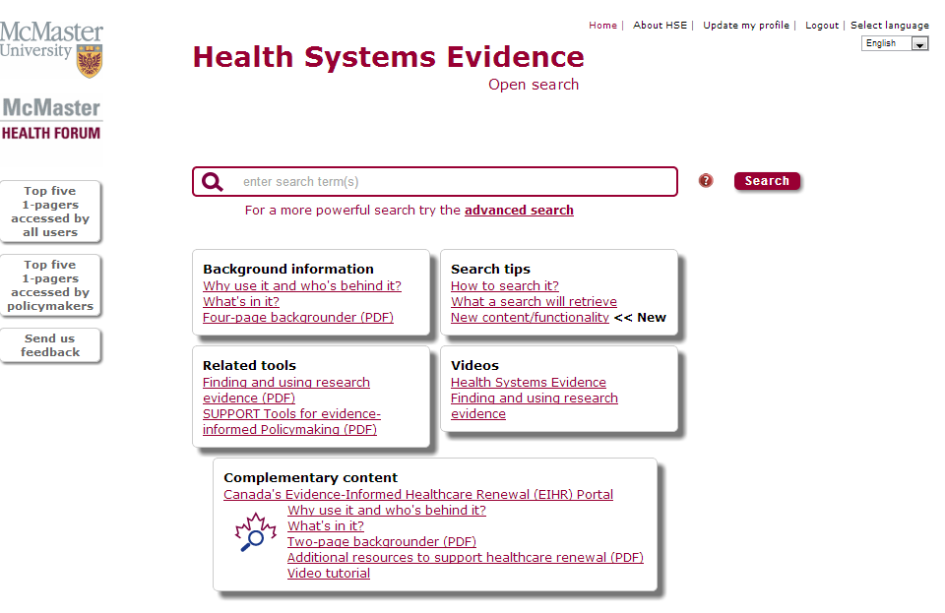
Resources

Slide 8
Products: briefs & dialogues

Slide 9
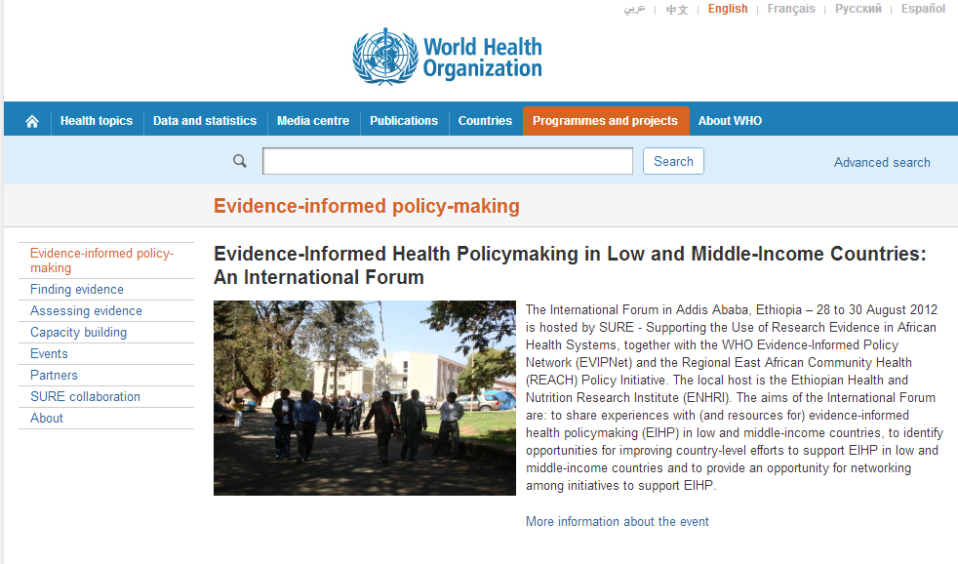
Dissemination

Slide 10
EVIPNet en las Américas
Países del lanzamiento de EVIPNet 2007
Argentina
Bolivia
Brasil
Chile
Costa Rica
Colombia
Mexico
La Frontera
Paraguay
Puerto Rico
Trinidad y Tobago
2012
En ejecución
Intención
Otras plataformas
de TC
http://www.paho.org/portalinvestigacion/evipnet
http://www.evipnet.org/php/index.php

Slide 11
Impact evaluation

Slide 12
Challenges 1
Sustainability
At national and regional levels (e.g. national EVIPNet teams, EVIPNet Secretariat & Resource Group)
Financial sustainability: who is the responsible/accountable?
New products/activities
Going beyond evidence briefs & policy dialogues (e.g. rapid response units)
Involvement of civil society, the media
Global evidence versus local decisions
What are the core competences in a EVIPNet team

Slide 13
Challenges 2
Impact versus Knowledge Translation (KT)
Knowledge Management & Communication (KMC) versus KT

Slide 14
Objective 6.1 Continue to encourage open access to scientific literature and to foster novel approaches to copyright and intellectual property that will allow knowledge essential for health, equity, and development to be shared and made widely available.
Objective 6.2 Be an active partner in the international debate on how legal frameworks for intellectual property affect research for health, especially the impact on development and equitable access to the benefits research
Objective 6.3 Promote knowledge sharing among researchers, policy makers, and other stakeholders to foster the development and evaluation of new knowledge translation initiatives and tools in the Region
Objective 6.4 Seek the empowerment and participation of civil society organizations in setting priorities, generating knowledge, and harnessing research evidence
Objective 6.5 Publish relevant research findings, recommendations, and guidelines that emerge from research for health in formats that is most appropriate for the target audience

Slide 15
Objective 6.6 Work with the media to improve public understanding of the benefits of research for health and to improve scientific literacy of policy makers, health providers, and the public
Objective 6.7 Work in cooperation with its specialized centers, such as the Latin-American and Caribbean Center on Health Sciences Information (BIREME), to index and organize research evidence in helpful ways and promote the Virtual Health Library model and the indexing, organization, access, and sharing of relevant health information
Objective 6.8 Promote access to and use of research evidence summaries that integrate results through valid methods, thus facilitating a better understanding of the relevance and effects of interventions and promoting efficiencies in the search and analysis of qualitative and/or quantitative scientific research.
Objective 6.9 Help governments increase their capacity to adapt, disseminate, and use knowledge translation tools that facilitate linking research to health care policy and practice and to the assessment and selection of health technologies, essential medicines and devices

