Slide 1
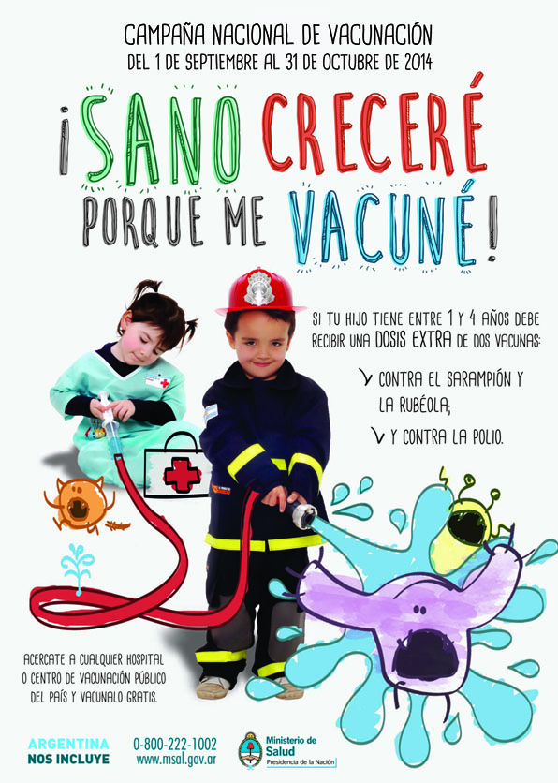
On September 1st, Argentina launched a combined measles-rubella and polio follow-up campaign to sustain the elimination gains in the country. The campaign will target around 2.8 million children aged 1-4 years old nationwide.

