Slide 1
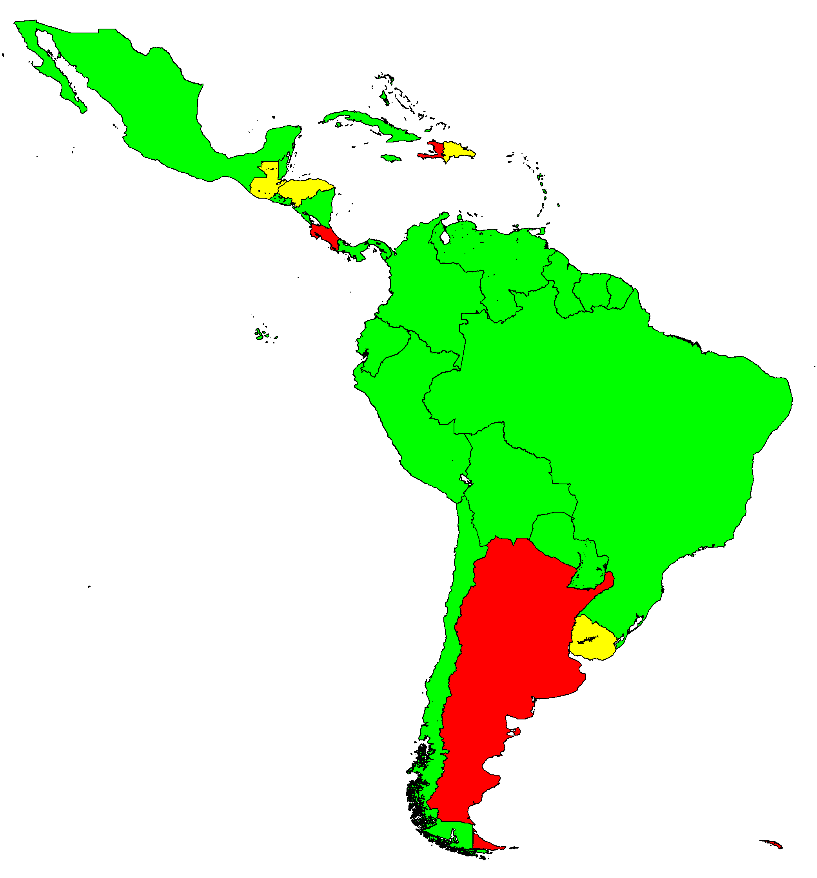
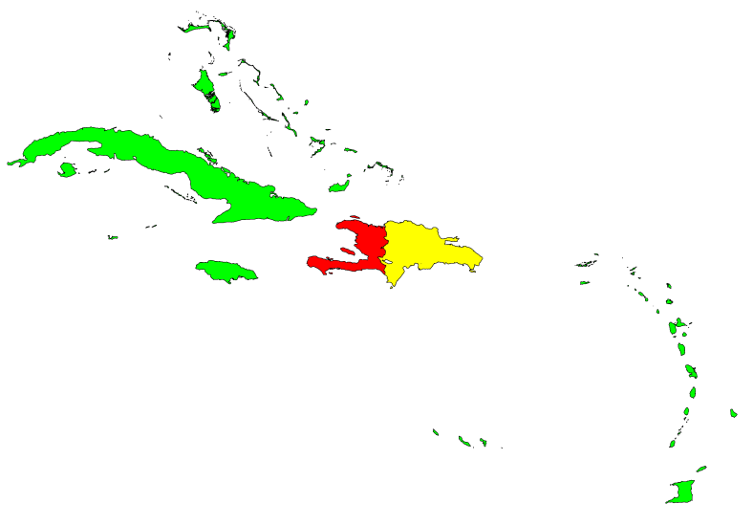
Rate of Suspect Measles/Rubella Cases per 100,000 population, Latin America and the Caribbean, 2011
Rate per 100,000 population
<1
1-1.99
≥2
Source: MESS, ISIS and country reports to Immunization.

