Slide 1
Governance Strengthen research governance and promote the definition of research agendas
45th session of the
advisory committee on health research of the Pan American Health Organization (CAIS)
Hasmilton, Ontario, Canada, October 16-19, 2012

Slide 2
Agendas for health research in the Region
Governance
Processes for collective action that structure the interaction between actors, process dynamics, and the rules of the game (formal and informal), with which a society determines its behaviors and makes and implements its decisions.

Slide 3
Agendas for health research in the Region
Governance
Mainstay of robust national health research systems
Essential part of all organizations and institutions involved in research for health
Steers the research agenda, promotes efficiencies, minimizes duplication and encourages effective shared leadership.

Slide 4
Activities undertaken 2011-2012
1.1 Strengthen capacities at PASB
1.2 Assist Member States in developing appropriate research governance structures
1.3. Support countries in developing strategies and action plans to implement and articulate policies for research for health and innovation
1.4 Foster an appreciation, at the political level, of the value of research in accelerating health improvements and development

Slide 5
Activities undertaken 2011-2012
1.5 Help governments increase their capacity
1.6 Work with Member States to strengthen research

Slide 6
Activities undertaken 2011-2012
1.1 Strengthen capacities at PASB
PASB entities receive reports informing about their research resources and outputs
All research in humans is reviewed by PAHOERC
Work with Human Resources Management to integrate research capacity

Slide 7
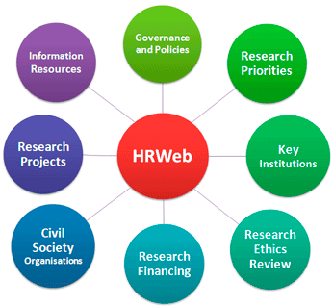
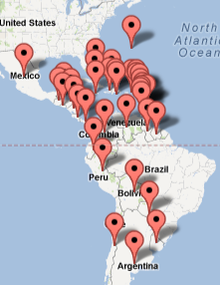
Activities undertaken 2011-2012
1.2 Assist Member States in developing appropriate research governance structures

Slide 8
Activities undertaken 2011-2012
1.3. Support countries in developing strategies and action plans to implement and articulate policies for research for health and innovation
Sustained efforts to develop, implement and update policies and agendas
COMISCA
Equidad Listserv

Slide 9
Activities undertaken 2011-2012
1.4 Foster an appreciation, at the political level, of the value of research in accelerating health improvements and development
Analysis of financial flows
CEWG (Consultative Expert Working Group) discussions
Art for research exhibitions
Research grants mobilization

Slide 10
Activities undertaken 2011-2012
1.5 Help governments increase their capacity
Evidence Portal
EvipNet
Technical cooperation at PAHO uses EVIPNet tools

Slide 11
Activities undertaken 2011-2012
1.6 Work with Member States to strengthen research
Enhanced capacities
Research synthesis
Networking and collaboration

Slide 12
Activities undertaken 2011-2012
1.7 Assist Member States in monitoring funding flows for research for health
Efforts to prioritize research questions
Development of research agendas and priorities.

Slide 13
Agendas for Research
Guide countries to direct research expenditure, promote science - technology - innovation for health, stimulate human resource development for research, negotiate with partners for targeted funding and long-term efforts.
With priorities, the science and innovation sectors can grow to support development, equity and health.

Slide 14
Comparing national health research priorities setting methods and characteristics in Latin America and the Caribbean countries. DRAFT PAPER. Ludovic Reveiz, Vanessa Elias. PAHO.
Eleven Latin American countries had policies, strategic plans and/or health research priorities, although varying in objectives, content, dissemination and implementation.
Additionally, the Caribbean Health Research Council (CHRC) developed a Health Research Agenda specific to countries that are members of the Caribbean Community.

Slide 15
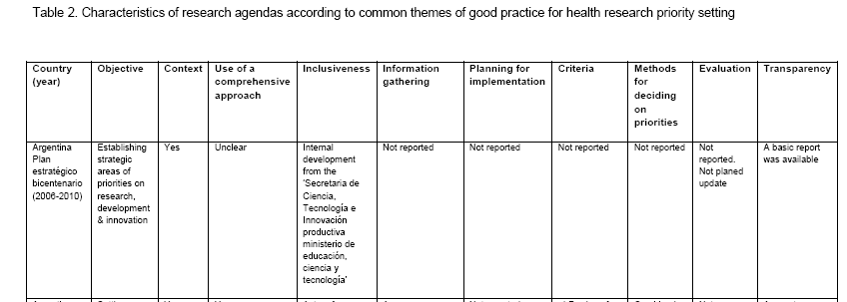
Comparing national health research priorities setting methods and characteristics in Latin America and the Caribbean countries. DRAFT PAPER. Ludovic Reveiz, Vanessa Elias. PAHO.

Slide 16
Proyecto EU-LAC HEALTH COHRED European Union
Participating countries
- Not stablished priorities: Dominican Republic, Honduras, Panama,
Mexico and Uruguay
Argentina
Brazil
Costa Rica
Ecuador
Caribbean Sub-region
Guatemala
Paraguay
Peru

Slide 17
Activities Planned for 2012-2013
Research becomes integral to PAHOs work and resources and outputs are monitored
All research in humans is reviewed by PAHOERC
PASB Staff and country teams have the skill sets to deliver evidence-informed recommendations
Publication of regional and sub-regional priorities for research on key topics

Slide 18
Future Developments
Convene donors and development agencies seeking to fund priority areas
Having consistent meaningful data about health research systems
Understand all the routes, processes and capacities

Slide 19
Key Issues
How to better organize PAHO’s research coordination? Does the location in the organizational structure matter?
How to better engage development and funding agencies with different agendas in financing key research?
How to promote public engagement, monitoring and evaluation and better accountability on research for health?

Slide 20
Key Issues
What is needed to find common ground in the research funding proposals (CEWG) and how to reconcile the needs of countries with a strong research culture versus those with the need to develop?
What kind of efforts should countries be sponsoring considering their research capacities?

Slide 21
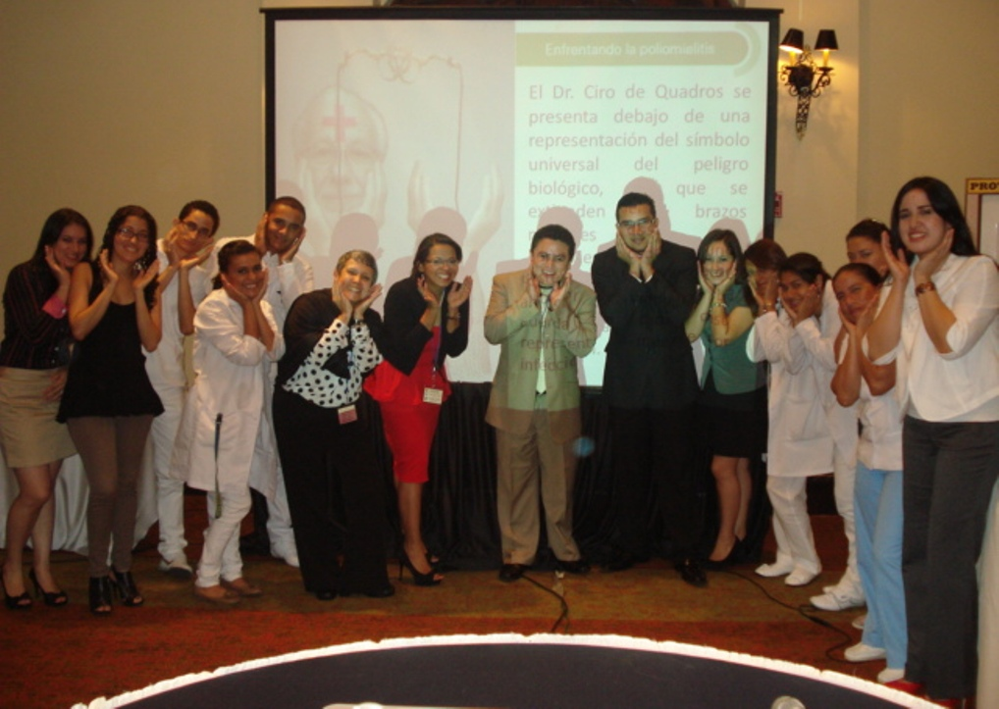
XIX Jornada Científica y VI Congreso de Investigación de las Ciencias de la Salud, Facultad de Ciencias Médicas, UNAH
Tegucigalpa, HONDURAS, Septiembre 19 – 21, 2012

