Slide 1
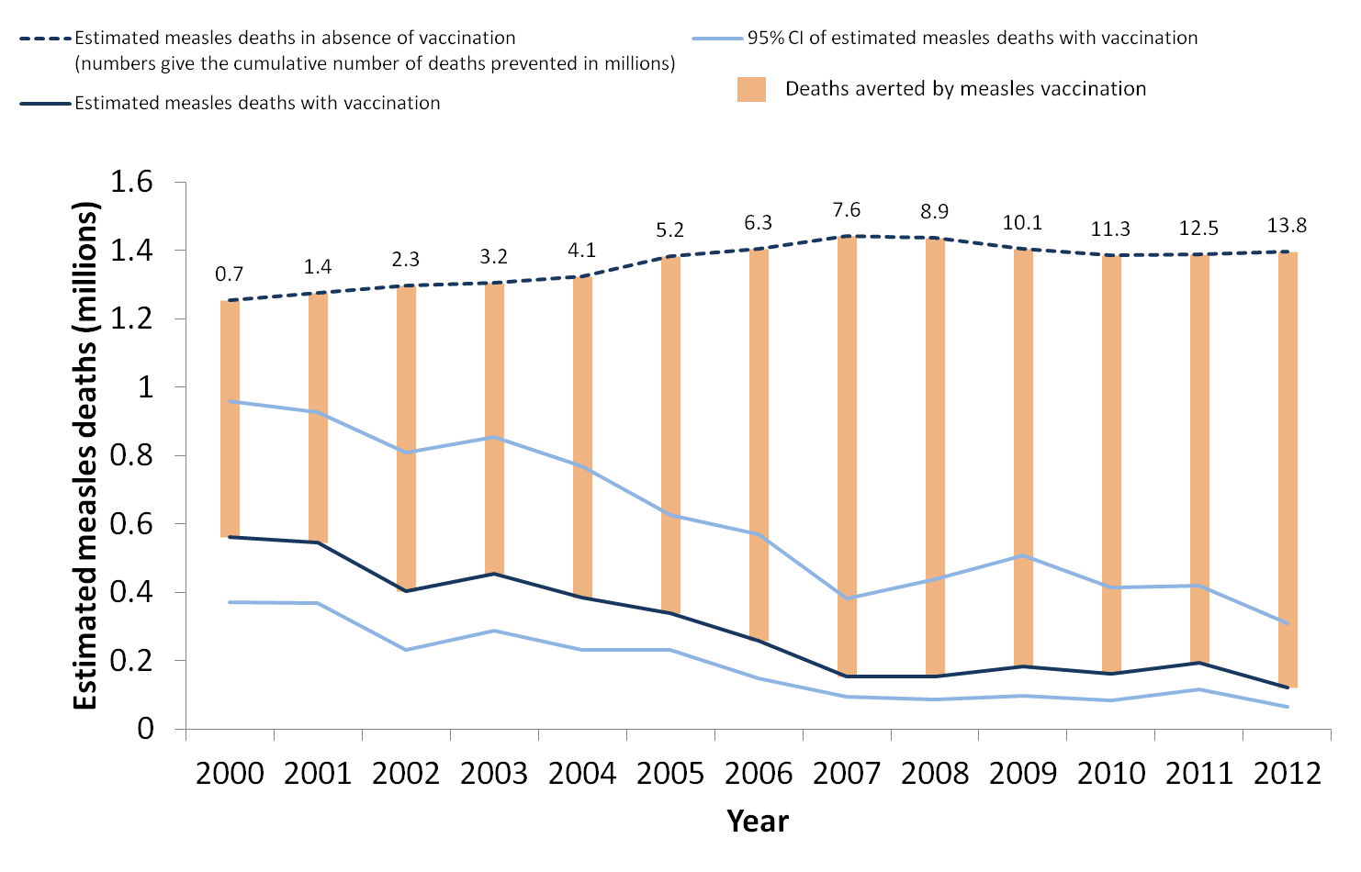
Global estimated measles mortality and measles deaths averted, 2000 - 2012
Source: MMWR http://www.cdc.gov/mmwr/pdf/wk/mm6305.pdf and WER http://www.who.int/entity/wer/2014/wer8906.pdf?ua=1 7 Feb 2014

