Slide 1
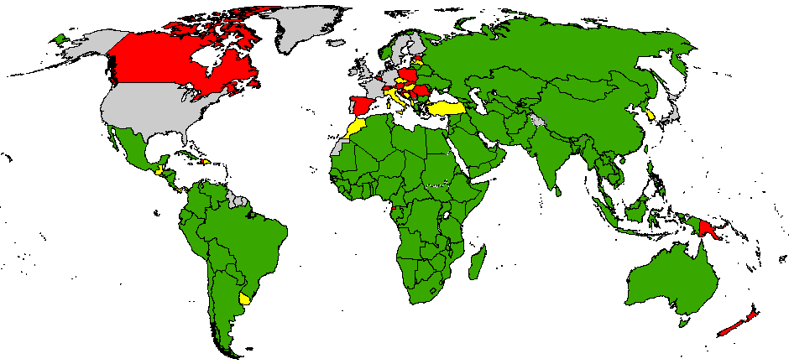
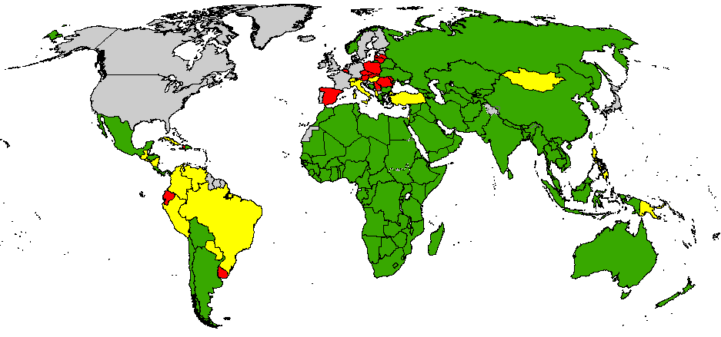
Tasa de PFA no polio
Sept 2011 – Agosto 2012
Sept 2012 – Ago 2013
< 0.5
0.5 - 0.99
> 1
Sin vigilancia o sin datos
The boundaries and names shown and the designations used on this map do not imply the expression of any opinion whatsoever on the part of the World Health Organization concerning the legal status of any country, territory, city or area or of its authorities, or concerning the delimitation of its frontiers or boundaries. Dotted lines on maps represent approximate border lines for which there may not yet be full agreement.
© WHO 2013. All rights reserved
Datos en la Sede de OMS al 8 de Oct 2013
Notes:
1

