Slide 1
public policy to promote human security: Medellin, Colombia, Experience
Luis Fernando Duque, MD MPH
Professor, University of Antioquia

Slide 2
Presentation overview
1. Public policy
1.1 Public policy definition
1.2 Public goods: human safety
2. Human security approach
2.1 Definitions
2.2 Components
2.3 Relationship between public health and human security approaches
2.4 Human security applied to violence prevention, i.e Public Policy of Medellin and metropolitan area
3. Rationale to design human security public policy
4. Medellin experience for designing human security public policy

Slide 3
1.1 Public policy definition 1.2 Public good: human safety
Public policy
Human security approach
RATIONALE
Medellin experience
A policy is public when it is about a public good and when its objective is to promote development of public goods and the access to them with equity and justice
Public
Policy
Its acceptance, feasibility and legitimacy increase when it becomes of public interest and becomes part of the political agenda
Public policy for the coexistence promotion and violence prevention in Medellin and metropolitan area, 2007-2015.

Slide 4
1.1 Public policy definition 1.2 Public good: human safety
Public policy
Human security approach
Medellin model
Medellin experience
Concerns all people
Its violation affects the whole community
Human safety = a public good
Public good
Public policy for the coexistence promotion and violence prevention in Medellin and metropolitan area, 2007-2015

Slide 5
2.1 Definition 2.2 Components 2.3 Relationship between public health and human security 2.4 Human security applied public policy in Medellin
Public policy
Human security approach
Medellin model
Medellin experience

Slide 6
2.1 Definition 2.2 Components 2.3 Relationship between public health and human security 2.4 Human security applied public policy in Medellin
Public policy
Human security approach
RATIONALE
Medellin experience
“Human security is a concern with human life and dignity”
Universal
Multidimen sional and interconnec ted
People-centred
Public good
United Nations Development Programme. Human development report, 1994. Chapter 2. New dimensions of human security,. New York: Oxford University Press, 1994.

Slide 7
2.1 Definition 2.2 Components 2.3 Relationship between public health and human security 2.4 Human security applied public policy in Medellin
Public policy
Human security approach
RATIONALE
Medellin experience
Human security
Early prevention of social, economic and political risks to human security
Protection of vulnerable groups
Public health
Health promotion
Primary prevention
Public health approach applied to violence
Development and equity promotion
Early prevention of violence risk factors: personal, family, neighborhood and society
At risk group intervention
Secondary prevention
At risk groups intervention
Impunity and weapons reduction
Terciary prevention
Victims attention, aggressors rehabilitation and community protection
Public policy for the coexistence promotion and violence prevention in Medellin and metropolitan area, 2007-2015.

Slide 8
2.1 Definition 2.2 Components 2.3 Relationship between public health and human security 2.4 Human security applied public policy in Medellin
Public policy
Human security approach
RATIONALE
Medellin experience
Public policy for the coexistence promotion and violence prevention in Medellin and metropolitan area, 2007-2015
Human security was considered central to the PP formulation and implementation
Human security is a public good
And enables the guarantee of human rights and freedom options, governance and human development
This is of vital importance due to negative consequences of violence on human development
Violence causes involved personal, economic, political, social, environment, health, and community factors , which have same dimensions of human security
Public policy for the coexistence promotion and violence prevention in Medellin and metropolitan area, 2007-2015

Slide 9
Public policy
Human security approach
RATIONALE
Medellin experience
Duque LF (Ed). La violencia en el Valle de Aburrá: Caminos para la superación. Universidad de Antioquia y Área Metropolitana del Valle de Aburrá. Cátedra Litografía, Medellín; 2008

Slide 10
4.1 Action oriented information 4.2 Epidemiologic tools 4.3 Social science tools 4.4 Risk and protective factors grouping 4.5 Police statements derived of factors 4.6 Public policy in Medellin 4.7 Resources organization 4.8 Next steps
Public policy
Human security approach
Medellin model
Medellin experience
- Actors mapping
- Interventions inventory
- Problem discussion and consensus
-Empowerment
- Surveillance system
- Surveys
- Income and outcome matrix
-Actors mapping
-Interventions inventory
-Problem discussion and consensus
-Empowerment
-Surveillance system
-Surveys
-Income and outcome matrix
Coexistence and security committees
Social science approach
Coexistence and security committees
Social science approach
Epidemiological approach
Epidemiologic approach

Slide 11
4.1Action oriented information 4.2 Epidemiologic tools 4.3 Social science tools 4.4 Risk and protective factors grouping 4.5 Police statements derived of factors 4.6 Public policy in Medellin 4.7 Resources organization 4.8 Next steps
Public policy
Human security approach
Medellin model
Medellin experience
Victimization
surveys
Magnitude
Aggression surveys
Distribution
Public Policy Strategies: adjusted %PAR
Strength of association adjusted OR
Age
Education
Location
Occupation
SES
Sex
Analysis with communities and local authorities

Slide 12
PREVIVA EXPERIENCE examples of epidemiological findings

Slide 13
Victims, aggressors and witnesses, violence. Medellin metropolitan area, 2007. Percentage (CI 95%).
Notes:
We will look at some survey results that show us the scale.

Slide 14
Protective factors for interpersonal violence. Medellin metropolitan area, 2007
Factors | Armed threat |  | Physical aggression with a weapon |  | Physical aggression without a weapon |  | Robbery without a weapon
 | OR | %PAR | OR | %PAR | OR | %PAR | OR | %PAR
Mother´s watching | 0,1 | -92,5 | 0,2 | -79,5 | 0,3 | -50,7 | 0,5 | -96,1
Social cohesion |  |  |  |  | 0,5 | -100,0 | 0,3 | -48,5
Attitude of cooperation with local authorities |  |  | 0,5 | -85,2
1 point increase Socioeconomic level |  |  |  |  | 0,8 | -25,0

Slide 15
Risk factors for interpersonal violence.
Medellin metropolitan area, 2007
Factors | Threat with a weapon |  | Physical aggression with a weapon |  | Physical aggression without a weapon |  | Robbery without a weapon
 | OR | %PAR | OR | %PAR | OR | %PAR | OR | %PAR
Anomy | 7,2 | 86,1 | 7,52 | 86,7 |  |  | 14 | 92,9
Neighborhood violence | 7,1 | 85,9 | 6,84 | 85,4 | 4,6 | 78,1 | 4,7 | 78,7
Victim of physical child abuse |  |  | 4,37 | 77,1
Legitimating violence as a mechanism for conflict resolution | 3,0 | 66,9
Legitimating violence as an education method |  |  |  |  | 3,2 | 69,0
Social control in the neighborhood | 2,9 | 65,6
Distrust of others |  |  |  |  | 2,1 | 51,9
Unemployment in the past year | 2,0 | 50,5 |  |  | 1,4 | 29,1

Slide 16
Risk factors for interpersonal violence.
Medellin metropolitan area, 2007
Factors | Threat with a weapon |  | Physical aggression with a weapon |  | Physical aggression without a weapon |  | Robbery without a weapon
 | OR | %PAR | OR | %PAR | OR | %PAR | OR | %PAR
Machismo | 2,7 | 63,4 |  |  | 2,5 | 59,8 | 7,4 | 86,5
Physically abused by mother during childhood | 2,8 | 63,9 | 2,2 | 55,2 | 3,1 | 67,3 | 2,1 | 51,2
Lifetime unemployment |  |  | 3,0 | 66,4
Approval of murder use for community protection |  |  |  |  | 1,5 | 31,9
Higher education and professional activity frustrations |  |  |  |  | 1,9 | 47,1
Legitimating violence for family protection | 1,9 | 45,9 | 3,2 | 69,1

Slide 17
Intimate partner violence during past year Medellín, 2003 - 2007.
Source: PREVIVA surveys 2004-2007
Notes:
In this graphic we can appreciate, that between 2004 and 2007 there was a relative reduction of partner physical violence of 50% (17.5% vs. 8.5%). Also presented a reduction in verbal and psychological aggression
Son dos tablas con diferente indicador: % vs casos, no prueba cual es correcto frente al otro.
They are two tables with a different indicator: % vs cases, no proof of which one is correct.

Slide 18
Logistic regression to explain associated factors for reduction of intimate partner physical violence in Medellin, Colombia, 2004-2007
Relative reduction | Variable | B | S.E. | Sig.
-0,4% | Machismo | -2,88 | 1,03 | 0,0053
-2,6% | Distrust of others (people and authorities) | -1,98 | 0,70 | 0,0046
-14,7% | Delinquency in neighborhood | -1,42 | 0,59 | 0,0170
-7,4% | Past year unemployment | -0,07 | 0,03 | 0,0174
-35,3% | Interpersonal physical aggression index | -1,50 | 0,11 | 0,0000
3,3% | Social control | 3,26 | 0,94 | 0,0005
 | Constant | -2.61
Source: PREVIVA Surveys 2004-2008

Slide 19
4.1Action oriented information 4.2 Epidemiologic tools 4.3 Social science tools 4.4 Risk and protective factors grouping 4.5 Police statements derived of factors 4.6 Public policy in Medellin 4.8 Resources organization 4.9 Next steps
Public policy
Human security approach
Medellin model
Medellin experience
Validiting evidence with community and authorities.
Workshops
Civic Coexistence and Violence Prevention Committee meetings
EFFECTS:
Knowledge ownership upon seeing themselves reflected
Myths abolishing
Greater probability of accepting change

Slide 20
4.1Action oriented information 4.2 Epidemiologic tools 4.3 Social science tools 4.4 Risk and protective factors grouping 4.5 Police statements derived of factors 4.6 Public policy in Medellin 4.7 Resources organization 4.8 Next steps
Public policy
Human security approach
Medellin model
Medellin experience
Committees of civic coexistence and security
Created by decree in all municipalities (ten) of Medellin’s Metropolitan Area.
Created by decree in 10 other municipalities in the Antioquia State
Participants:
The Mayor, Mayor’s cabinet members (health, education, social action, interior)
NGOs, community leaders, religious and educational leaders
The Police, the Attorney General’s office, and judges.
School of Public Health PREVIVA team members

Slide 21
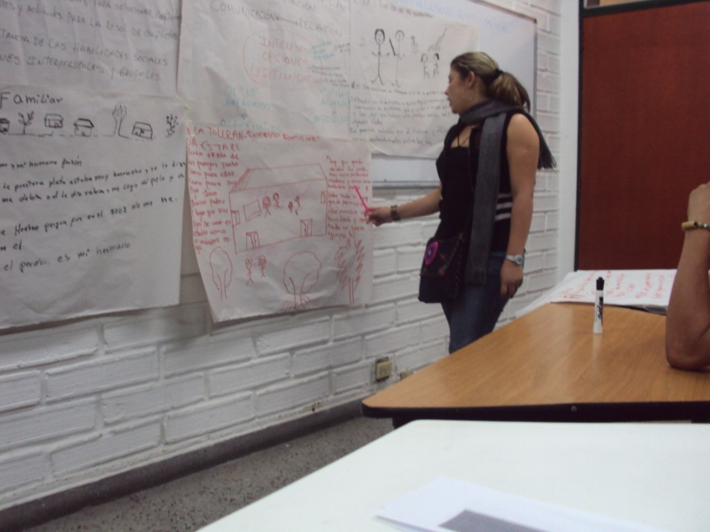
4.1Action oriented information 4.2 Epidemiologic tools 4.3 Social science tools 4.4 Risk and protective factors grouping 4.5 Police statements derived of factors 4.6 Public policy in Medellin 4.7 Resources organization 4.8 Next steps
Public policy
Human security approach
Medellin model
Medellin experience
Committees of civic coexistence and security
activities
Map of stakeholders
Assessment of existing programs
Assessment of problems, risk factors and opportunities (Input –product matrix)
Annual planning
Monthly follow-up

Slide 22
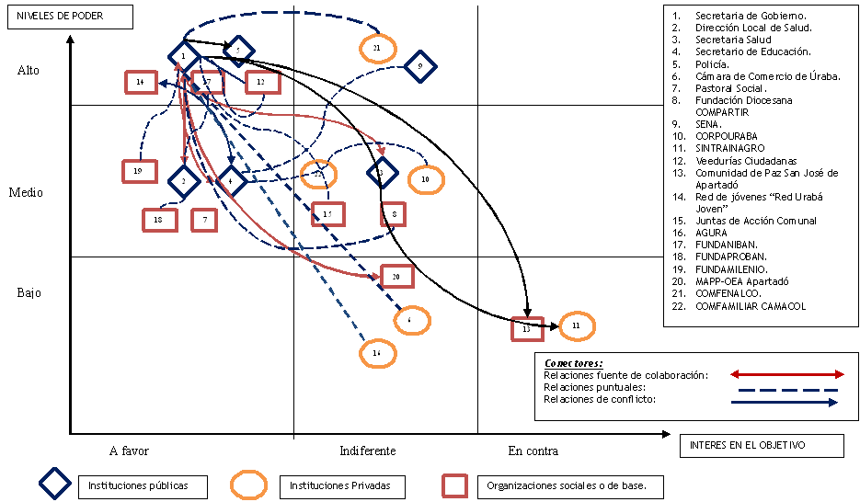
PREVIVA EXPERIENCE. Formulation of public policy. MAP OF STAKEHOLDERS built with the community, Apartado
Municipal Secretary of Interior
Municipal Health Department
Municipal Education Secretary
Police
Chamber of Commerce
Social Catholic Church Institutions
Religious NGOs
Public Training Institute: SENA
Cooperatives
Workers Associations
Citizen oversight committees
Peace Community
Youth Association
Community associations
Entrepreneurs Association: AGURA
Entrepreneurs Social NGO: Funadauniban
NGO: Fundamilenio
NGO: OAS
Confenalco
Camacol
Power levels
High
Medium
Low
Connectors:
Parthnerships
Weak relationships
Conflict relationships
Interest in the problem
Support
Indifferent
Opposition
Public institutions
Private institutions
Community organizations
Source: PREVIVA

Slide 23
PREVIVA EXPERIENCE. Formulation of public policy INPUT-PRODUCT MATRIX built with the community, Apartadó municipality
PROBLEMS |  |  | MOBILITY (how much can be modify by….)
 |  |  | P1 | P2 | P3 | P4 | P5 | P6 | P7 | P8 | P9 | P10 | Σ
P1 | Intrafamily violence |  |  | 1 | 1 | 1 | 1 | 0 | 1 | 1 | 0 | 1 | 7
P2 | Psychoactive substance abuse |  | 1 |  | 0 | 1 | 1 | 0 | 1 | 1 | 1 | 1 | 7
P3 | Single mothers |  | 0 | 0 |  | 0 | 0 | 0 | 1 | 1 | 1 | 0 | 3
P4 | Adolescent pregnancy |  | 0 | 0 | 1 |  | 0 | 1 | 0 | 0 | 1 | 0 | 3
P5 | Adolescent prostitution |  | 0 | 0 | 1 | 0 |  | 0 | 0 | 1 | 1 | 0 | 3
P6 | Extended and family overcrowding |  | 1 | 0 | 0 | 0 | 0 |  | 0 | 0 | 0 | 0 | 1
P7 | Absence of norms/family and school commitment |  | 1 | 1 | 1 | 1 | 1 | 0 |  | 1 | 1 | 1 | 8
P8 | Inadequate use of leisure time |  | 1 | 1 | 1 | 1 | 1 | 0 | 0 |  | 1 | 1 | 7
P9 | Easy money acceptance |  | 1 | 1 | 0 | 0 | 0 | 0 | 0 | 1 |  | 1 | 5
P10 | Low education levels |  | 1 | 1 | 1 | 1 | 1 | 0 | 1 | 1 | 1 |  | 8
DEPENDENCE |  | Σ | 6 | 5 | 6 | 5 | 5 | 1 | 4 | 7 | 7 | 5 | 52
Source: PREVIVA
Notes:
Needs good explanation

Slide 24
PREVIVA EXPERIENCE. DESIGN OF PUBLIC POLICIES.INPUT-PRODUCT MATRIX GRAPH BUILT WITH THE COMMUNITY, ITAGUI MUNICIPALITY
10
9
8
7
6
5
4
3
2
1
POWER ZONE
CONFLICT
ZONE
MOBILITY
P7
P10
P8
P1
P2
P9
AUTONOMOUS PROBLEM ZONE
P5
P4
P3
OUPUT
ZONE
P6
1 2 3 4 5 6 7 8 9 10
Resource: PREVIVA
DEPENDENCE

Slide 25
4.1Action oriented information 4.2 Epidemiologic tools 4.3 Social science tools 4.4 Risk and protective factors grouping 4.5 Police statements derived of factors 4.6 Public policy in Medellin 4.8 Resources organization 4.9 Next steps
Public policy
Human security approach
Medellin model
Medellin experience
CONSTRUCTS | PROTECTIVE AND RISK FACTORS
Family as source of attitudes, values, and practices with respect to violence and coexistence | Communication and affection between children and parents; vigilant mother and father Legitimacy of violence, especially as educational method Machismo Childrearing practices for early prevention of aggressive, risky, and criminal behaviors
Unequal and exclusive society | Frustration over access to quality higher education (e.g., technical, university) Frustration over professional or career opportunities
Lack of communication and trust amongst citizens and between them and authorities | Distrust amongst citizens and between citizens and local authorities Collective efficacy: social cohesion and taking care of the neighborhood
Lack of civic culture for coexistence and security | Non-acceptance of rule of law Lack of social responsibility and high individual efficacy

Slide 26
4.1Action oriented information 4.2 Epidemiologic tools 4.3 Social science tools 4.4 Risk and protective factors grouping 4.5 Police statements derived of factors 4.6 Public policy in Medellin 4.8 Resources organization 4.9 Next steps
Public policy
Human security approach
Medellin model
Medellin experience
PUBLIC POLICY STATEMENTS | PROGRAMS ADOPTED IN PUBLIC POLICY APPROVAL DECREE
Development of family coexistence | Early prevention of aggression. From prenatal up to 3 years of age
 | Promotion of civic awareness and early prevention of violence (4 to 11 years of age)
 | Gender oriented early prevention of intimate partner violence
 | Re-socialization of severe domestic aggressors
Improvement of inclusion and equity | Increasing access to high quality higher education
 | Strengthening already existing mechanisms of coordination among public and private universities and the private sector
 | Stimulation of the development of micro enterprises and productive chains among low SES population
 | Resilience promotion among children and adolescents
Strengthening communication and interaction among citizens and between them and local authorities | Strengthening relationships between the Police and local communities
 | Strengthening effectiveness, efficiency, and transparency of municipal institutions
 | Strengthening social cohesion and collective efficacy
Development of a culture of acceptance of formal and social norms for civic coexistence and security | Municipal social pacts for the culture of legality
 | Re-socialization of young gang members

Slide 27
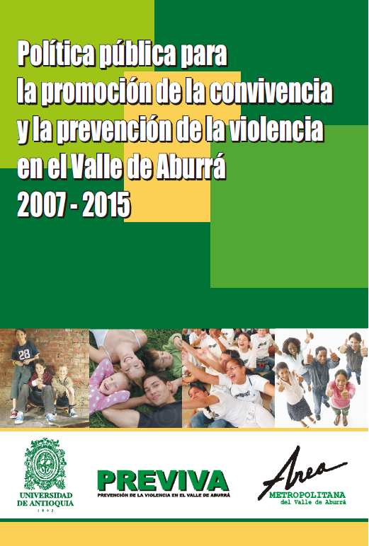
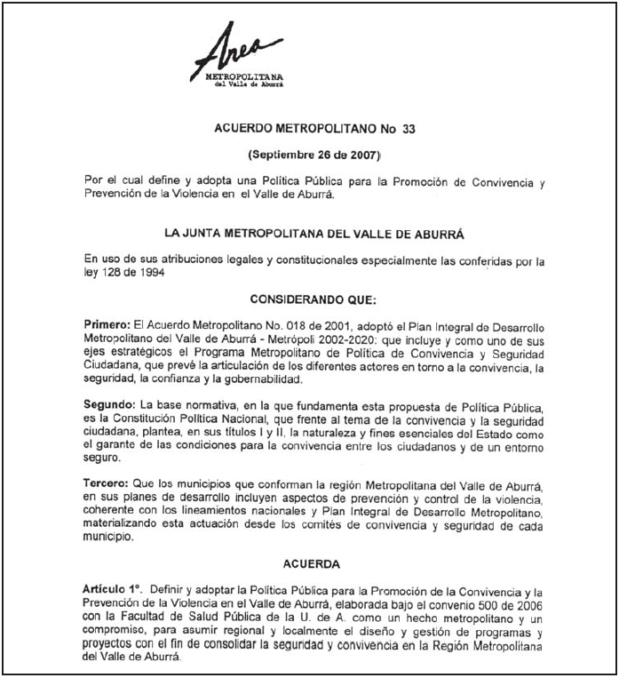
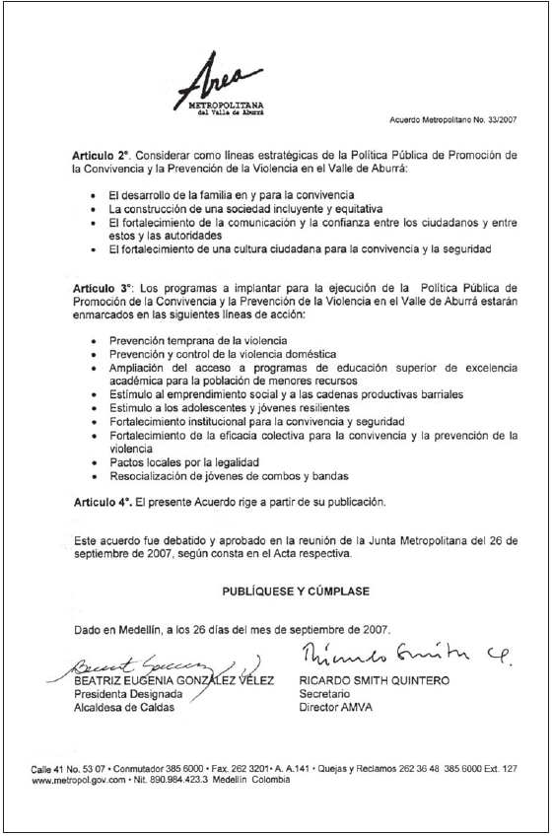
4.1Action oriented information 4.2 Epidemiologic tools 4.3 Social science tools 4.4 Risk and protective factors grouping 4.5 Police statements derived of factors 4.6 Public policy in Medellin 4.7 Resources organization 4.8 Next steps
Public policy
Human security approach
Medellin model
Medellin experience
Metropolitan decree No. 33 (September 27, 2007)
Notes:
And? What has happened after its signature? NO NEEDED> DELETE IT>

Slide 28
4.1Action oriented information 4.2 Epidemiologic tools 4.3 Social science tools 4.4 Risk and protective factors grouping 4.5 Police statements derived of factors 4.6 Public policy in Medellin 4.7 Resources organization 4.8 Next steps
Public policy
Human security approach
Medellin model
Medellin experience
RESOURCES ORGANIZATION IN PROGRAMS AND PROJECTS
Primum non nocere. “First, do not harm”
Attributable impact
There are very few programs aimed at human behavioral change having been conducted with appropriate measurement of their attributable impact
Campbell Collaboration.
Welsh, BC, Farrington DP. (eds) Preventing Crime: What works for children, offenders, victims and places. Springer, NY, NY. 2007.

Slide 29
4.1Action oriented information 4.2 Epidemiologic tools 4.3 Social science tools 4.4 Risk and protective factors grouping 4.5 Police statements derived of factors 4.6 Public policy in Medellin 4.7 Resources organization 4.8 Next steps
Public policy
Human security approach
Medellin model
Medellin experience
RESOURCE MANAGMENT AS CONCRETE PROGRAMS
TO DEFINE PROGRAMS AND PROJECTS TO IMPLEMENT PUBLIC POLICY (Civic Coexistence and Security Committees and identified strategies)
IDENTIFICATION AND ALLOCATION OF RESOURCES (Civic Coexistence and Security Committees)
ADAPT OR DESIGN PROGRAMS AND PROJECTS. (PREVIVA).
Scientific evidence-based
Culturally appropriate
Advice and Support from CDC
Notes:
29

Slide 30
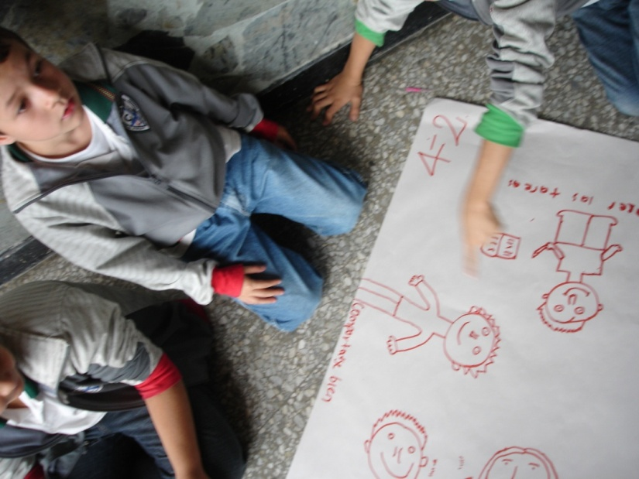
4.1Action oriented information 4.2 Epidemiologic tools 4.3 Social science tools 4.4 Risk and protective factors grouping 4.5 Police statements derived of factors 4.6 Public policy in Medellin 4.7 Resources organization 4.8 Next steps
Public policy
Human security approach
Medellin model
Medellin experience
Interventions developed by PREVIVA, with CDC technical advise
Prevention of intimate partner abuse in families of former members of illegal armed groups (guerrilla and paramilitaries)
Prevention of domestic violence in general population
Prevention of child abuse in families
Prevention of aggression among children aged 0 to 3
Early prevention of risk behaviors in pre-schoolers and school age children
Promotion of the rule of law acceptance in communities
Adopting public policy on human security and violence prevention in municipalities

Slide 31
4.1Action oriented information 4.2 Epidemiologic tools 4.3 Social science tools 4.4 Risk and protective factors grouping 4.5 Police statements derived of factors 4.6 Public policy in Medellin 4.7 Resources organization 4.8 Next steps
Public policy
Human security approach
Medellin model
Medellin experience
TO CONTINUE WITH IMPACT EVALUATION OF PROGRAMS DEVELOPED BY PREVIVA OR IMPLEMENTED AT OUR LOCAL AREA
PUBLIC POLICY FOLLOW-UP AND EVALUATION

Slide 32
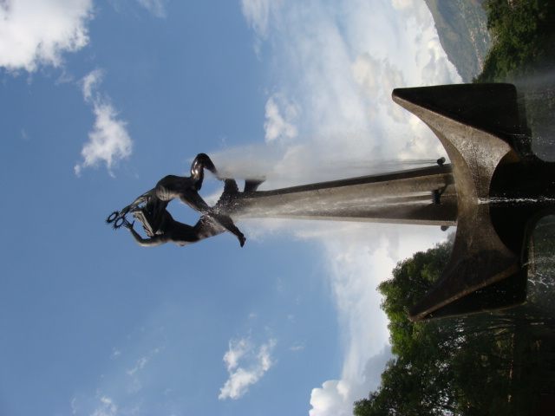
PREVIVA
previva@gmail.com
http://previva.udea.edu.co/
LUIS F DUQUE
lfduque@saludpublica.udea.edu.co
lfduque.ramirez@gmail.com
Thanks!

