Slide 1
CDC’s Environmental Public Health Priorities
Christopher J. Portier, Ph.D.
Director
National Center for Environmental Health
Agency for Toxic Substances and Disease Registry
Sustainable Development and Environment Health
October 2011
National Center for Environmental Health
Agency for Toxic Substances and Disease Registry

Slide 2
Human Systems
Gohlke and Portier (2006)

Slide 3
Our Environment and Our Health
Gohlke and Portier (2007)

Slide 4
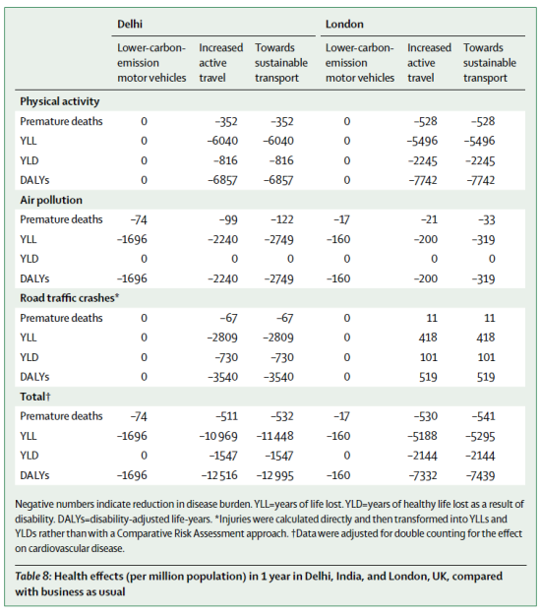
Transportation and Human Health
Woodcock, et al, Lancet, Nov. 2009

Slide 5
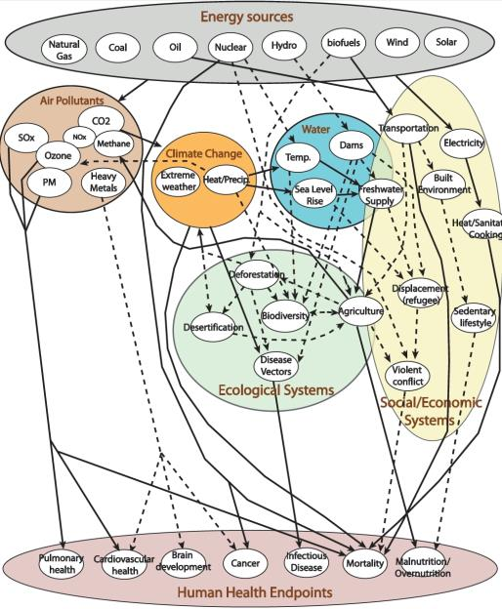
Energy Policy
and
Human Health
Gohlke, et al., 2008

Slide 6
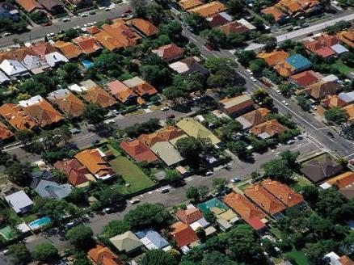
Housing Conditions Have an Important Impact on Public Health
Most people spend an average of 50% or more of every day inside their homes

Slide 7
Community Design and Health
Related to land use
Related to automobile dependency
Related to social processes
Obesity, physical activity, CVD
Water quantity and quality
Air pollution and asthma
Climate change contribution
↑ Car crashes
↑ Pedestrian injuries
Mental health impact
↓ Social capital

Slide 8
CDC’s Healthy Homes Program
CDC’s Healthy Homes Program is a coordinated, comprehensive, and holistic approach to preventing diseases and injuries that result from housing-related hazards and deficiencies.

Slide 9
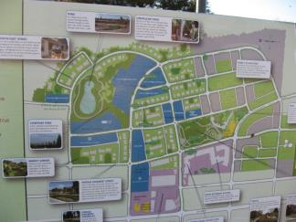
Community Design and Land-Use Choices Can Either Promote or Harm Human Health
One tool: health impact assessments (HIAs)
CDC is building capacity for HIA in land-use and transportation sectors

Slide 10
Estimated Return on Investment of Asthma Control
Trends over the last decade show that more people with asthma are living with their disease under control.
Prevalence has increased 12.3% since 2001, however:
1.7 million fewer people had asthma attacks in 2009; and
1400 fewer people died in 2007.
$3.96 billion were saved in health care costs in 2008 because 233,000 fewer people were hospitalized due to asthma.¹
Asthma interventions save up to $35 dollars in health care costs and work days lost for every $1 spent.²
Children missed 4.2 million fewer school days because of asthma in 2008.
States funded by CDC to implement comprehensive asthma control programs show a 10% decline in hospitalization rate from asthma between 2000 and 2007 which translates in to healthcare cost savings.
¹ 2008 National Health Interview Survey and CDC unpublished analysis
²(Castro M, et. Al (2003). “Asthma intervention program prevents readmissions in high healthcare users.” American Journal of Respiratory and Critical Care Medicine. 168:1095-1099)
Notes:
¹ 2008 National Health Interview Survey and CDC unpublished analysis
²(Castro M, et. Al (2003). “Asthma intervention program prevents readmissions in high healthcare users.” American Journal of Respiratory and Critical Care Medicine. 168:1095-1099)
“$3.96 billion were saved in health care costs because 233,000 fewer people were hospitalized due to asthma in 2008.”
This is using hospitalization rate difference between 2003 (2.9/100 ppl) and 2008 (1.9/100ppl) figured on the 2008 asthma prevalence of 23.3 million ppl. It’s multiplied by AHRQ figure of $17K in cost per hospitalization in 2008.

Slide 11
Notes:
TALKING POINTS:
The National Environmental Public Health Tracking Program (Tracking Program) consists of:
the Tracking Network, a system of integrated health, exposure, and hazard information and data from national, state, and city sources;
the know-how of trained public health professionals who develop better ways to make information accessible on the Tracking Network; and
the information technology which supports the Tracking Network.
This conceptual model gives you a high level visual of the foundational concepts that the Tracking Program is built on.
Hazard, Exposure, and Health Effect data is standardized across grantees and integrated into the National Tracking Network. In many states and at national levels environmental and health data are kept in disparate systems which makes them difficult to combine for meaningful analysis.
Once these data are integrated into 1 system, (orange circle), they can be analyzed, interpreted, and disseminated to the many stakeholders who want access to this type of information. Stakeholders (purple circle) include a wide variety of audiences including (list 2 or 3 that might be important to your audience).
The overarching goal of the Tracking Program is to improve and protect public health by allowing scientists, researchers, and public health professionals, and policy makers access to data that was previously not available in standardized formats. This allows them to monitor trends over time, to see where resources are needed for further research or public health interventions.

Slide 12
National Biomonitoring Program
400 environmental chemicals
measured in blood or urine

Slide 13
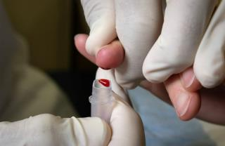
Second National Report on Biochemical Indicators of Diet and Nutrition in the U.S. Population
Assess and monitor the nutritional status of the U.S. population every two years
Improve measurements of nutritional status
58 biochemical indicators
Water-soluble vitamins.
Fat-soluble vitamins and nutrients.
Trace elements.
Isoflavones and lignans.
Acrylamide adducts.

Slide 14
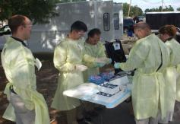
Detecting Human Exposure to Chemical Agents
An Efficient Protocol for Laboratory Response Following An Exposure Event
Event
* Chemical * Military Exposure * CWA * Industrial *
Chemical Emergency
Response Team
24/7
Rapid deployment
Aliquot & Track
Samples
Rapid Toxic Screen
40 persons
25 aliquots/person
150 analytes evaluated
Large Scale Response
1000+ persons
1-2 aliquots/person
1-2 analytes evaluated

Slide 15
Environment and Health Meeting Hierarchy of Human Needs
Self
Community
Safety and Security
Air, Food, Water, Shelter

Slide 16
Four Key Areas for Strategic Initiatives
Sustainable Environments for Human Health
Core activities of Environmental Public Health
Evidence-Based Decision Making
Risk assessment development
Public health emergency response
Obvious by definition
Emerging issues
New hazards
New science

Slide 17
Sustainable Environments for Human Health
Initiative 1: Identify the bounds of a sustainable, healthy environment for humans
Workshop
Guide all other activities
Initiative 2: Build an international partnership focused on creating sustainable, healthy environments
Global conference of mayors?
Yearly/Monthly Earth watch measure?

Slide 18
Sustainable Environments for Human Health
Initiative 3: Compare health risks, set priorities to create the largest number of sustainable, healthy environments possible
Create a certification program - “My city is a WHO Sustainable Healthy Environment”
Build coalition to address most pressing needs (probably water and sanitation, possibly food quality)
Choosing the focus should help to define the partners
Initiative 4: Educate and train global public health practitioners
Instill Environmental Public Health ideas and priorities into the global public health community
Develop an in-house rotation allowing training here at WHO for 1 year

Slide 19
Evidence-Based Decision Making
Initiative 1: Develop better metrics for quantifying risks and comparing them to benefits
Could be existing metrics (e.g. DALY), but need better international buy in
Need a means to do semi-quantitative analyses - use what we have and get a quick-and-dirty answer
Combine aggregate and cumulative risk assessment to better set priorities - do we go after the exposure, the disease, the route?
Initiative 2: Harmonization of definitions and methods
What does public health protection mean?
Where to draw the line between sensitive subpopulations and individuals?

Slide 20
Evidence-Based Decision Making
Initiative 3: Priority setting - how do we make it more effective
Burden of disease?
Cost of intervention?
Initiative 4: High level risk assessment advice on a global basis on issues of multinational concern
Locust control vs pesticide use, mercury in vaccines versus no vaccine, malaria control versus use of DDT

Slide 21
Environmental Public Health Emergencies
Create a focus for managing a global response
Identify experts/organizations to contribute to a response
Convene on an annual basis to be certain there is overall guidance on when and how to response to emergencies
Define the bounds of what constitutes a environmental public health emergency

Slide 22
Emerging Issues
Emerging Hazards
Establish a means to rapidly identify emerging issues
This could also work through the “Convention of Mayors”
Develop a management structure consisting of country representatives to meet annually and advise PAHO on national, regional and global emerging threats
Emerging Science
Identify opportunities for Collaborating Centers to lead on new science
Evaluate current programs to ensure they are using the best available science

Slide 23
Questions?
National Center for Environmental Health
Agency for Toxic Substances and Disease Registry

