Slide 1
Dirección Nacional de Medicamentos
Of El Salvador

Slide 2
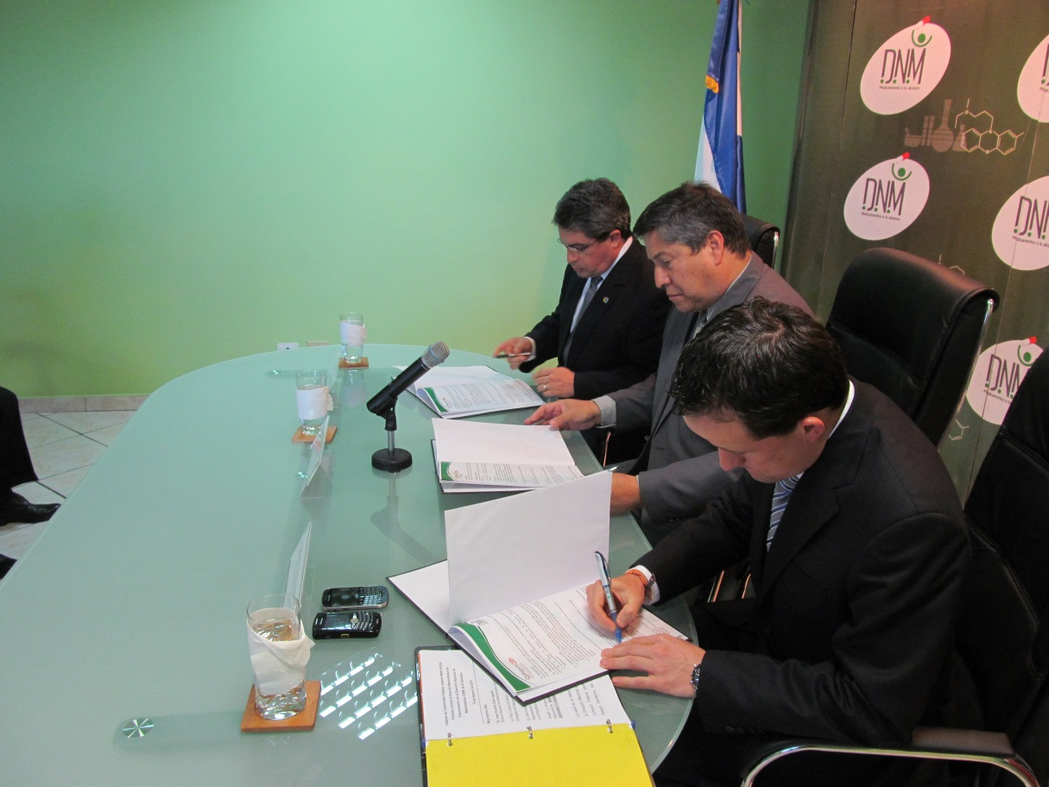
COFEPRIS COOPERATION WITH EL SALVADOR

Slide 3
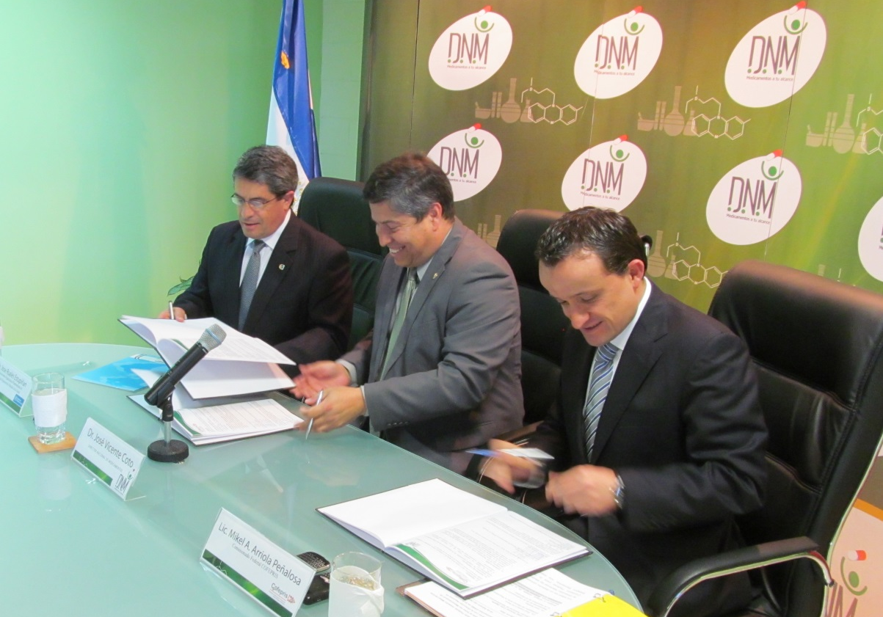
Memorandum of Understanding between
COFEPRIS and DNM
Objective: « "To promote understanding between the "Parties“ on their respective regulatory frameworks, requirements and processes for cooperation in the area of ​​health regulation and control of drugs, health products and cosmetics»

Slide 4
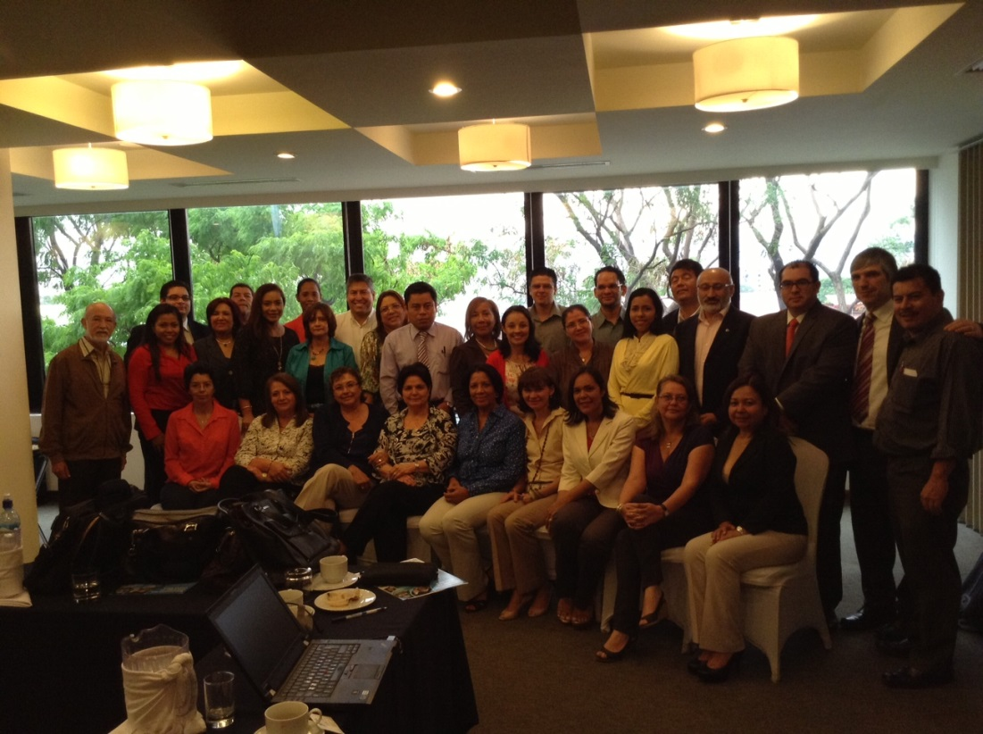
Meeting of Regulatory Authorities
from C.A. and DOR
Costa Rica, May 2013

Slide 5
COFEPRIS IN THE INTERNATIONAL CONTEXT
PAHO has created a mechanism in order that the countries that do not have aptitude to guarantee generic insurances accede to them in an immediate way.
The mechanism consists of the Certification of Sanitary Agencies that guarantee approval of drugs and vaccines in accordance with best international practices, conferring the status as a National Regulatory Authority Regional Reference Level IV, (RNA's Level IV: Argentina, Brazil, Colombia and Mexico).
This allows countries with weaknesses, to access generic drugs authorized by RNAs, reducing health costs. El Salvador and Ecuador recently approved a simplified mechanism for Mexican generic entry with the following projection:

Slide 6
COFEPRIS obtained the international recognition as regulatory national authority of regional reference in medicines and vaccines on the part of the OPS.
COFEPRIS becomes the first regulatory agency with Level IV recognition for drugs and vaccines.
Mexico now has a recognized regulatory agency in the world for their best practice to review the quality and safety of health products they use and consume Mexicans.
These actions and institutionalization of the regulatory agency directly translate into transparency and legal certainty for the economic operators
This possibility already is detonating important possibilities of investment and exterior trade for the pharmaceutical sector.

Slide 7
Special Regulations for the Recognition
of Foreign Sanitary Registration
Article 1
The Dirección Nacional de Medicamentos, hereafter "The Dirección", will officially recognize medical records provided by health authorities of countries whose drug regulatory agencies have been certified for level IV Pan American Health Organization (PAHO) and health records as those provided by health authorities in the United States, Canada, Australia, Switzerland, Japan and the European Medicines Agency (EMA).
The recognition shall be applicable to all drugs that have been registered in the register of the countries mentioned in the preceding paragraph. However, biotech drugs, or biosimilars and biologicals, will be awarded the appropriate register, provided they have been recorded by these countries and that these countries have specific regulations for these.
The Department, through the Registration Unit will award the relevant health registration, taking into account the provisions of the preceding paragraphs, as long as they meet all requirements and submit documentation established in Article 20 of the General Regulation of the Drug Law.

Slide 8
Special Regulations for the Recognition
of Foreign Sanitary Registration
Article 2, paragraph “e”
e) If the technical documentary report is favorable, the Direction, in the maximum term of ten (10) business days from receipt of the application and other requirements set forth in the preceding articles, assigned the approval number of automatically and granted the respective Sanitary Registration Certificate of Registration with Health Abroad recognition, using the format for the purpose by the respective Registration Unit.

Slide 9
Drugs approved with this modality
Mexico 24
Italy 1
Denmark 6
Germany 2
Colombia 32

Slide 10
ACTION BY COFEPRIS
STARTING EVALUATION VISIT
DETERMINATION OF NEEDS
ESTABLISHMENT OF PROGRAM
IMPLEMENTATION OF THE PLAN
Example 1: Registration Unit
Example 2: Herbalists Laboratory

Slide 11
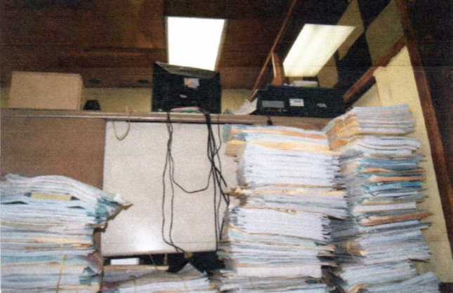
Unit of Registration and drugs visa
BEFORE
The registers received by the DNM showed considerable delays at different steps:
-Delays of requests for new records unsolved.
-Delays in post-registration procedures.
- Inconsistencies in the electronic record of data relating to paper files

Slide 12
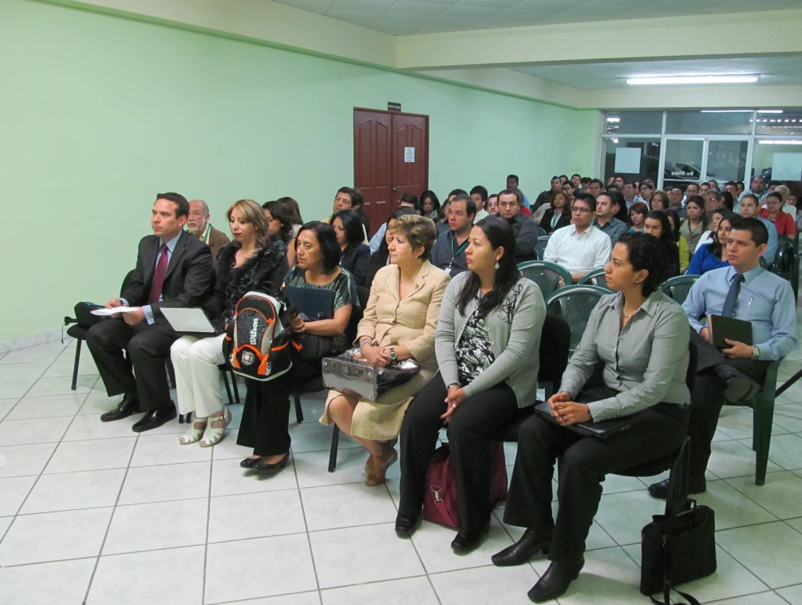
COFEPRIS VISIT

Slide 13
Unit of Registration and drugs visa
ACHIEVEMENTS
1. Restructuring review of files processes
2. Writing manuals for the various procedures of the Unit
3. Unification of technical criteria in the area of ​​stability studies, terms of sale, packaging labeling
4. Criteria for the classification of natural products, homeopathic and nutritional supplements
5. Development measurement indicators
6. Setting Goals for Unit staff

Slide 14
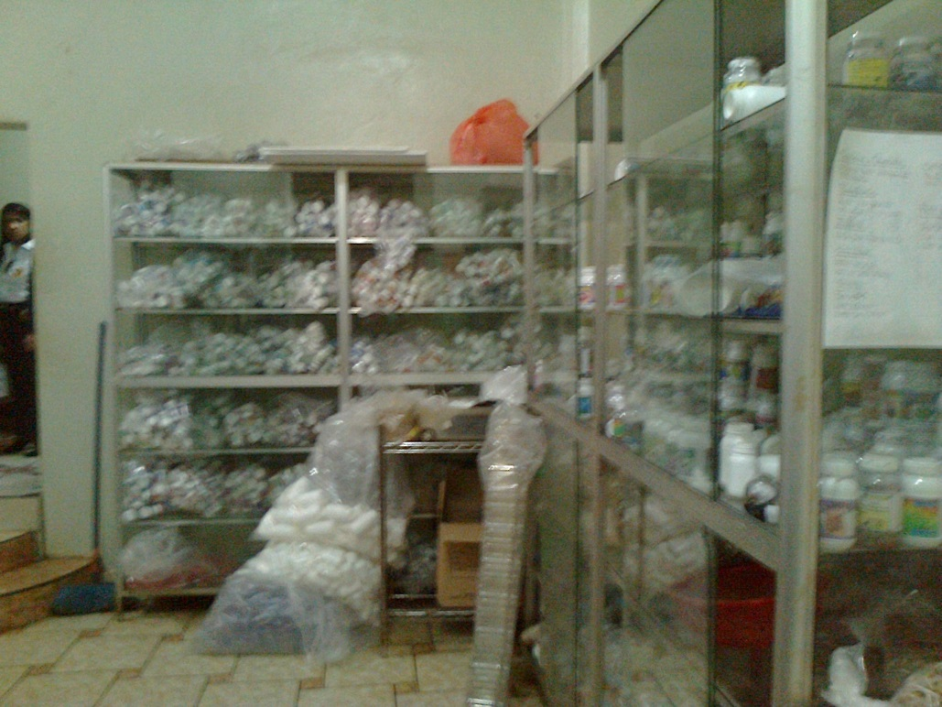
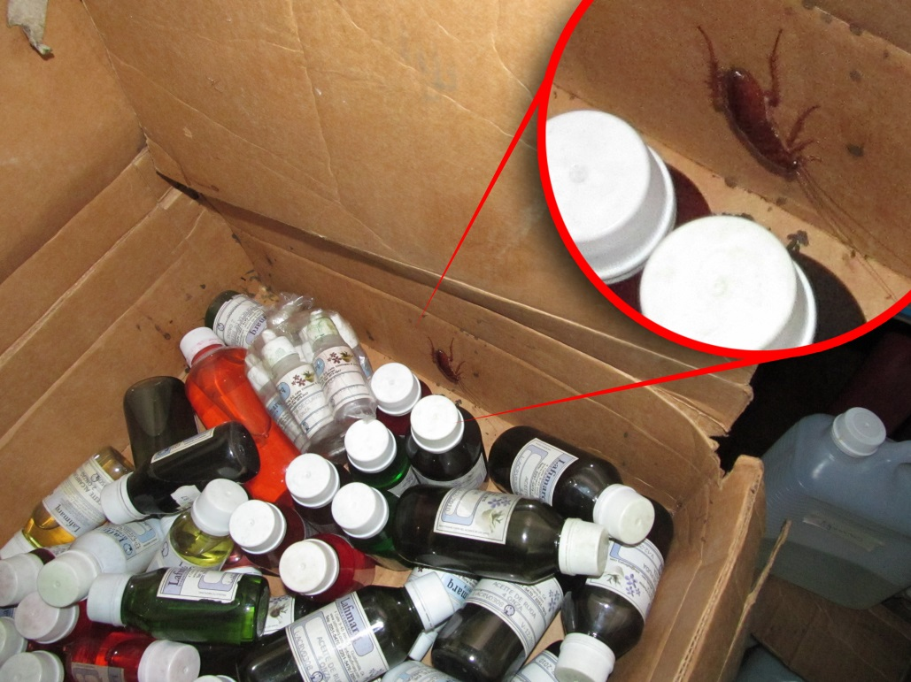
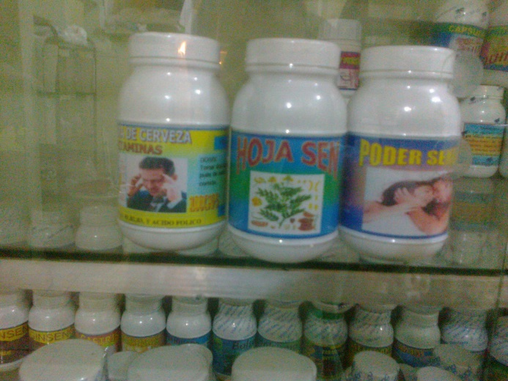
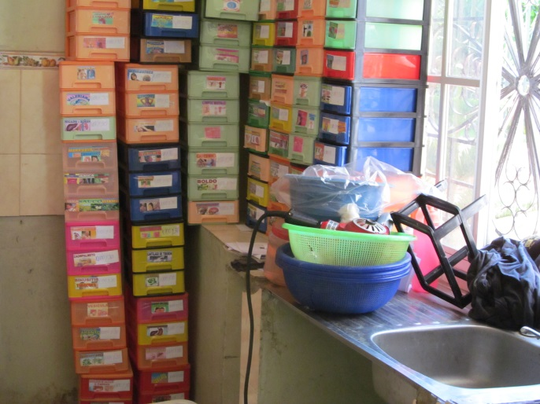
Natural Drugs
BEFORE

Slide 15
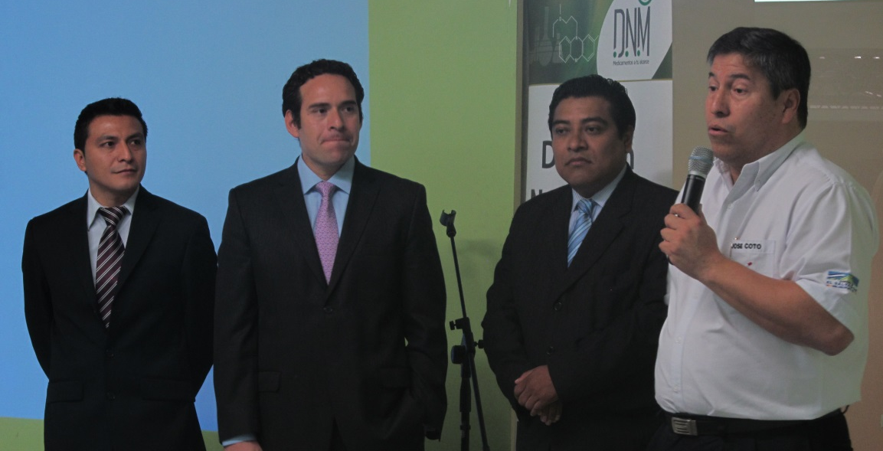
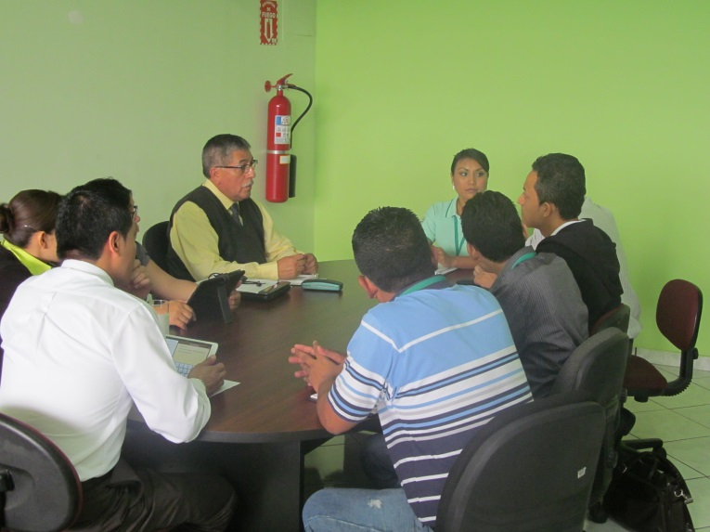
COFEPRIS VISIT

Slide 16
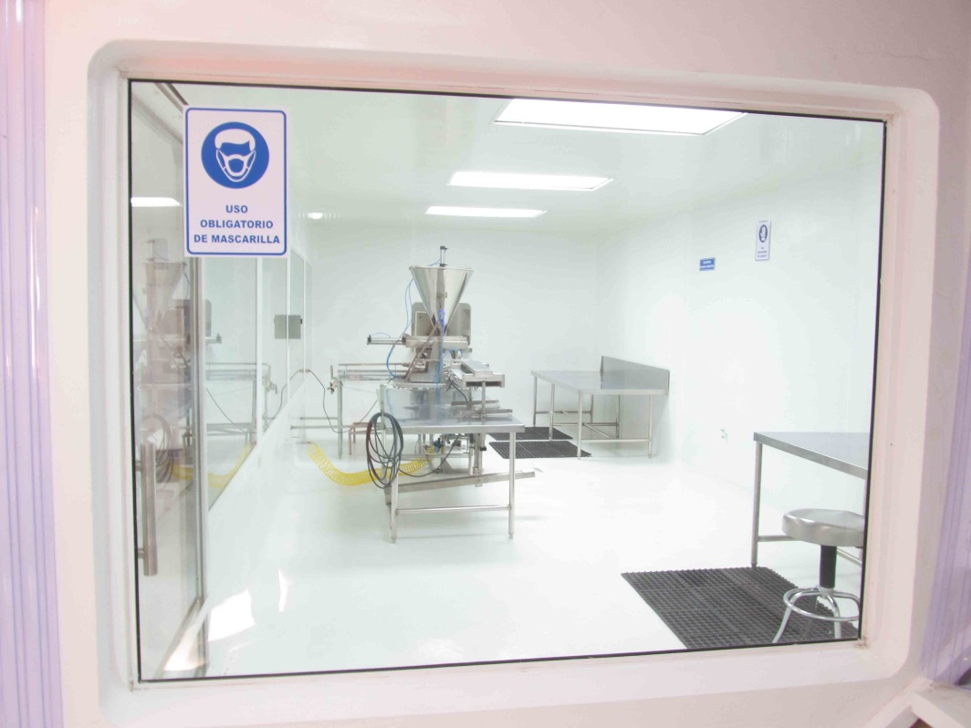
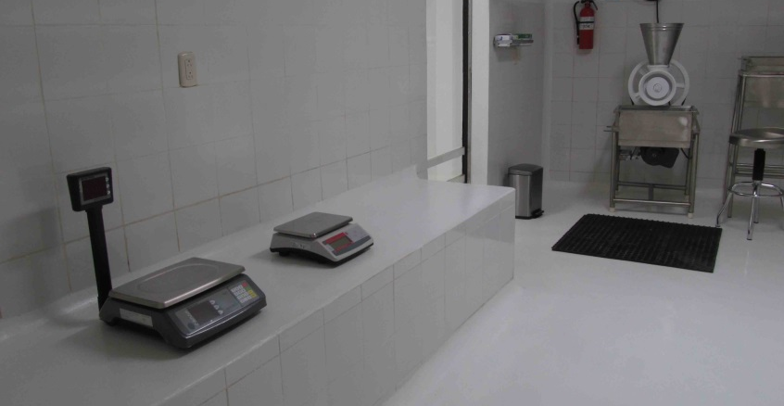
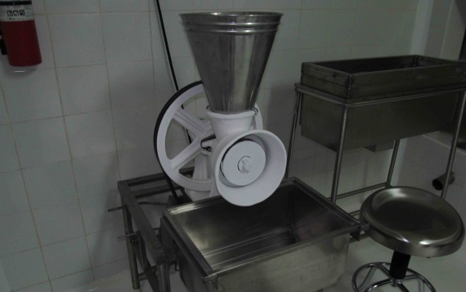
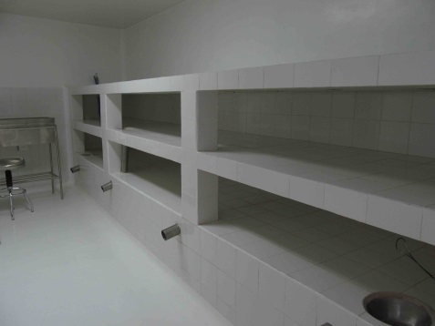
Natural Drugs
ACHIEVEMENTS
Development of regulations for the approval of manufacturing establishments for botanical natural product

Slide 17
Presentation of Special Regulation for
the Recognition of Foreign Sanitary Registration

Slide 18
Thank you very much

