Slide 1
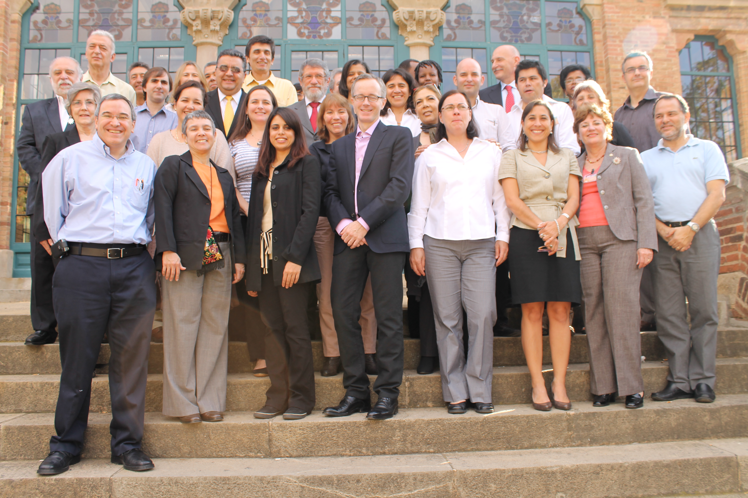
ACHR HCF 2012 Best Practices and Standards

Slide 2
Best Practices and Enhanced Standards for Research
“International norms, standards, and guidelines … are required to govern, manage and improve the quality of research; address inefficiencies…; promote transparency (related to planned, ongoing, and completed research); improves access to information”
Basis: maintaining public trust & participation in research
Need to develop systematic method to select, develop, adopt and evaluate new standards & in line with ethics principles.

Slide 3
1. Recommended Processes Technical Documents & Guides PAHO & Member States ≈ WHO Standards
training workshops on guideline development in Chile, Guatemala, Peru with support McMaster & Nat. Univ. Colombia
Glossary of guideline related terms in Spanish
Mapping of handbooks to elaborate guidelines as well as a repository of official guidelines

Slide 4
2. Clinical Trial Registration: Mapping legislation; help construct; advocate; monitor
Clear progress as highlighted by Luis-Gabriel
Peru: applied to become primary registry
Argentina: research registry
Canada TCPS research ethics guideline 2011:
Oct. 18, 2012: announcement of Health Canada clinical trial ‘registry’
Bireme/PAHO: Software development OPEN TRIALS permits establishment Spanish/Portugese/English Primary Registries for the Region
Development of software for RECs including 20 fields for trial registration (Coll. PAHO Bioethics Ctee & Pontificia Universidad Católica Paraná de Brazil
Monitoring of Trial Registration

Slide 5
Trial Registration: Publications
Reveiz L, Saenz C, Murasaki RT, Cuervo LG, Ramalho L. Progress and challenges of clinical trials registration in Latin America and the Caribbean's. Rev Peru Med Exp Salud Publica. 2011;28(4):676-81
White L, Ortiz Z, Cuervo LG, Reveiz L. Clinical trial regulation in Argentina: overview and analysis of regulatory framework, use of existing tools, and researchers' perspectives to identify potential barriers. Rev Panam Salud Publica. 2011;30(5):445-52.
Trudo Lemmens & Candice Telfer, “L’accès à l’information et le droit à la santé : la transparence des essais cliniques comme une obligation dans le contexte des droits de l’homme” in Louise Lalonde, ed., Le droit, vecteur de la gouvernance en santé?Défis théoriques et enjeux pratiques de l’accès aux soins de la santé (Sherbrooke: Éditions Revue de Droit de l'Université de Sherbrooke)
Trudo Lemmens, “Reimagining Global Governance of Pharmaceutical Knowledge Through a Human Rights Kaleidoscope” (forthcoming 2013 Journal of Law, Medicine and Ethics)
Trudo Lemmens & Candice Telfer, “Access to Data and the Right to Health: The Human Rights Case for Clinical Trials Transparency” (2012) 31(1) American Journal of Law & Medicine 63-112.
Matthew Herder, Francoise Baylis, Trudo Lemmens, Submission to Standing Senate Committee on Social Affairs, Science and Technology on Clinical Trials Registration and Access to Clinical Trials Data (2012)

Slide 6
3. Strengthen PAHO Research Standards: Implement Registry PAHO research; Mapping RECs; Capacity Building bioethics
Evaluation of the required modifications to research registry system
PAHOERC Standards Operation Procedures updated
Ethics Capacity building at PAHO
Development of an open source software to support the process of revision of RECs

Slide 7
4. Reporting Standards: Equator; assessment of reporting quality; and promotion of reporting standards
Development of the Spanish EQUATOR portal
Assessment Research Reporting Quality: Translation of a number of reporting guidelines into Spanish
Publications to advocate for adequate reporting of research & on reporting quality
e.g. Reveiz L, Sangalang S , Glujovsky D, et al. Characteristics of randomized controlled trials published in Latin America and the Caribbean according to funding source. Plos One (Peer review)
Contributions to develop standards for good clinical practice reports of experiences (i.e. maternal mortality)

Slide 8
5. Evipnet Standards
Training workshops for EVIPNet teams, on policy brief and deliberative dialogue - development under EVIPNet global standards (Mc Master and SURE): Capacity building for understanding the processes of knowledge translation and contributing to development of PB and DD with best standards.
Technical cooperation on PB and DD development provided to countries : Capacity building "learning by doing" in the reality of each country.

Slide 9
Plans 2012/13
Publication Policy on Guideline Development: make all guidelines in which PAHO is involved comply with PAHO/WHO standards
Promote Guideline Standards:
Training activities
Improvement in quality of PAHO guidelines

Slide 10
Plans 2012/13
Establish Regional Trial Registry Network:
Network Governance
Organizing knowledge; fostering communication on trial registration through workshops, conferences, newsletters and a website; presenting strategies for implementation of trial registration
Further Promote National Trial Registries & Promote Reporting Standards:
The “Open Trials” software
Monitoring of progress in regulatory initiatives trial registration
Results reporting and access to data initiatives
Promote Good Practices for Setting Research Priorities

Slide 11
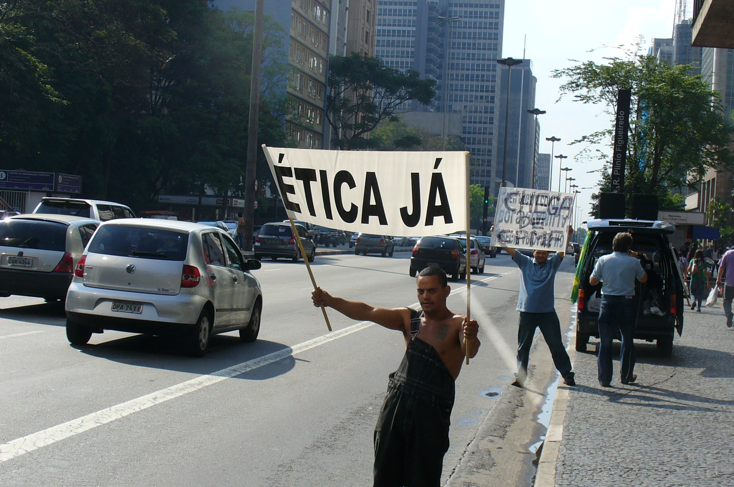
Future
Improve standards Research Ethics
Committees in Americas
Rapid Response mechanisms:
Evipnet’s team capacity work
Harmonized standards
Development and implementation of policies to increase the investment in research :
Identification of alternative sources of research funding
Strengthening south –south collaboration in research project

Slide 12
5.1. To promote the implementation of recommended processes for technical documents and guides at PAHO and Member States using scientific evidence in line with WHO standards
Indicators:
analysis of financial flows for research for health
Analysis of research agendas and outputs, and organizational plans and priorities

Slide 13
5.2. promote development of validated indicators to assess and monitor the effects of investment in research and scientific production & alignment of research activities with research priorities
Indicators:
analysis of financial flows for research for health
Analysis of research agendas and outputs, and organizational plans and priorities

Slide 14
5.3. Advocate development of research methods that promote better knowledge and standardization of the reporting and analysis of the equity and implementation aspects of qualitative and quantitative research and systematic reviews
INDICATORS:
- Analysis of research pubs. By PAHO staff ~ BIREME, EQUATOR & WAME recommendations & standards
- Analysis of research publications from region ~ with international standards

Slide 15
5.4. Help create or access research for health inventories/registries that are comparable and integrated with WHO’s ICTR platform & adopt standard identifiers and data set collections that contribute to international registration efforts and international ethics and publication standards

Slide 16
5.5. Promote access, use, and further development of helpful organized collections & registries of research syntheses (systematic reviews, evidence summaries, policy briefs)

Slide 17
5.6. Support Member states in development of strategies and action plans, regulations, and incentives to strengthen adherence to research registration by building effective and efficient tools for determining and assessing the extent to which the research they conduct adheres to international good practice standards—including ethics, safety, and research management standards.
Indicators: PAHO Ethics Review Committee Annual report; analysis of the characteristics of studies submitted for review

Slide 18
5.7. Work in collaboration of stakeholders to promote the ethical regulation of research for health in humans and the strengthening of ethical review committees and commissions in Member States.

Slide 19
5.8. Promoting the notion that health care interventions must be subject to fair tests and evaluations (including interventions in alternative, traditional, and complementary medicine) in order to support wider access to safe and effective care and to protect individuals from interventions likely to be harmful or ineffective.
Indicators: countries with health technology agencies and processes requiring fair tests to balance the effects of interventions including benefits and harms.

