Slide 1
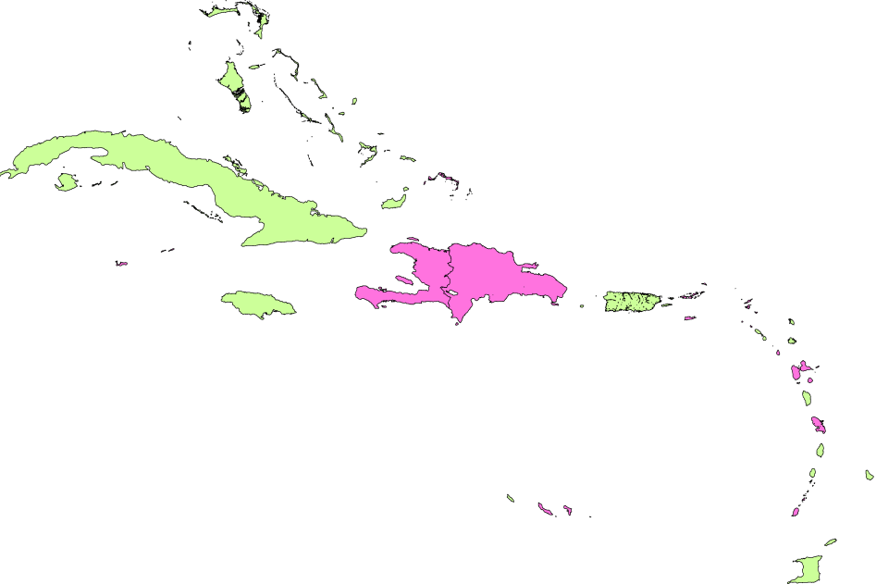
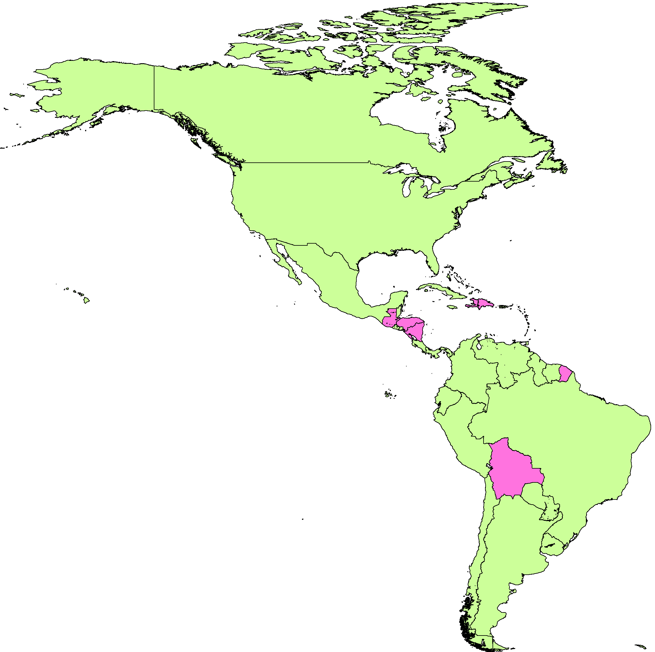
Countries that have introduced MMR2 into
the routine vaccination program in the Americas
Legend
Have MMR2 in routine schedule
Provide MMR/MR2 through follow-up campaigns
Source: Country reports , OPS-OMS/UNICEF (JRF), 2013

