Slide 1
How much will it cost in 2050? Future health spending in Brazil, Chile and Mexico
Amanda Glassman and Juan Ignacio Zoloa
Inter-American Development Bank
June 14, 2013

Slide 2
Public spending on social sectors including health has increased…
Total public spending on social sectors, % GDP
In real terms, public spending on health increased 88% since 1995
Fastest growth:
DR (336%)
Venezuela (244%)
El Salvador (161%)
Chile (112%)
Brazil (98%)
Mexico (71%)
57%
Source: Panorama Social 2013, ECLAC
Notes:
El gasto social en America Latina se ha duplicado, pasando del 11% del PIB regional en 1990 a casi 19% del PIB en 2009/10.
Of this, the amount spent on health is marginal
Empujado por diversos factores, algunos estructurales que afectan la demanda por servicios (ingresos, transicion demografica, mayores niveles de escolaridad), otros de politica al lado de la oferta (esquemas universales de aseguramiento y acceso, descentralizacion, etc.).

Slide 3
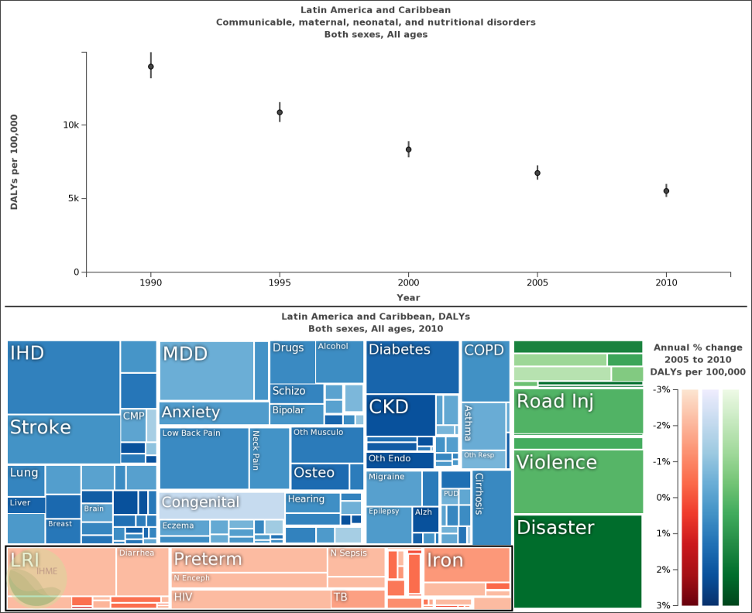
Source: IHME, 2013 (http://viz.healthmetricsandevaluation.org/gbd-compare/
Notes:
Top part of chart shows life years lost on vertical axis, years on horizontal axis
- Increased health spending was associated with rapid declines in communicable disease and maternal/neonatal/nutritional causes
Life years lost from these causes cut in half
Interventions in this area are cheap, and countries did them
But bottom half of chart shows causes of life-years lost – darkness of the color shows those causes that are increasing most rapidly
IHD – heart disease, CKD – kidney disease requiring expensive dialysis, MDD – depression, disasters and violence
Simulatneously, we have increasing incomes

Slide 4
As countries grow wealthier, they shift towards public spending
Source: Hsiao 2005
Notes:
Left hand side countries are Africa; middle is Asia; right hand side is Latin America – Large shares of public spending, increasing over time

Slide 5
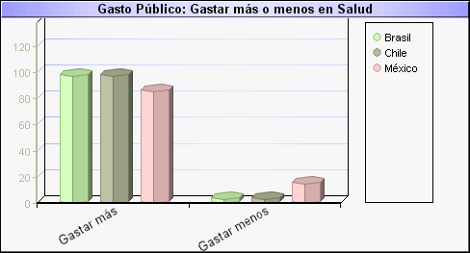
Expectations are increasing over time…
Source: http://www.latinobarometro.org/latino/LATAnalizeQuestion.jsp
Notes:
Latinobarometro, circa 2010
As wealth, education, urbanization, and disease burden change, expectations about health care change too. People want more health care and better/fancier health care technology, and they want the government to spend more.

Slide 6
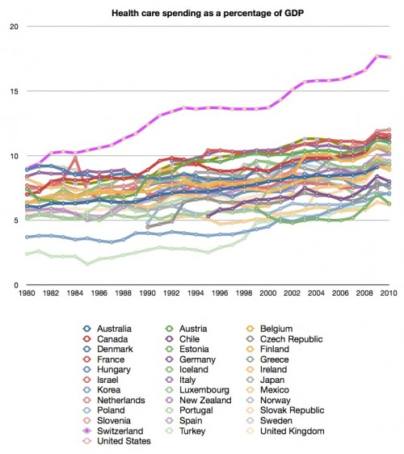
What can we expect in the future then?
Long-term fiscal projections and simulations
Identify factors that can be modified via public policy
Allows for ex ante identification of inter-temporal inconsistencies in needs and revenues
Illustrative analyses
Models that allow for modification of assumptions
Notes:
Although we can’t modify most of the structural factors that push expenditure growth, if we plan for long-term policies in health, we can affect te trajectory and effectiveness of future spending. But to design these long-term policies –decisions today that are fiscally sustainable tomorrow- we have to understand the different possible future scenarios.
We have to decide – do we want to spend like USA or like England

Slide 7
Methods
Estimate probability of acquiring disease and seeking care
Assume:
Current patterns of screening and treatment stay constant (improbable)
Prices of services and medical technology in relation to general price levels remain constant
Use annual projections of age structure, education, labor market participation
Assign probabilities to individuals, assign expenditure to each person
Notes:
Estimate probability of acquiring disease and seeking care using age, gender, education, ethnicity, risk factors and other characteristics

Slide 8
Levels of risk factors in Brazil, Mexico and Chile, circa 2008
Genero | Fumadores | Sedentarios
Mujeres | 23.8% | 4.4%
Hombres | 37.7% | 3.7%
Total | 30.5% | 4.1%
Notes:
Los fumadores son aquellas personas que han fumado al menos 100 cigarrillos a lo largo de su vida.
Se definió como sedentarias a las personas que están sentados más de 8 horas mirando televisión o usando la computadora para fines recreativos y que no realizan actividades deportivas (incluidas caminatas) de más de 30 minutos.

Slide 9
Projections of 10 conditions based on age structure and risk factors, Brazil 2008-2050
Source: Own analysis based on PNAD 2008 and IBGE projections 2008.
Notes:
Tomando en cuenta la evolución de la estructura etarea y los niveles actuales de factores de riesgo, utilizando las probabilidades de contraer enfermedad y utilizar servicios (actuales), una simple proyección del numero de enfermos por 10 condiciones. Casi 120 millones de personas en 2050, mas que el doble de los enfermos de hoy y un 53% de la población total proyectada en ese año (OJO QUE UN INDIVIDUO PUEDE TENER MAS DE UNA ENFERMEDAD).

Slide 10
Public spending projections associated with hospitalization for 10 conditions, Brazil
Source: Own analysis based on PNAD 2008 and IBGE projections 2008.
Notes:
En la Ilustración, se presenta la evolución del gasto en atención hospitalaria por tipo de enfermedad, donde puede observarse un aumento en la participación en el gasto total de las enfermedades relacionadas con el corazón y el cáncer y una reducción en el gasto en asma, enfermedades renales y depresión, mientras que para las restantes enfermedades no se evidencian variaciones importantes. Línea de base en 2007, casi 12% del total del consumo en salud (224 million reales is total in 2007, as a share of GDP 8.4% )
Al analizar la evolución del gasto en cada grupo etáreo, se encuentra una disminución en la participación de los menores de 25 años, con reducciones cercanas a 5.1 (menores a 35 años 7.1PP) puntos porcentuales, una reducción en los adultos [25-65] (poco más de 9 puntos porcentuales) la cual contrasta con el fuerte aumento en el participación de las personas de más de 65 años, con más de 20 puntos porcentuales de aumento.

Slide 11
Projections in public spending (% GDP), under different policy scenarios, Brazil
Source: Own analysis based on PNAD 2008 and IBGE projections 2008.
Notes:
To project the share of GDP: keep real income constant, no modification of labor participation rates – conservative assumption since we would expect income to grow over time. MORE
With no intervention, we project health spending growth of 8 percentage points, from 8.7% in 2008 to 16.7 in 2050, under the assumption that te expenditure in spending related to technology maintains the same rhythm of historical growth. In absolute terms, this amounts to $180 billion USD. Find about the same order of magnitude increases in Chile and Mexico.
Si en cambio, existen políticas de contención del gasto, el incremento en la participación del gasto en salud sobre el PBI se reduciría de 16.7 a 14.1% en 2050, lo que representa un ahorro de 80,859 millones de reales (44,185 millones de dolares ) en el 2050. El ahorro durante todo el periodo seria de 1,664,337 millones de reales [909,474 millones de dolares]
Blue line – projections of the 10 diseases only
[DIFFERENCES WITH IMF ESTIMATES – they project on average 3 percentage points of GDP in health spending growth over next 20 years (to 2020); about the same]

Slide 12
Potential public policy levers and impact on spending scenarios to 2050 (% GDP), Chile
Source: Own analysis based on ENS 2009 and INE projections.
Notes:
El escenario analizado abarca una situación donde se logra la universalización de la salud. Es decir, donde todos los individuos que contraen una determinada enfermedad realizan el tratamiento correspondiente. En dicha ilustración puede observarse que bajo este escenario el gasto en salud en 2050 se incrementará en un 47%.
Our GDP estimates use existing GDP per worker and multiply by our projections of increases in working age adults, maintaining the current rates of labor market participation. This is a conservative estimate since we might expect income to increase due to future increases in productivity. In the IMF scenarios, we use IMF projections for the next couple of years, which are higher than our estimates. This makes a big difference for the importance of the expenditure increases as a proportion of GDP – ie, increased health spending not a problem if growth accelerates.

Slide 13
Geographic distribution of variations in health spending – 25% increase in smokers (trend)
Notes:
Important information in decentralized settings for purposes of budget allocation and risk adjustment of capitated health transfers, understanding political economy in the future

Slide 14
Key messages
Even under conservative assumptions, public spending on health will grow more rapidly in the future, pushed by aging, risk factors and technology.
Labor market participation and growth can slow the spending trajectory, as can policy measures related to risk factors.
Benefits and access expansion should be accompanied by policies to maximize value for money and contain current and future costs.
Notes:
Con implicacione
La magnitud de este gasto podría representar una contingencia fiscal tan o mas importante que la contingencia del sistema de pensiones.
s politicas…

Slide 15
Conclusions
Only a few Latin American countries conduct long-term fiscal projections in support of social policy decisions, none as a matter of routine
Without LT projections, can’t understand implications of policies and trends on public finances, can’t manage expectations and can’t maximize welfare.
Possible to do but merit greater methodological development, more and better data.
HH surveys on behavior, disease and utilization
Spending and cost by episode of illness
Notes:
Se requieren más y mejores datos sobre el gasto por enfermedad, que es lo que limita la cantidad de países utilizados.

Slide 16
AnNex

Slide 17
Metodología y datos: Salud (1)
Identificar los factores históricos que determinen el gasto publico en salud:
Demanda: demografía, epidemiologia, participación laboral, niveles educativos, ingresos, factores de riesgo (tabaco, sedentarismo, alcohol), lugar de residencia, utilización de servicios de salud.
Proyecciones demográficas oficiales.
Encuestas de hogares con módulos sobre salud.
Oferta: niveles de detección y tratamiento, precios, productividad, calidad de la oferta, gasto.
Datos administrativos oficiales sobre el gasto en salud .

Slide 18
Metodología y datos: Salud (2)
Simular 2010-2050 en base a la historia:
Cambios en la estructura etaria, consistentes con estimaciones oficiales.
Probabilidad de contraer enfermedad utilizando modelo probit tomando como variables explicativas edad, genero, nivel educativo, etnia, factores de riesgo y otras características socioeconómicas.
Asumiendo que las relaciones entre las variables explicativas y las enfermedades se mantienen constantes
Notes:
Enfermedades: asma, cáncer, cirrosis, colesterol, depresión, diabetes, dolor de columna, enfermedades renales, enfermedades cardiovasculares, hipertensión, reuma, tendinitis y tuberculosis

