Slide 1
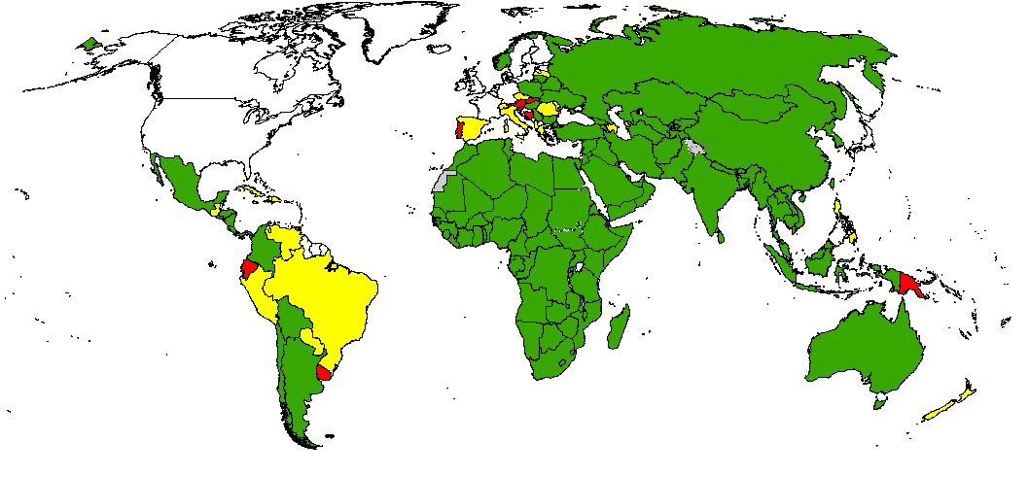
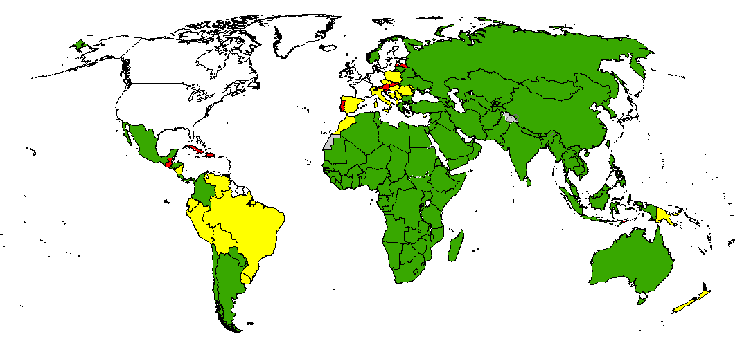
Non-polio AFP Rate
December 2013 – November 2014
December 2014 – November 2015
< 0.5
0.5 - 0.99
> 1
No AFP Surveillance/data
Data in WHO/HQ as of 12 January 2016
Source: WHO
The boundaries and names shown and the designations used on this map do not imply the expression of any opinion whatsoever on the part of the World Health Organization concerning the legal status of any country, territory, city or area or of its authorities, or concerning the delimitation of its frontiers or boundaries. Dotted lines on maps represent approximate border lines for which there may not yet be full agreement.
© WHO 2016. All rights reserved

