Slide 1
Extended Cost-Effectiveness Analysis (ECEA) June 24th – 25th, 2013 Pan American Health Organization
Rachel Nugent, DCP3 Series Editor
University of Washington
Notes:
Ole Norheim: Dashboard is good but will be very difficult for policymakers to understand, so we need clear and consistent definitions across ECEAs.

Slide 2
Outline
Background
Limits of CEA
Introduction to ECEA
Distributional, equity aspects
Financial Risk Protection
Example

Slide 3
From Cost-Effectiveness Analysis (CEA) to Extended Cost-Effectiveness Analysis (ECEA)
Traditional economic evaluation focus (CEA)
Cost-effectiveness of technical health interventions
(e.g. antiretroviral therapy for HIV/AIDS)
Policymaking focus (ECEA)
Resources allocated across different options
1) Health interventions
2) Health service delivery platforms
3) Health policy levers (e.g. universal public finance)

Slide 4
Specific Consequences of universal public finance (UPF)
Health gains (burden of disease averted)
Financial consequences for household expenditures
UPF “crowds out” medical expenses privately financed
Financial protection benefits
UPF provides “insurance” to households from medical
impoverishment
Distributional consequences (across income groups)

Slide 5
Distributional Consequences
Traditional CEA often deals in averages for a population. This means not taking into account inequalities in:
Access
Coverage
Cost
Incidence
Effectiveness
Other parameters

Slide 6
Financial Risk Protection
FRP can be quantified in many ways
Money-metric value of insurance
Impoverishments averted
Catastrophic Expenditures averted
Forced borrowing and asset selling
others?
Can be useful information for policy-makers to have when defining health packages.

Slide 7
ECEA of Salt Reduction in South Africa
Preliminary Example – please do not quote

Slide 8
Objective
Goal: reduce strokes and other health insults due to high blood pressure
Primary target: reduce risk of high blood pressure
Immediate lever: reduce salt consumption at population level
Policy tool: voluntary reduction of salt in selected manufactured foods

Slide 9
Step 1. Data for the reference population
The National Income Dynamics Survey (NIDS)
7300 households, nationally-representative
Includes income, consumption, and expenditures
Also includes blood pressure, health status, etc
All above by age and ethnicity
Wave 1 in 2008, wave 2 in 2010, conducted every two years
NIDS was used to construct a cohort of 1 million individuals over 40 years of age, separated into income quintiles. No dietary intake data in NIDS. ☹
http://www.nids.uct.ac.za/home/

Slide 10
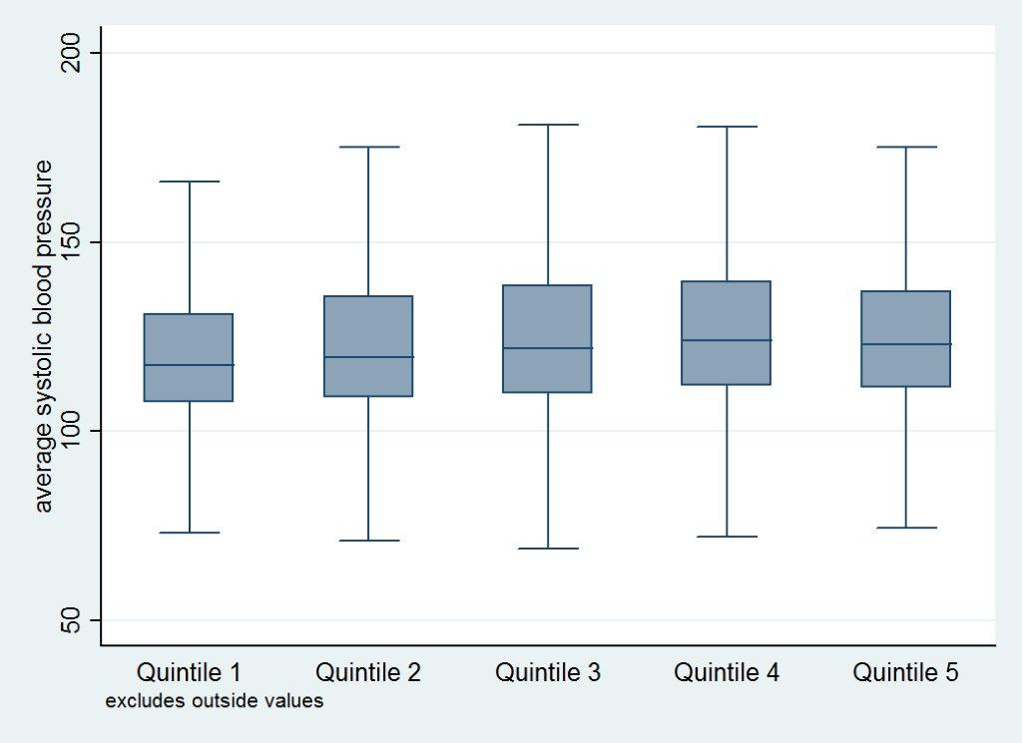
Step 1: Blood pressure by quintile in the NIDS
Mean systolic BP was calculated separately for
hypertensives (>140mmHg)
vs.
non-hypertensives
(<140mmHg)
to capture differential effect sizes from salt reduction
Notes:
As shown in slide 5
Excludes outside values?

Slide 11
Step 2: Baseline salt intake
Dietary surveys from South Africa are heterogeneous
Our analysis used urban consumption patterns from a contemporary study in Cape Town
Average intake: 7.8g/day in blacks (vast majority of population), 8.5g/day in mixed ancestry folks, 9.5g/day in whites
CT salt intake data by ethnicity were combined with NIDS to construct a weighted average salt intake for each quintile

Slide 12
Step 3: Effects of intervention
South Africa’s proposed policy is complex: involving many food groups, coverage assumptions, and a mass media campaign
Target consumption is 5g/day for all ethnic groups
Our preliminary intervention is “whatever policy is required” to reach 5g/day in each quintile
The difference between current and target salt consumption levels was used to calculate reductions in blood pressure (He and MacGregor 2004)

Slide 13
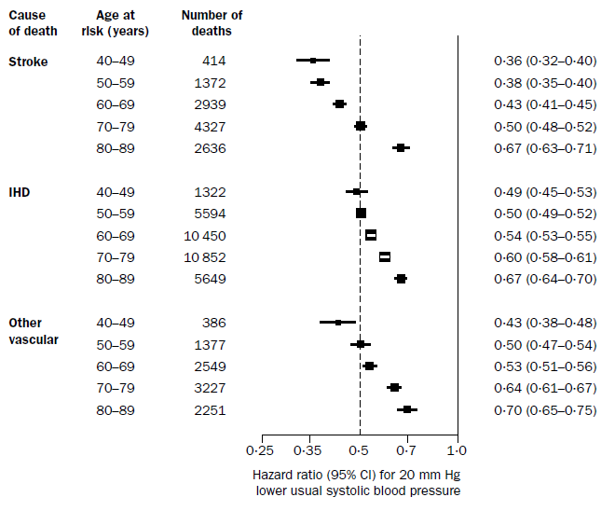
Step 4. Estimating CVD cases averted
Baseline age-specific mortality rates for southern sub-Saharan Africa were obtained from GBD 2010
Incident cases of CVD were back-calculated from case-fatality rates for SSA from GBD 2006
Age-specific hazard ratios for CVD mortality
Analysis was performed separately for stroke and for heart attack (IHD)
Fatal stroke and IHD were assumed to be independent events
Lewington S et al. Age-specific relevance of usual systolic blood pressure to vascular mortality: a meta-analysis of individual data for 1 million adults in 61 prospective studies. Lancet 2002; 360:1903-13
http://www.healthmetricsandevaluation.org/gbd/visualizations/gbd-2010-patterns-broad-cause-group
Notes:
Step B applied to entire popn, not by race?
New GBD has published CFR?

Slide 14
Step 5: Types and Costs of treatment
Utilization of healthcare was modeled over 1 year (including short-term follow-up and drug costs)
Model protocols for managing acute stroke, acute heart attack, and chronic hypertension were designed in consultation with local physicians
Assumed daily hospital user fees and average length-of-stay as reported for level 2 hospitals (middle-range estimates)
The “Uniform Patient Fees Schedule” for the Western Cape Province was used to tally professional fees
Administration at Groote Schuur Hospital, Cape Town (level 3 facility) provided costs for drugs and devices
Assumed 70% of strokes were ischemic and 30% hemorrhagic; no precise data on true proportions, modest effect on treatment costs
Notes:
Walk through for relevance: everyone seeks Tx in public hospitals. Ignores variable health-seeking behavior and differential access
No costs of policy implementation

Slide 15
A note on the who pays for health care in the South African health system
H0 = on any gov’t. grant H1 = 0 – 50,000 ZAR
H2 = 50,000 – 100,000 ZAR H3 > 100,000 ZAR
Out‐of‐pocket user fees are calculated on a sliding scale basis
H0 status is “fully subsidized” and includes all using government grants (eg, pensioners, veterans, disabled, officially unemployed, etc)
About 41% of individuals with H0 status end up paying out‐of‐ pocket
H3 status reflects the “full” out‐ of‐pocket cost of care, ie, extent of government subsidies
 | Stroke | IHD
PUBLIC H0 | 77 | 85
PUBLIC H1 | 188 | 208
PUBLIC H2 | 2846 | 4089
PUBLIC H3 | 15964 | 17470
PRIVATE INSURED | 6649 | 9291
PRIVATE UNINSURED | 46201 | 63571
Average out‐of‐pocket on acute CVD events (2011 ZAR)

Slide 16
Results

Slide 17
CVD cases averted
8975 cases of CVD in the entire population (12.5 million)

Slide 18
CVD deaths averted
4000 CVD deaths in the entire population (12.5 million)

Slide 19
Average per capita OOP averted
R36.7M (about $4M) in total out-of-pocket payments

Slide 20
Cases of catastrophic OOP averted
6600 cases of potentially impoverishing stroke or heart attack

Slide 21
Health benefits, economic benefits – tradeoffs?
Verguet, Olson, Johansson, et al. 2013

