Slide 1
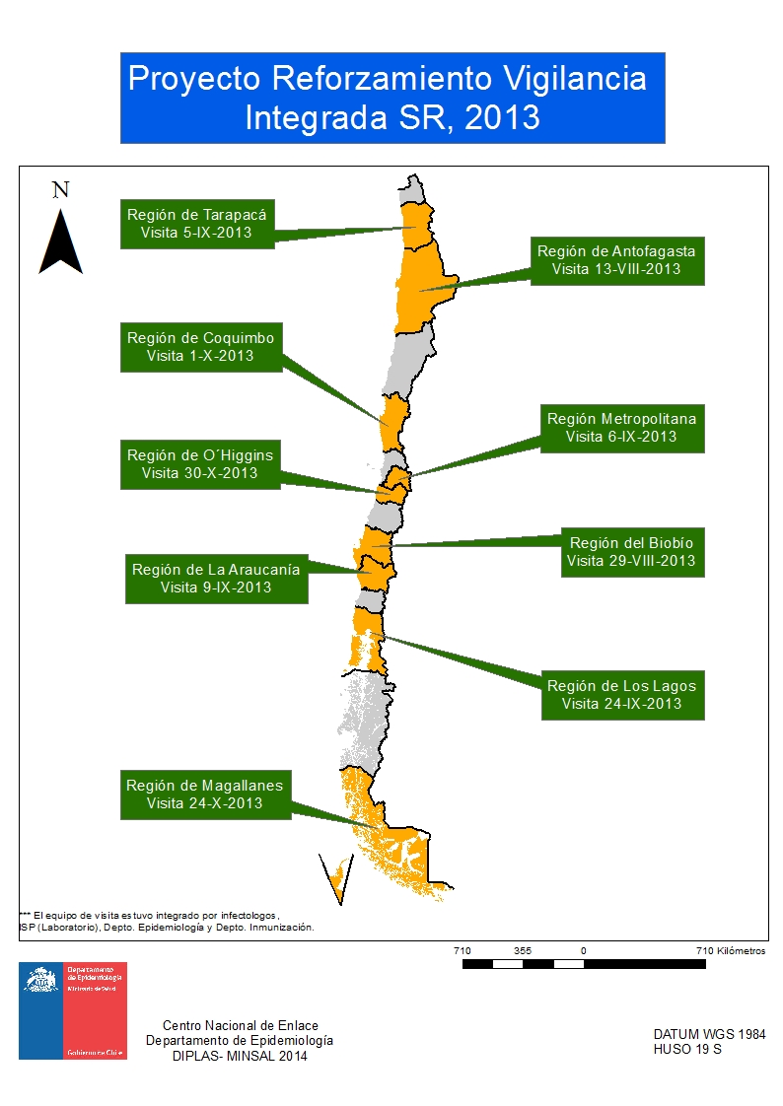
Strengthening surveillance systems:
the Chilean example
Due to the low reporting rate of suspected cases by the measles-rubella surveillance system, the Chilean MOH conducted site visits to 9 Health Departments.
Emphasis was given to increasing the reporting rate, and to implement active search cases periodically.
Source: Chilean Ministry of Health (MOH)

