Slide 1
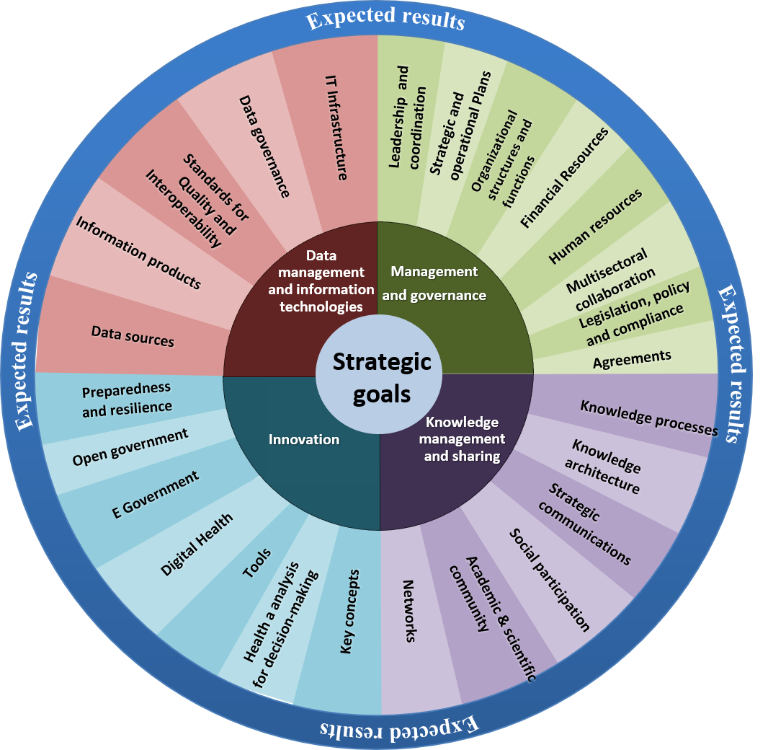

Information Systems for Health: Concept and Maturity Model Assessment

Slide 2

1. Background

Slide 3
Background
- High-level meetings with the Caribbean Sub-regions (November 2016), Central America (December 2017) and South America (August 2018)
- Sustainable health agenda for the americas 2018-2030: a call to action for health and well-being in the Region (ASSA2030): Strengthen health information systems in order to support policy formulation and policy making evidence-based decisions
- Action Plan for the Strengthening of Health Information Systems approved by PAHO Directing Council in October 2019

Slide 4

Key Concepts
Information Systems for Health
IS4H Framework

Slide 5
Information Systems for Health

Slide 6
Generating quality information for better clinical, management and policy decision-making
Information Systems for Health

Slide 7
Produced through effective Information Management and the use of Information Technology
Information Systems for Health

Slide 8
Enabled through systems of governance, management, knowledge management and innovation
Information Systems for Health

Slide 9
In collaboration with multi-sectoral partners working in health
Information Systems for Health

Slide 10
For better health outcomes and well-being for individuals and populations
Information Systems for Health

Slide 11
Information Systems for Health

Slide 12
IS4H

Slide 13
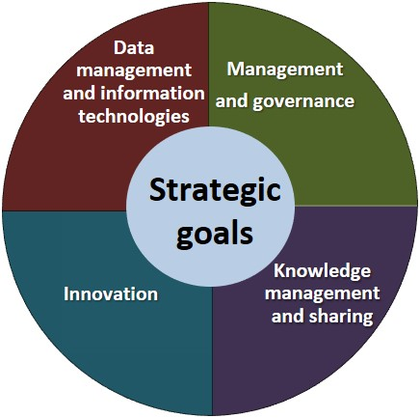

IS4H Framework
The IS4H Framework is built around four strategic domains.

Slide 14
IS4H Framework
Each domain focuses on key components or capacities that are required for effective IS4H.

Slide 15
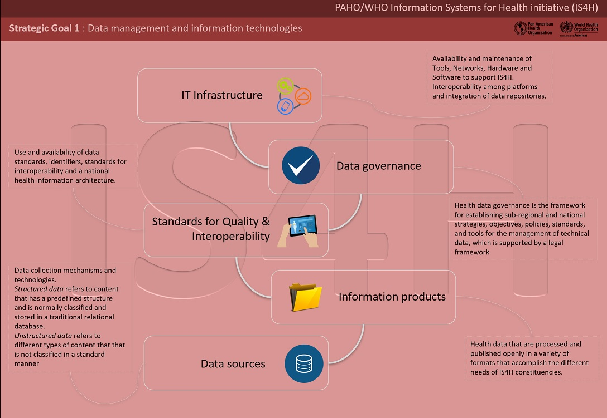
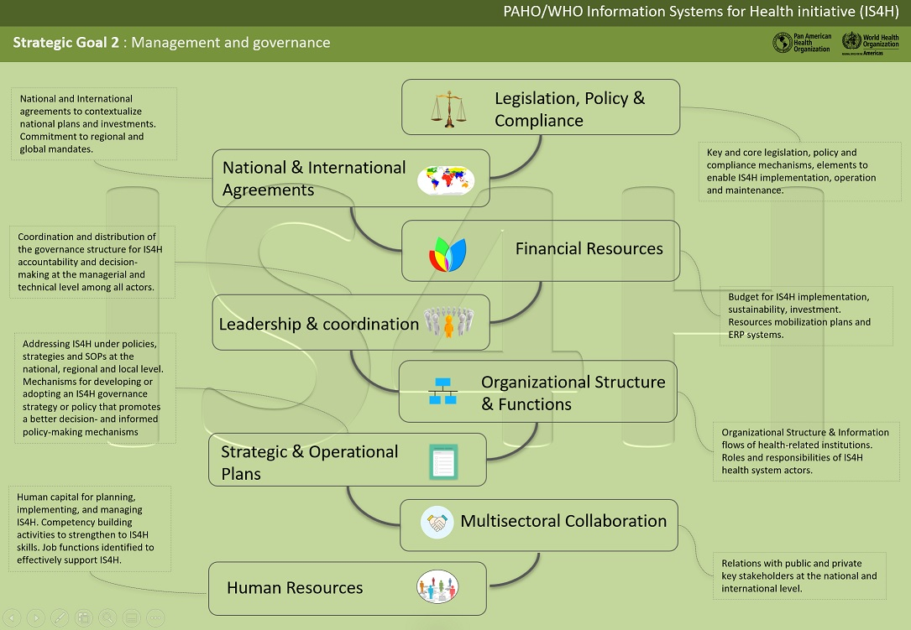

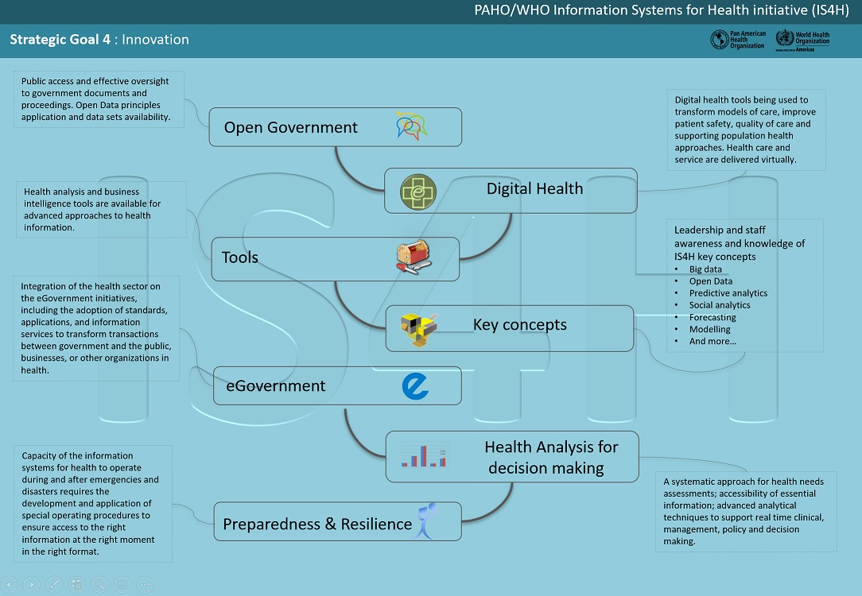
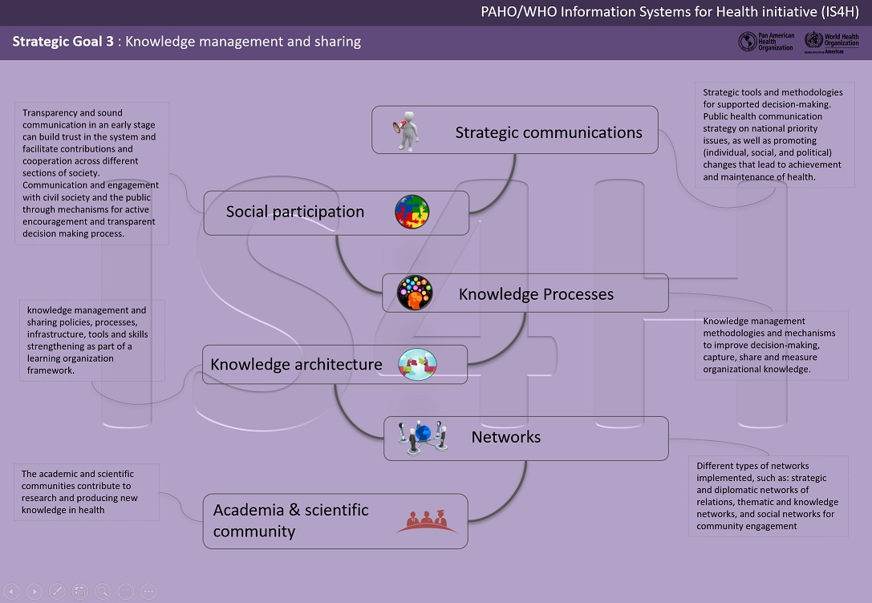

Slide 16

IS4H Framework
Learning Resources
National IS4H Strategic Plan
Tools and Templates
3
2
4
The Framework provides guidance to national health authorities on investment and capacity building.
1
5
Assessments
Networks and Communities of Practice

Slide 17
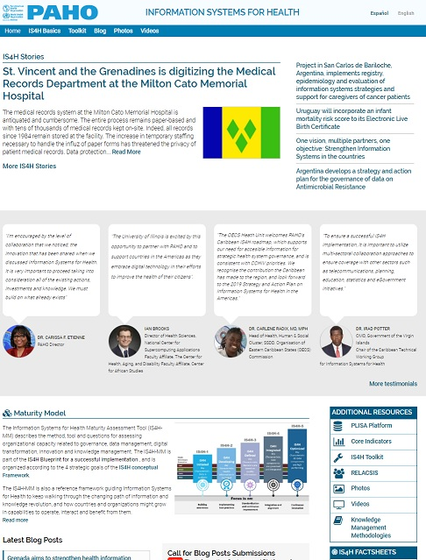
IS4H Resources
Framework
Toolkit
Maturity Model
Factsheets
Links to additional resources
PAHO.org/ish

Slide 18

IS4H Maturity Model

Slide 19
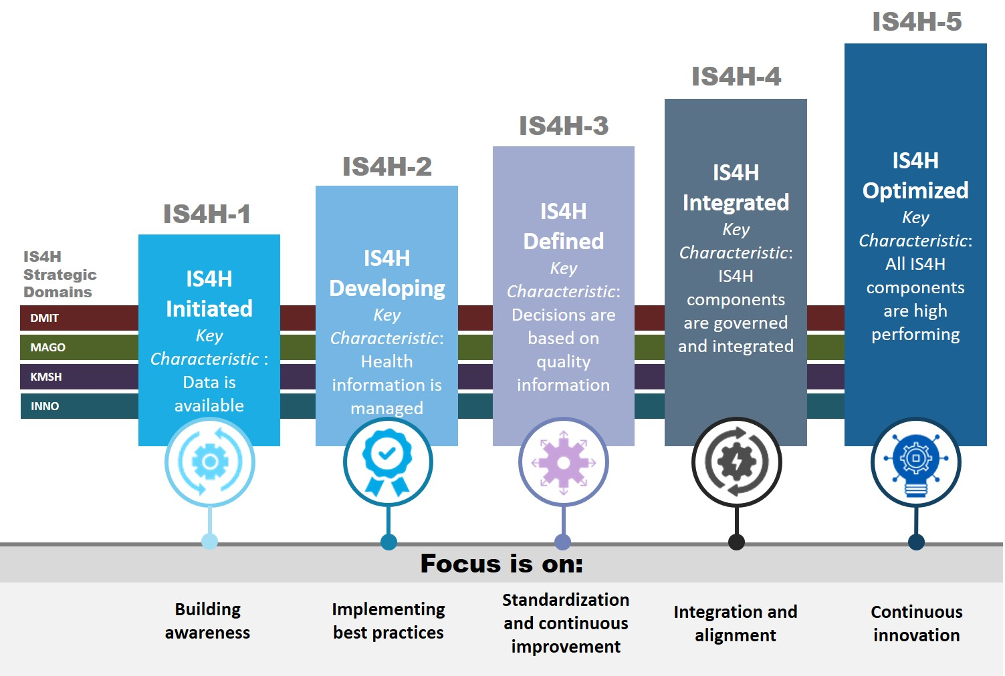
IS4H-Maturity Model
The IS4H-MM is a tool for assessing an organization's maturity level for Information Systems for Health.
Maturity is measured across the four strategic goals of the IS4H Framework.

Slide 20
IS4H-MM Purpose
Provides a benchmark of IS4H maturity against other health authorities in the Caribbean and Latin American Region
Provides the basis for establishing strategic priorities and work plans for IS4H capacity development
Provides input and focus for process improvement across the various IS4H domains
Provides a basis for ongoing monitoring of IS4H capacity and process improvement
How can the results of the IS4H-MM be used?

Slide 21
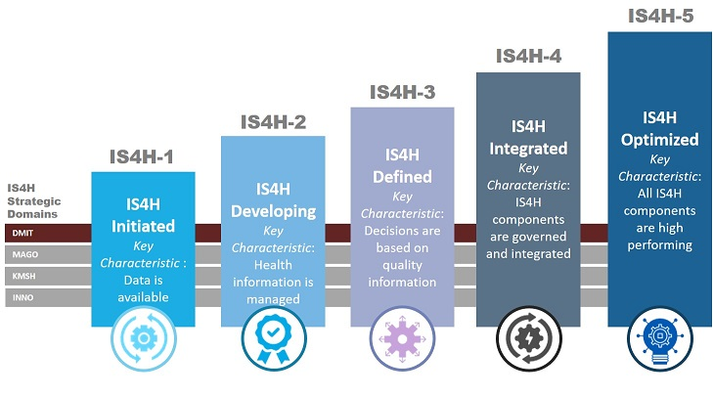
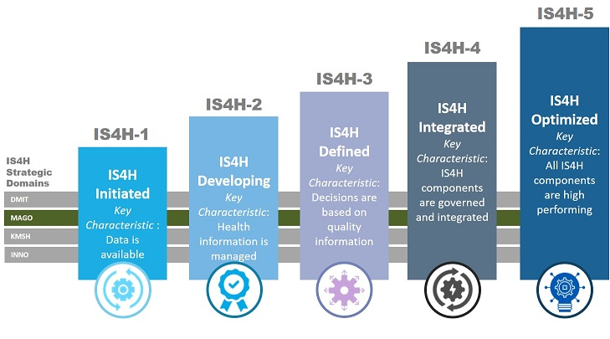
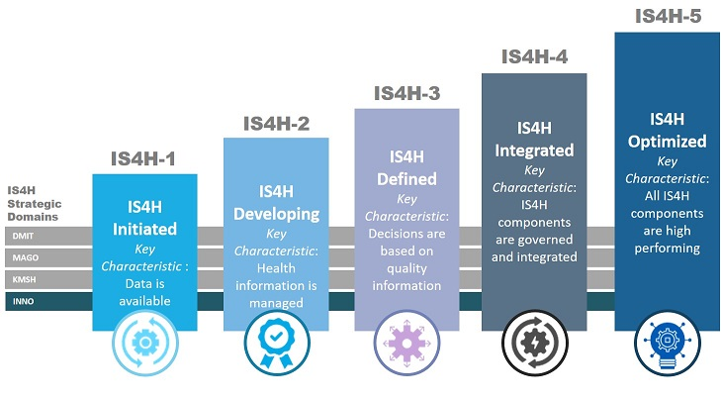
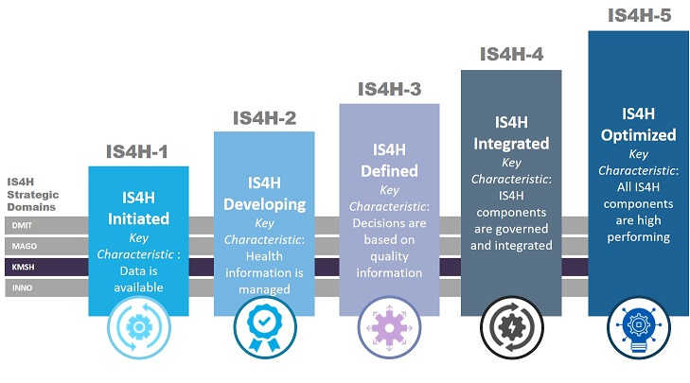
Maturity is measured over each COMPONENT of each STRATEGIC AREA

Slide 22
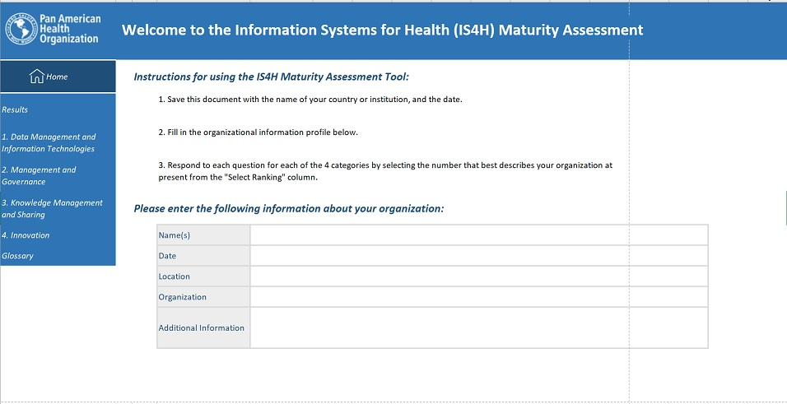
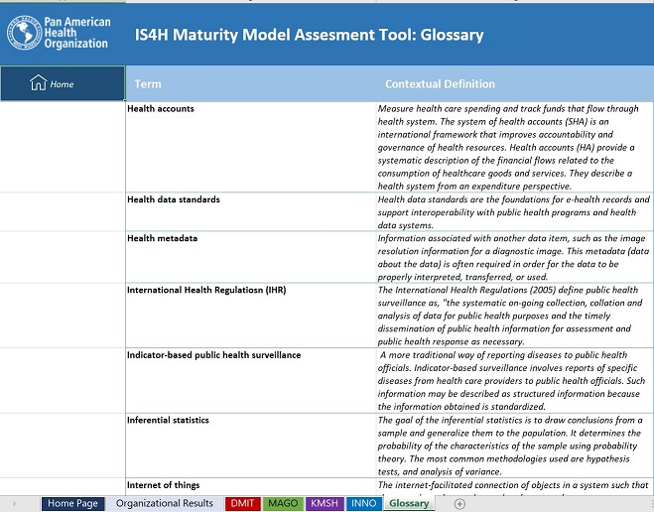
The tool
Home institutional data and guidance to complete
Glossary: of terms

Slide 23

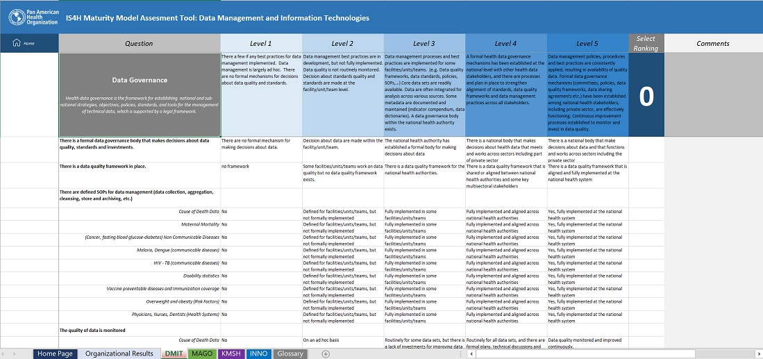
The tool
Questions Likert scale
Organized by strategic area
Organized by component

Slide 24
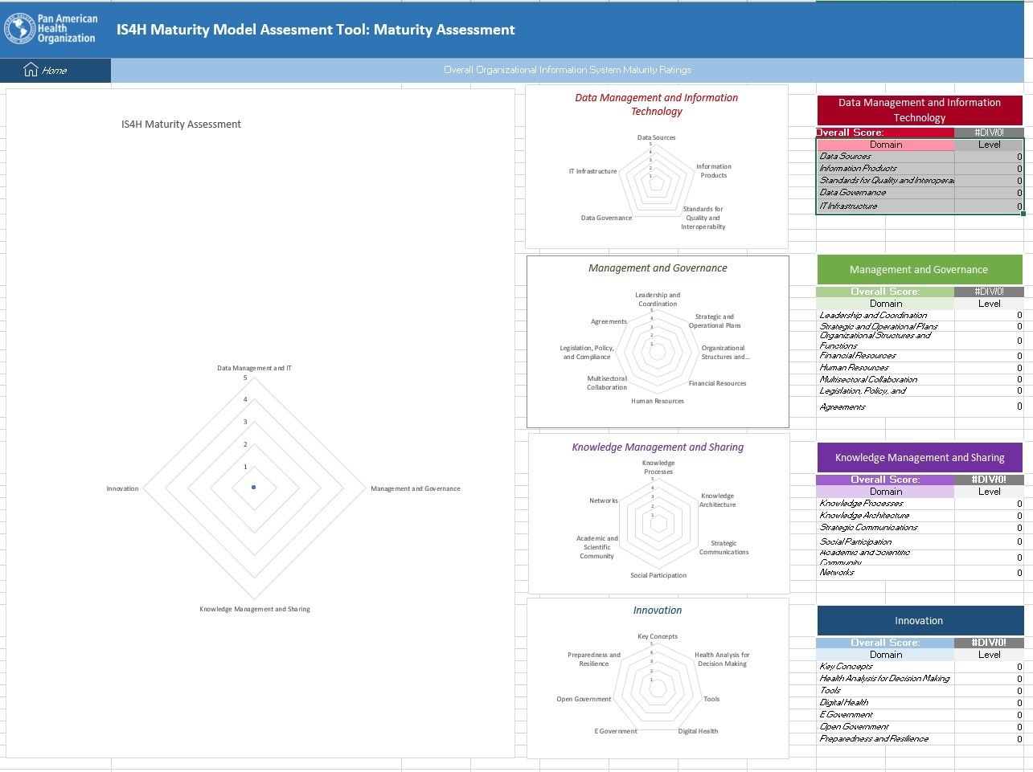
The tool: Results

Slide 25
IS4H-MM Purpose
Provides a benchmark of IS4H maturity against other health authorities in the Caribbean and Latin American Region
Provides the basis for establishing strategic priorities and work plans for IS4H capacity development
Provides input and focus for process improvement across the various IS4H domains
Provides a basis for ongoing monitoring of IS4H capacity and process improvement
How can the results of the IS4H-MM be used?

Slide 26

Thanks
This Photo by Unknown Author is licensed under CC BY-NC-ND

