Slide 1
Communication and behaviour: Using data to drive action
Webinar: Respiratory Pathogen Pandemic Preparedness and Response: Risk Communication – PAHO
Dr. Nina Gobat -- gobatn@who.int

Slide 2
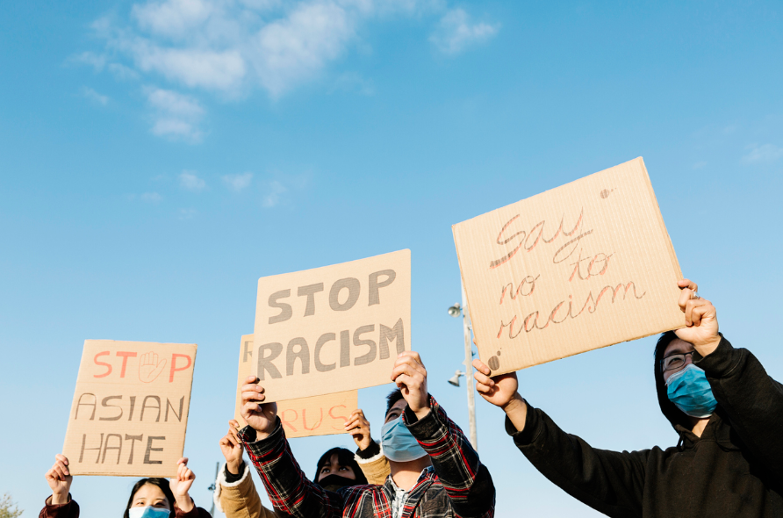
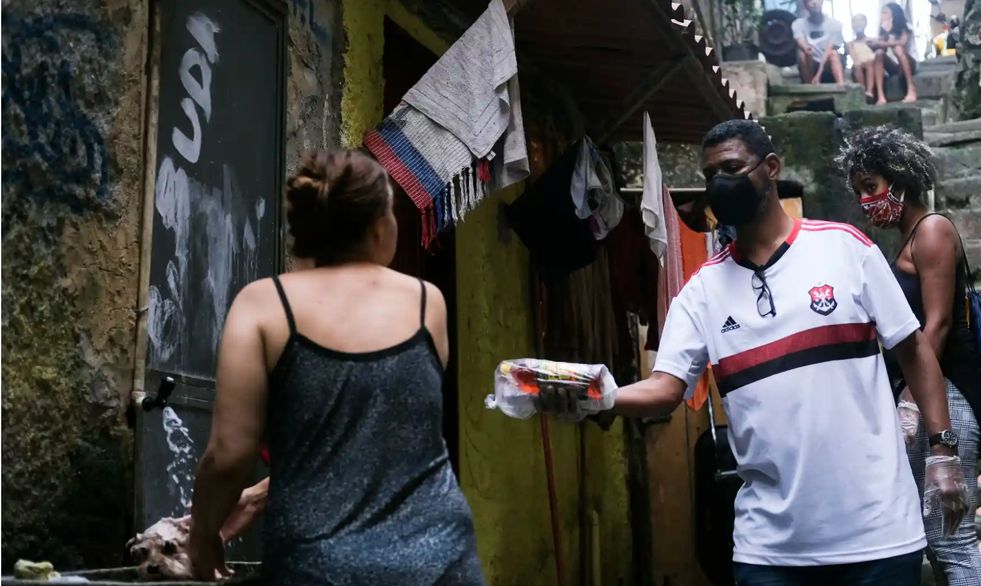
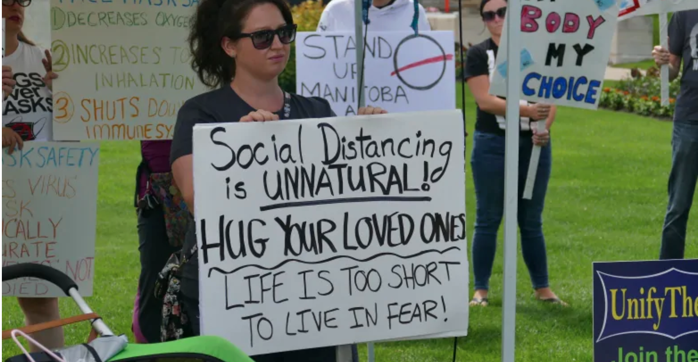
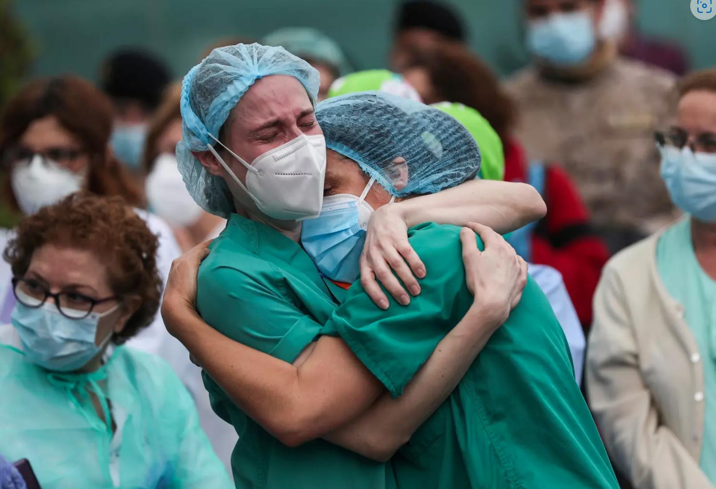
Notes:
Health emergencies are social events as much as they are biomedical
To
References:
Who bought all the toilet paper: Who bought all the toilet paper? Study suggests who was most likely to stockpile during COVID-19 (nbcnews.com)
COVID-19 protests: Covid protesters rally in Zurich and Lausanne - SWI swissinfo.ch
Canada protest: Protesters tell the Manitoba government they want the right to not wear masks | CBC News
Economic divide: COVID-19 exposes S. Africa's social and economic divide – DW – 06/09/2020
Aid donation to resident of Rocinha favela in Rio Rio's favelas count the cost as deadly spread of Covid-19 hits city's poor | Brazil | The Guardian
Health workers: 6 steps to protecting and supporting our healthcare workers | World Economic Forum (weforum.org)
Stigma: Study: Latinos, Asians Experience COVID-19-Related Discrimination - Salud America (salud-america.org)

Slide 3
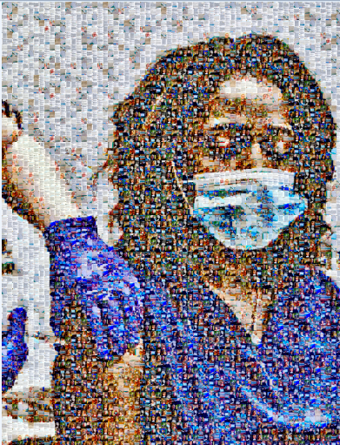
Notes:
Covid-19: Two hundred thank yous | The BMJ
Nathan Wyburn: Vaccination Art (cardiffandvale.art)

Slide 4
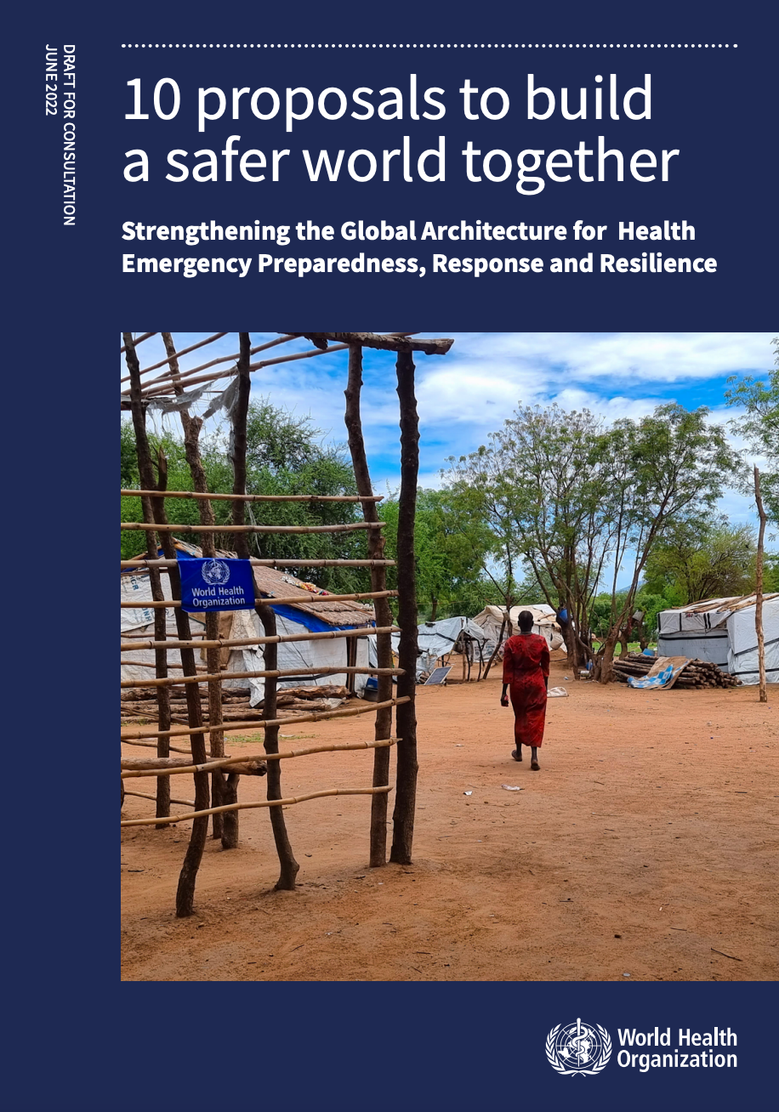
Global strategic frameworks and initiatives
Notes:
10 proposals to build a safer world together – Strengthening the Global Architecture for Health Emergency Preparedness, Response and Resilience: draft for consultation (who.int)

Slide 5
How to use behavioural science
WHAT WILL YOU USE DATA FOR?
To understand what is happening and what is needed
To co-develop a workable solution/ intervention
To assess how a solution is working – both intended and unintended impacts
HOW? METHODS
Quantitative, qualitative, mixed methods
Can be done rapidly, as a snapshot or over time
Innovative approaches to data collection and analysis during COVID-19
Notes:
Ref: Terry et al. Health Research Policy and Systems (2018) 16:116 Page 4 of 11

Slide 6
Getting ready…..
What do you need in your area of work to be able to access and to use behavioural data that can inform action?
What can you be doing now to make sure that in the next health emergency you will have the tools and technologies available to you?

