Slide 1
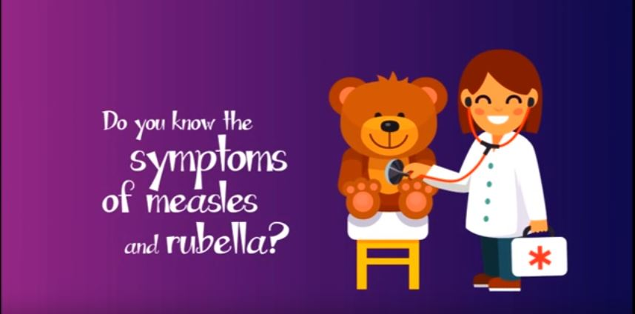
Symptoms of measles and rubella
In the following animated video, PAHO urges the community to be aware of measles and rubella symptoms, and to seek medical assistance immediately if symptoms occur. You can access the video here:
https://www.youtube.com/watch?v=z0SpTjDKO68

