Slide 1
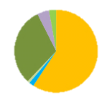
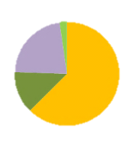
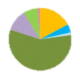
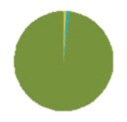
Measles Genotypes in the Region of the Americas, 2013-2015
CAN = 108
USA = 176
CAN = 51
CAN = 80
USA = 70
USA = 156
2014
BRA = 77
COL = 1
2013
BRA = 21
BRA = 122
Color code:
B3
D3
D4
D6
D8
D9
H1
2015
CHI = 1
Source: Sequences of N gene of measles virus reported to MeaNS by country.
Notes:
Title: Measles Genotype in the Region of the Americas, 2013-2015
Proportion of sequences of N gene of measles virus reported to MeaNS according with country.

