Slide 1
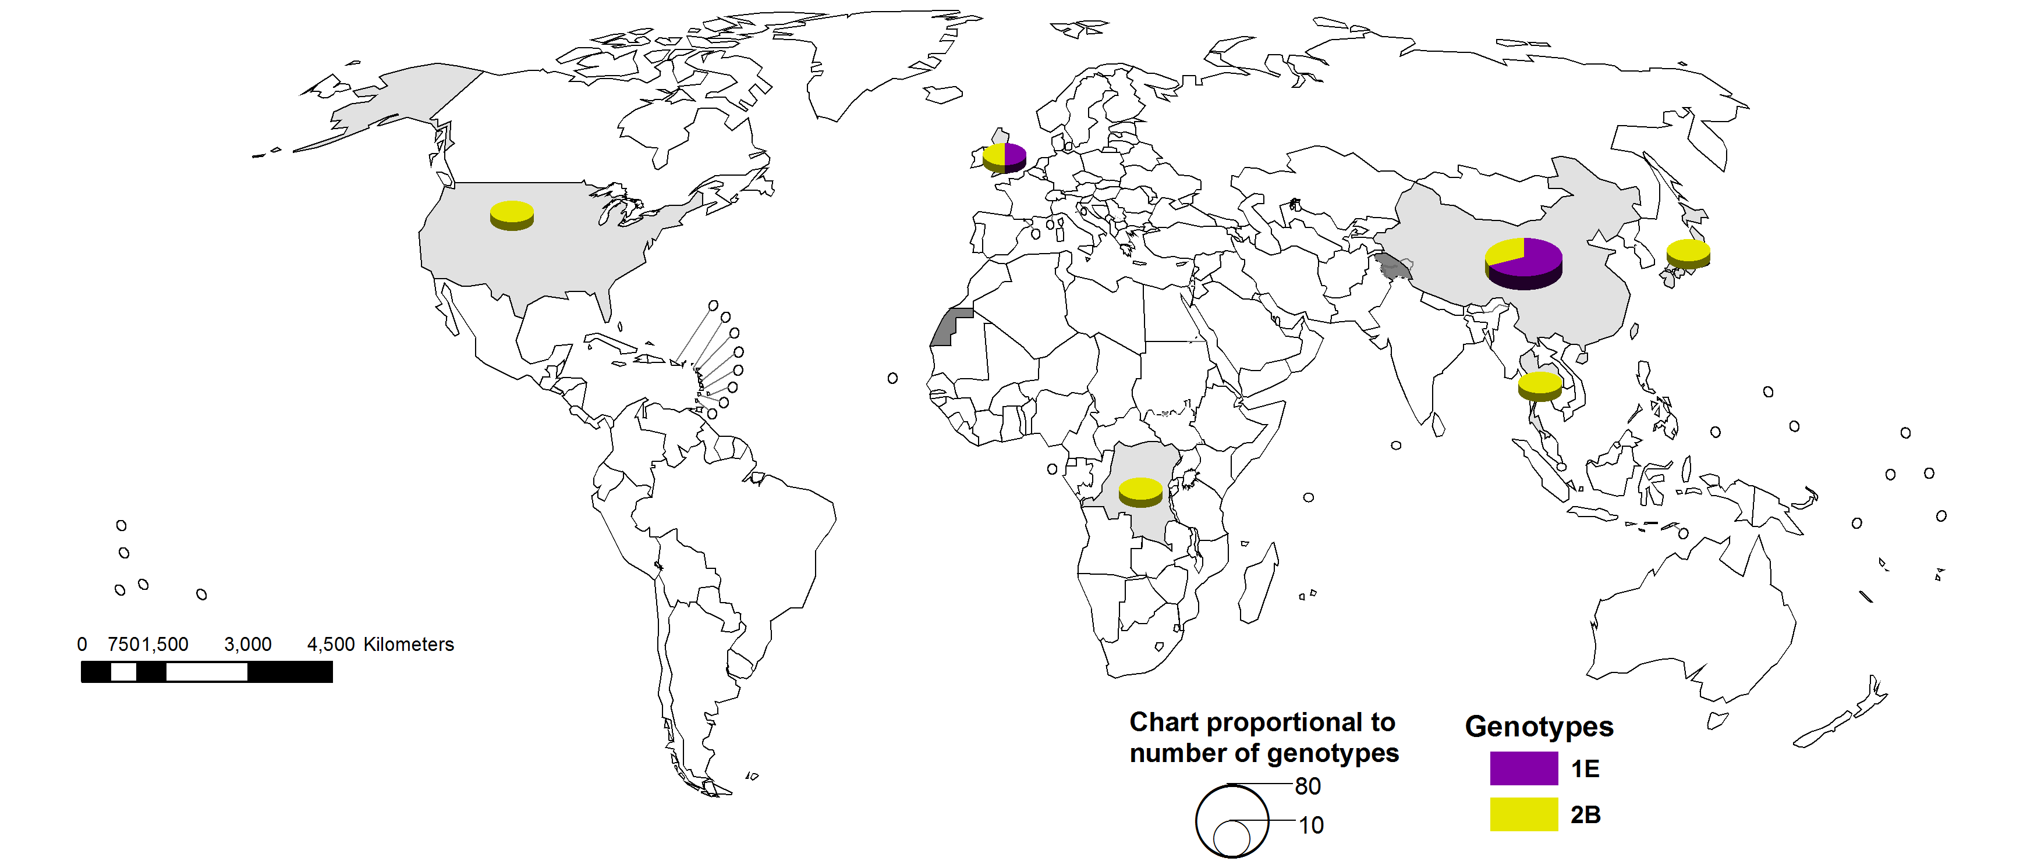
Distribution rubella genotypes (Oct 2012–Sep 2013)
Data source: RubeNS Database
Updated on 21 October 2013

