Slide 1
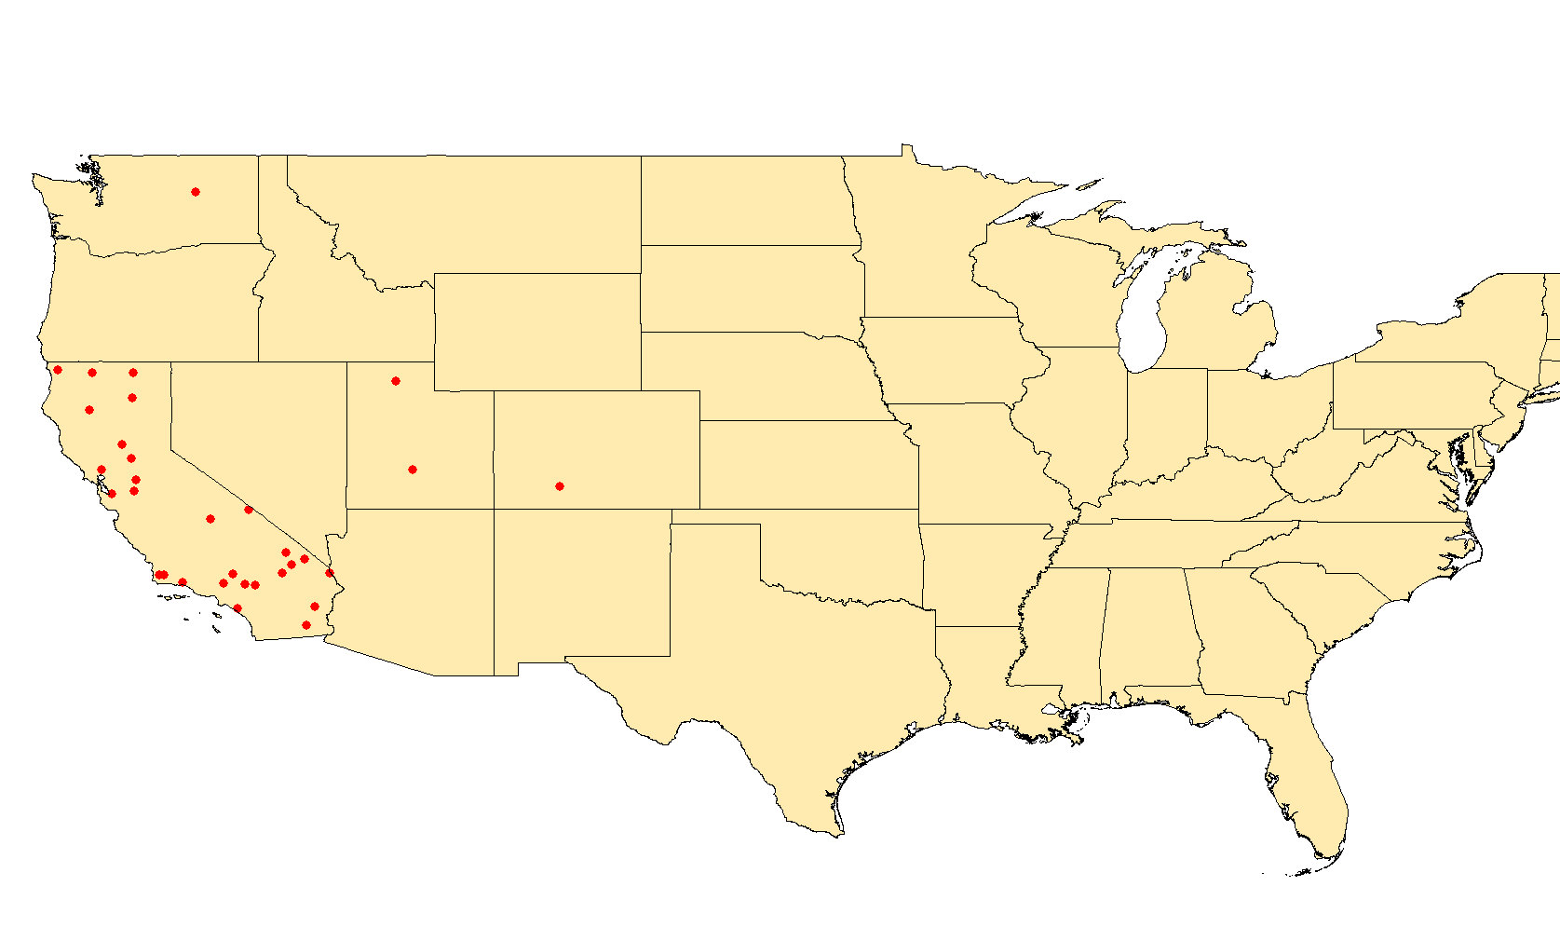
Confirmed measles case-cluster in California
United States, 2015*
Washington
1 case
Utah
2 cases
Colorado
1 case
California
28 cases
2015
N=32 confirmed cases
1 dot = 1 case
* Data as of 15 January 2015
Source: CDC report to FGL-IM/PAHO.

