Slide 1
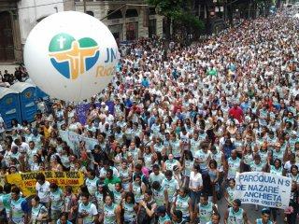
Preparation of health alerts to mitigate impact of importations
August 5-21,2016
September 7-18th, 2016
Notes:
In the post elimination era, the measles importations from people coming from other regions of the world are the biggest threats for maintain the elimination. The massive events in our region like deportive events: Cup of the world, massive church concentrantions, The World Games, etc need to be addressed for strenghentenign surveillance and vaccination coverage.

