Slide 1
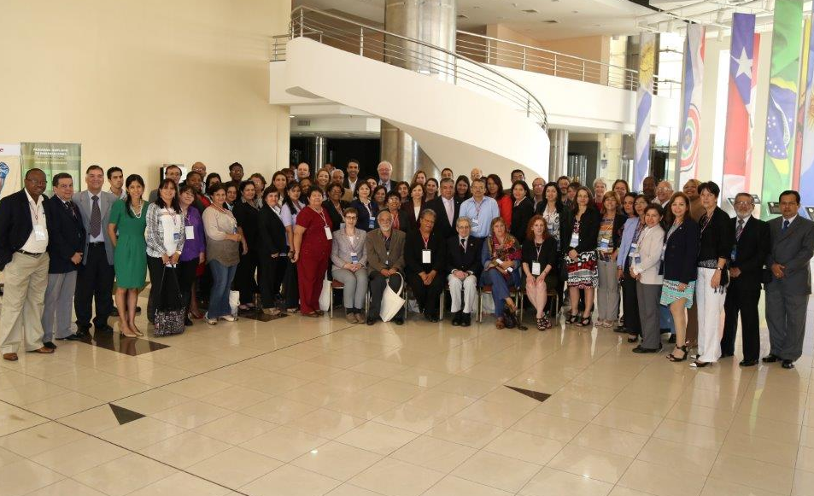
International Expert Committee (IEC) Meeting and National Commissions, Paraguay 2014

