Slide 1
Notes:
Social networking sites provide agencies and organizations with a new way to expand their outreach, establish a community experience for their audiences and provide personalized interactions. Facebook, flickr and Twitter, along with countless listservs, blogs and chats are Web environments where information about an organizations products and services can be shared and compared.
The National Institute for Occupational Safety and Health, as an agency, uses Facebook, Twitter (currently 7 sites), RSSready, Flickr, and YouTube for sharing ideas as well as wikipedia, blogs, and listservs.
PAHO uses these same sites, although PAHO has over 35 twitter sites which cover a variety of public health topics.
This talk focuses on the use of social media networking tools by government agencies and organizations in their role as authoritative sources of information.

Slide 2
Social Media in Worker’s Health
Starting a dialogue
Notes:
The objectives of this talk are to
Acknowledge the breadth of social media opportunities which are available
Reflect on NIOSH’s experience with selected social media paths
Review existing ways others are using social media in worker protection
Create a dialogue on the opportunities and challenges in our efforts to find paths for communicating messages for reducing work injury, illness, and death.

Slide 3
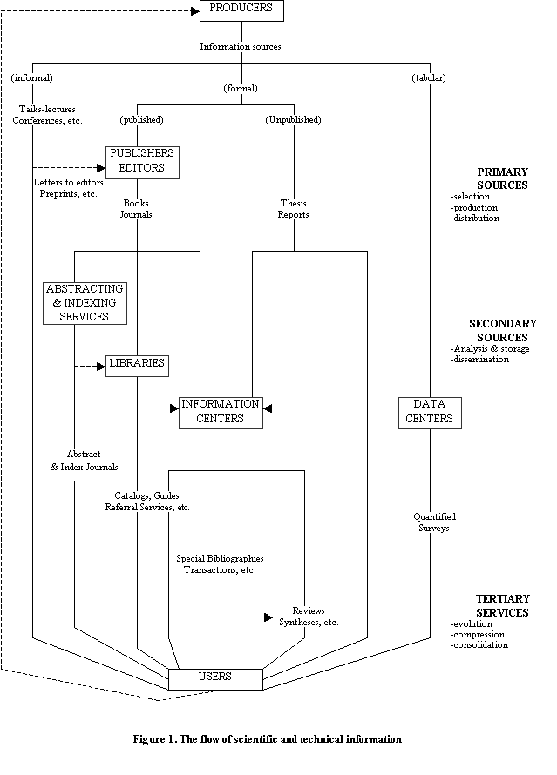
Information Dissemination Paradigm
Notes:
Social media, in the conventional sense, are media for social interaction, using highly accessible and scalable communication techniques. Social media is the use of web-based and mobile technologies (computer and cell phones) to turn communication into interactive dialogue. Blending of technology and social interaction for the co-creation of knowledge and understanding.
Historically social networking was top-down information sharing as can be seen in the 1971 model on the left hand side. Generally producers of knowledge generated information and through some informal and complex formal networks disseminated the information.
The slide on the right is from 2005 and reflects an emerging paradigm shift most clearly seen at the top and bottom of the diagram where the producers of information use “imports” and the users “export” suggesting information freely flowing in and out.
Björk, B-C. (2007). A model of scientific communication as a global distributed information system. Information Research, 12(2) paper 307. Available at http://InformationR.net/ir/12-2/paper307.html
Garvey, W. D. & Griffith, B.C. (1972). Communication and information processing within scientific disciplines: empirical findings for psychology. Information Storage and Retrieval, 8, 123-136.
Fjordback Søndergaard, T.; Andersen, J. & Hjørland, B. (2003). Documents and the communication of scientific and scholarly information. Revising and updating the UNISIST model. Journal of Documentation, 59(3), s. 278-320. http://www.db.dk/bh/UNISIST.pdf
Hjørland, B.; Fjordback Søndergaard, T. & Andersen, J. (2005). UNISIST Model and Knowledge Domains. In: Encyclopedia of Library and Information Science. New York: Marcel Dekker. Pp. 1-14. Online: http://www.dekker.com/servlet/product/DOI/101081EELIS120024989 (Only available for subscribers).
http://www.iva.dk/bh/core%20concepts%20in%20lis/articles%20a-z/unisist_model_of_information_dis.htm

Slide 4
Notes:
The good news is that in 2011 there are scores of options for interactive communications and many of them are free. Social media options can be used passively in that once the user joins a network information regularly “pops up” through the selected media. The joiner is sent messages. The user is then free to contribute to the discussion or not as experienced by Facebook, Twitter, wikis, listservs and blogs.
Alternatively users may not register to be in a particular conversation but rather seek out information when they need it as experienced through Google, webpages, and libraries.
The bad news is there are lots of options and we need to understand which are best for reaching our audiences.
What kinds of site do users look for?
A recent study conducted by… found that in a reversal from two years ago people now join or seek out sites where they believe they will get “reputable” information as oppose to their friends sites.

Slide 5
The right tool(s) for the message
The National Institute for Occupational Safety and Health uses social media as part of a strategic health communication plan to improve workplace health and safety.
Notes:
So what do we do with all of these opportunities?
The National Institute for Occupational Safety and Health has a mission to generate new knowledge in the field of occupational safety and health and to transfer that knowledge into practice for the betterment of workers. To accomplish this mission, NIOSH conducts scientific research, develops guidance and authoritative recommendations, disseminates information, and responds to requests for workplace health hazard evaluations.
All publications no matter the format (webased and print) are immediately communicated to stakeholders through:
Website
eNews listserv
Facebook
Twitter
NIOSHtic2-a data base of publications
For information about NIOSH we have
Website
Wikipedia definitions

Slide 6
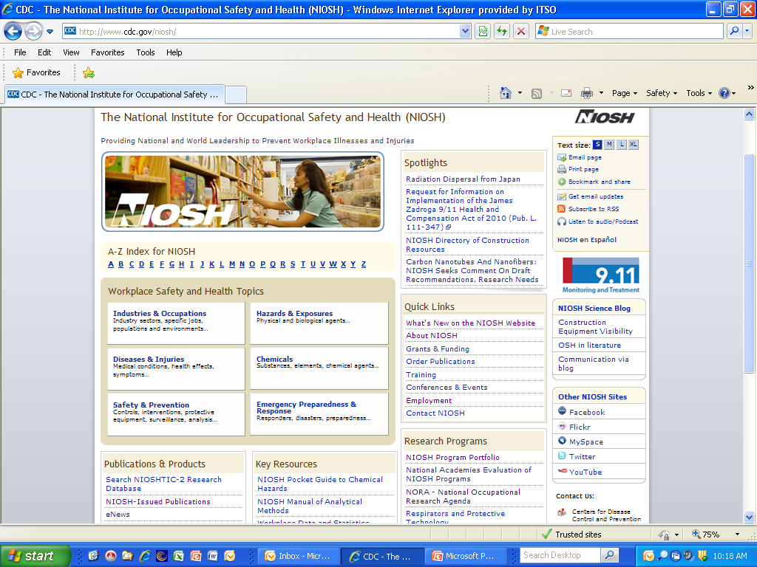
Notes:
NIOSH, like many organizations indexes social media options on the homepage.
NIOSH uses these particular social media paths for updating audiences on publications, highlights from conferences or meetings, to promote exhibit booth and presence at conferences, and to support health and safety campaigns.
Currently all of the NIOSH social media paths are in English.

Slide 7
Where does social media fit at NIOSH?
Facebook with 7,500 “likes”;
Twitter with 99,488 “followers” (in addition to seven subject specific accounts);
MySpace with 151 “fans”;
the Blog with 24,788 subscribers and
“eNews” with over 43,000 subscribers
Notes:
NIOSH is currently actively using these social networking sites to reach our diverse audiences with health and safety information.
In 2010, the communications office established a set of priorities to increase the Institute’s use in social media, expand reach, engage in new networks, and promote NIOSH program outcomes.
One person oversees clearance of ALL social media accounts and there are individuals who manage the content used on each of the social media sites.
What is our reach?
We know how many individuals we reach with each of our social media sites.
We know how many messages we generate
What is our impact?
This knowledge is evolving. We are considering measuring increases in website use following specific messages;

Slide 8
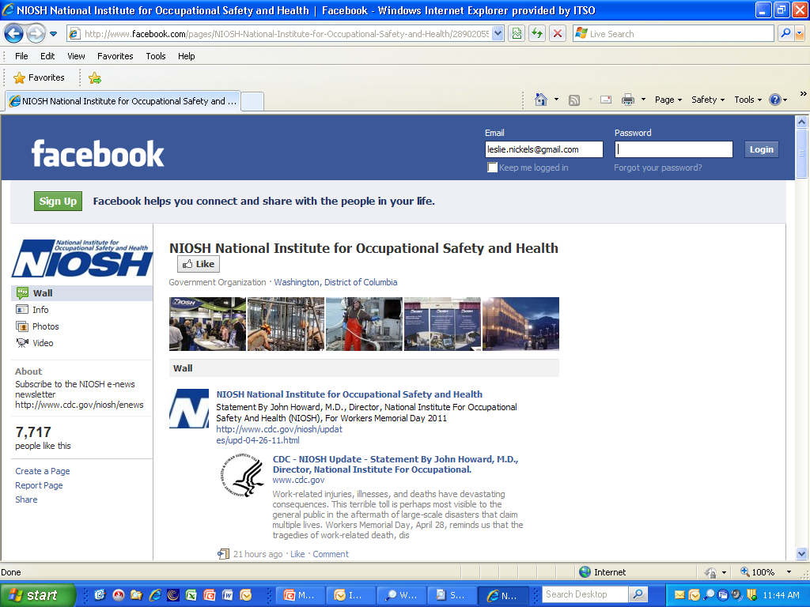
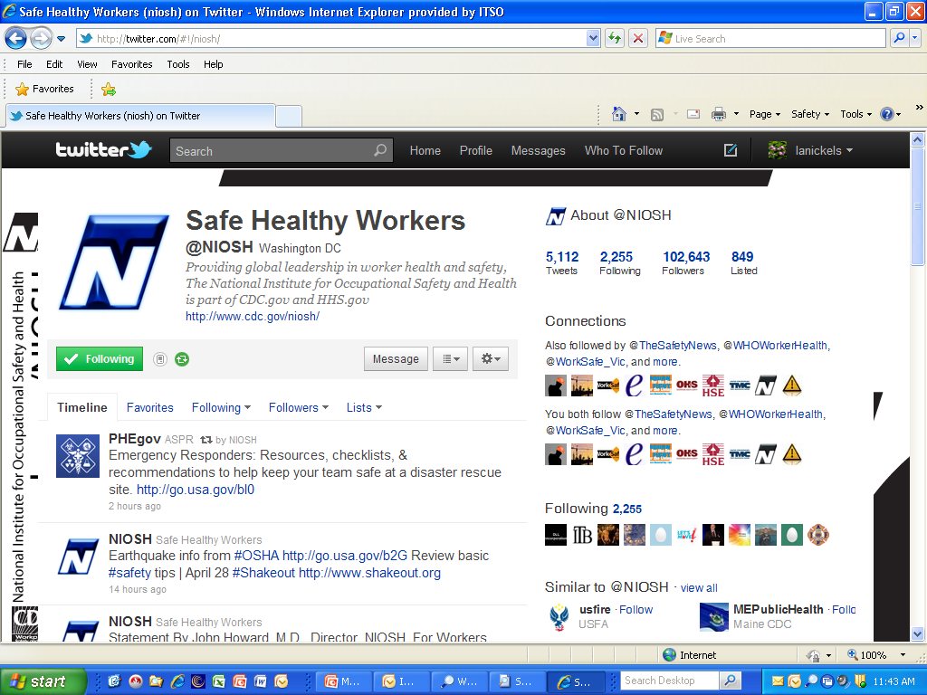
Notes:
NIOSH has one Facebook page and seven Twitter sites. The Facebook is content managed by one person. Each of the six of the twitter sites are content managed by one person and one twitter site, the newest on construction, is content managed by five people who rotate posting to the site. We have an emerging plan for evaluating the impact of these sites.

Slide 9
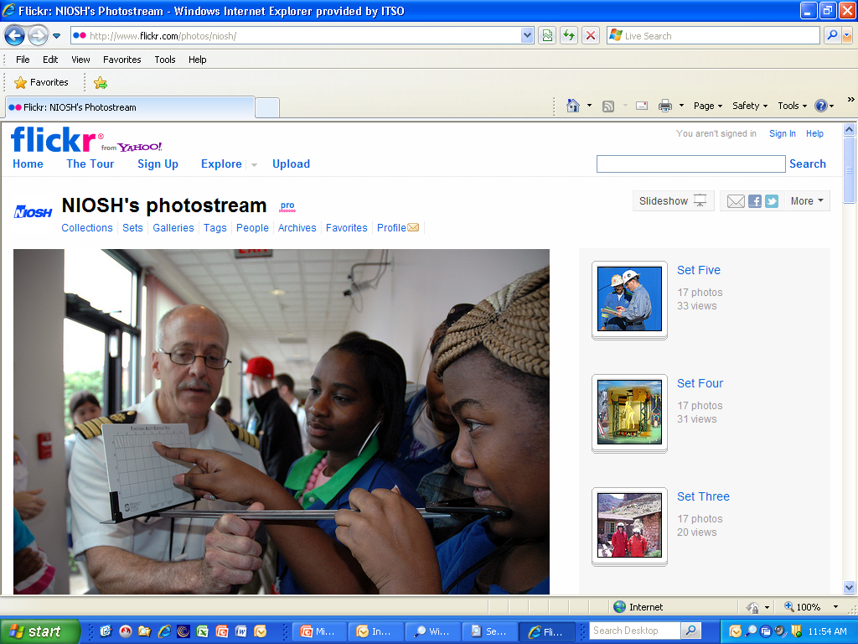
Notes:
In 2008 NIOSH developed a flickr site. To date NIOSH has over 800 photos. Almost 40 flickr users have marked one of NIOSH photos as their "favorite." We have never "marketed" our flickr page. The photos have been added to eight outside groups including ones called "Fishing Envy," "Road Rules Around the World," and "Safety Guru." This means are photos are included in groups where others interested in these topics may also find them. 36 people have added NIOSH as a "Contact" which means they are notified when we add new photos.
While these numbers seem small we are learning from this site ways to evaluate the impact of our other social media paths.
Currently we are reaching out to our partners to invite them to add pictures to this site and conducted an intramural photo contest called “NIOSH at Work” inviting NIOSH researchers and staff to submit photos which represent their vision of NIOSH.
Comment from a Flickr users (and photo)
"Great picture.....it helped tell our story. Thank you for sharing, we used this pic in an article about roadside worker safety." thedrivermagazine.com/2009/letter-from-th…-se ason-begin...

Slide 10
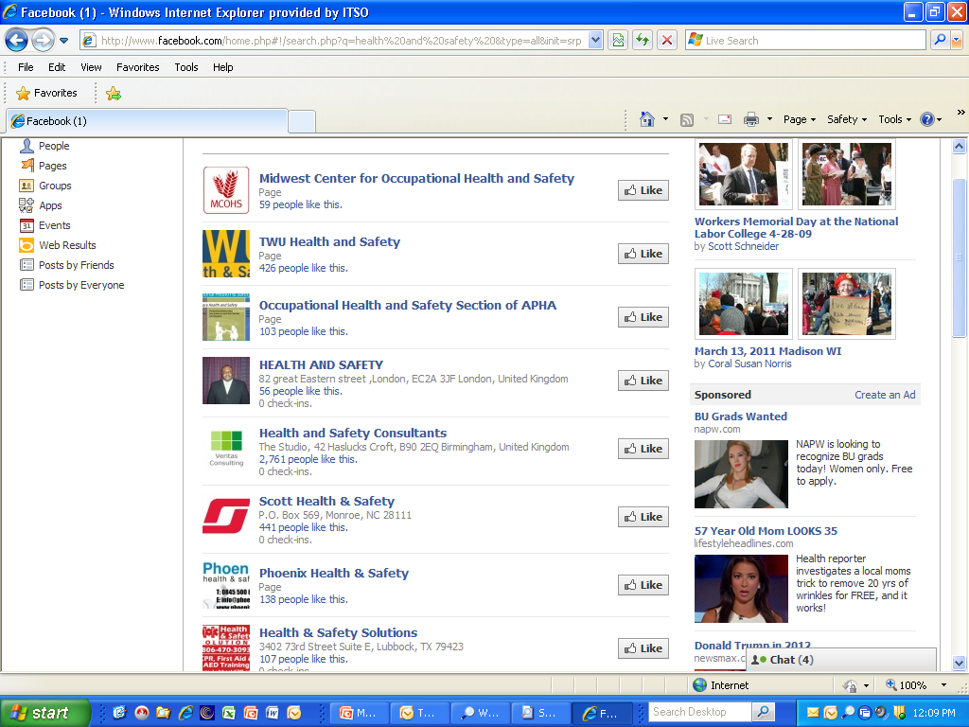
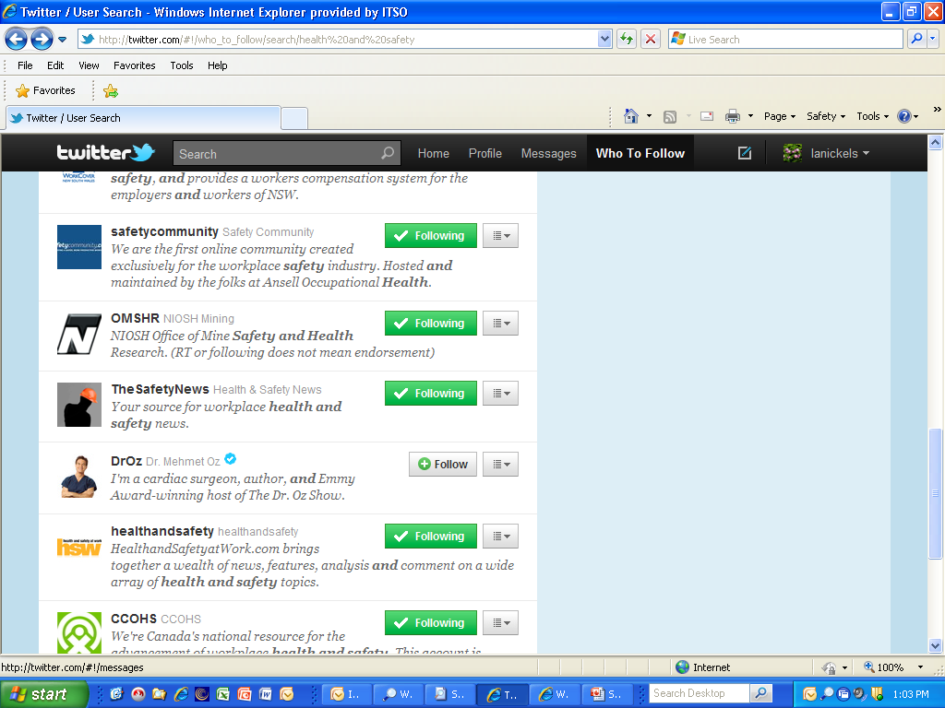
Notes:
Facebook health and safety groups from universities, governments, companies.
Twitter sites include government, trade associations, unions, universities.
Social media tool which is now being used by 100s of millions of people throughout the world. It is also a tool available to those concerned with worker health and safety to use as part of our information dissemination toolbox.
Facebook enables individuals and organizations to establish an interactive social environment for the exchange of information and ideas. Currently there are more than 600 million active users.
Twitter offers microblogging netwworking. Tweets are in real time and often are the leading edge in information. Twitter is estimated to have over 200 million users, generating 64 million tweets a day.

Slide 11
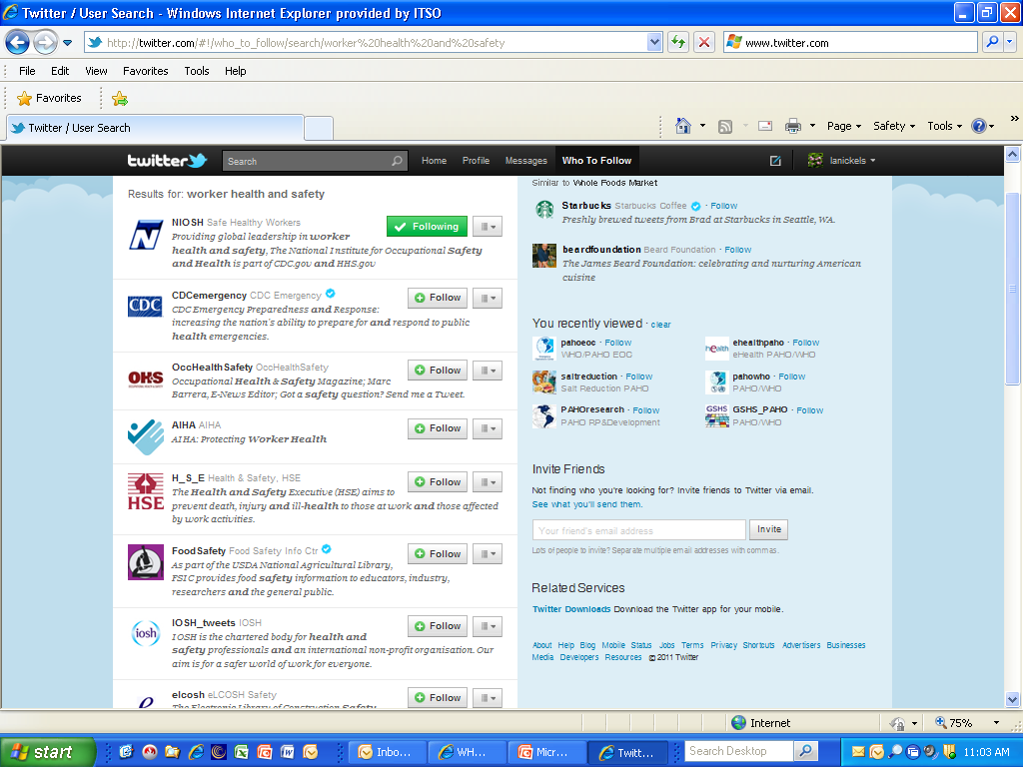

Slide 12
What was new on health and safety twitter sites on 26 April 2011
Forget me not-new Canadian book tells stories of workplace tragedies from families’ view
Snow is melting & you’ll see more construction on our roads. Slow Down ‘Cause My Daddy/Mommy Works Here’
Statement by John Howard, M.D., NIOSH for Workers Memorial Day 2011
Worker killed, seven injured in van rollover Investigation report of similar accident
Construction Worker Suffers Serious Head Injury at Fall at Chicago Water Plant
OSHA investigates death at Walmart
Report Urges Storing Spent Fuel, Not Reprocessing It
Who was Alice Hamilton? “first American physician to devot her life to the practice of industrial medicine”
Notes:
How do I use social media? This slide shows tweets from a variety of twitter sites on April 26th.

Slide 13
How do you use social media?
How many of you are “friends” with an occupational safety and health Facebook organization?
How many of you are “followers” of an occupational safety and health twitter site?
How many of you “tweet” health and safety messages?
How many of you are members of occupational safety and health listservs?

Slide 14
What are the barriers to you for using social networking as part of your health and safety outreach?
Too much information I don’t need
Prefer topic specific listservs
Twitter is more about personalities than trusted knowledge sources
Don’t know how to access or use
Too busy
Get information from World Health Assembly
Get training and have someone set up a site for you
Real time communication from colleagues in other offices
Provide daily communication on health and safety
Notes:
Best sites use social media for getting feedback and forwarding information to new networks like the Flickr example

Slide 15
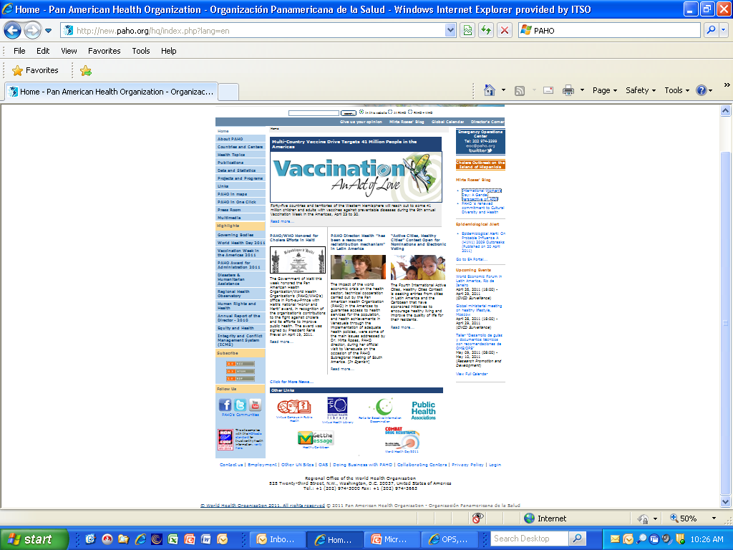

Slide 16
Notes:
More than 11 Twitter sites for PAHO. Most active site has 2, 599 tweets, 826 following, 4071 followers, and 346 list it is followed by
Least active site 31 tweets

Slide 17
Summary
Social media are “tools” in the communication “toolbox”.
Authoritative sources of information, like NIOSH and PAHO, need to be active in using social media in communication about health and safety
Reach out to your communications experts to help you find the social media tools which will work best to meet the needs of your audience

Slide 18
Other common social media we didn’t cover
Wikis
eLibraries
Geolibrary
Elcosh
Blogs
Thank you

