Slide 1
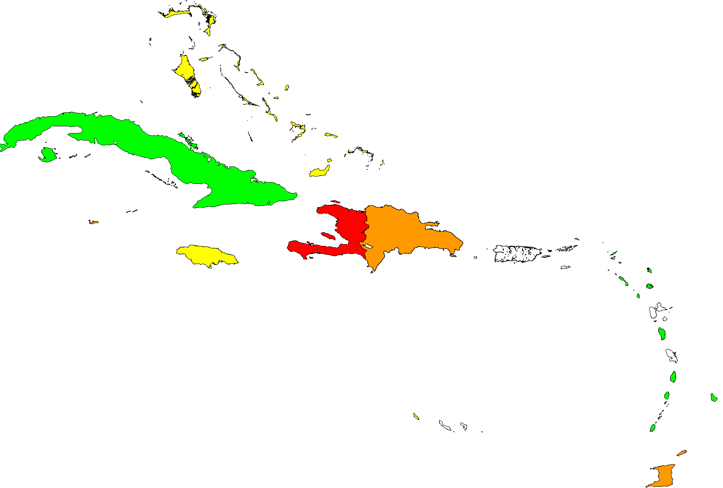
Reported MMR1 coverage in children aged 1 year*
Region of the Americas, 2015
Legend
Data not available
<80%
80-89%
90-94%
≥95%
* In Haiti, measles coverage in children <1 year of age.
Source: Country reports through the PAHO-WHO/UNICEF Joint Reporting Forms (JRF), 2016.

