Slide 1
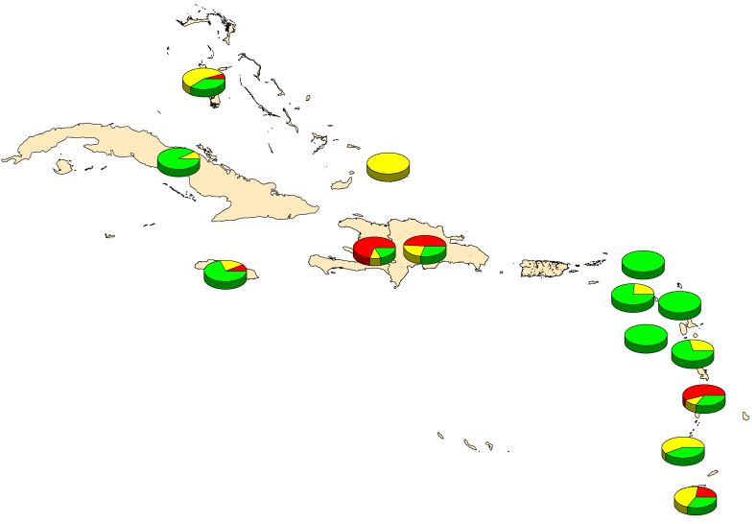
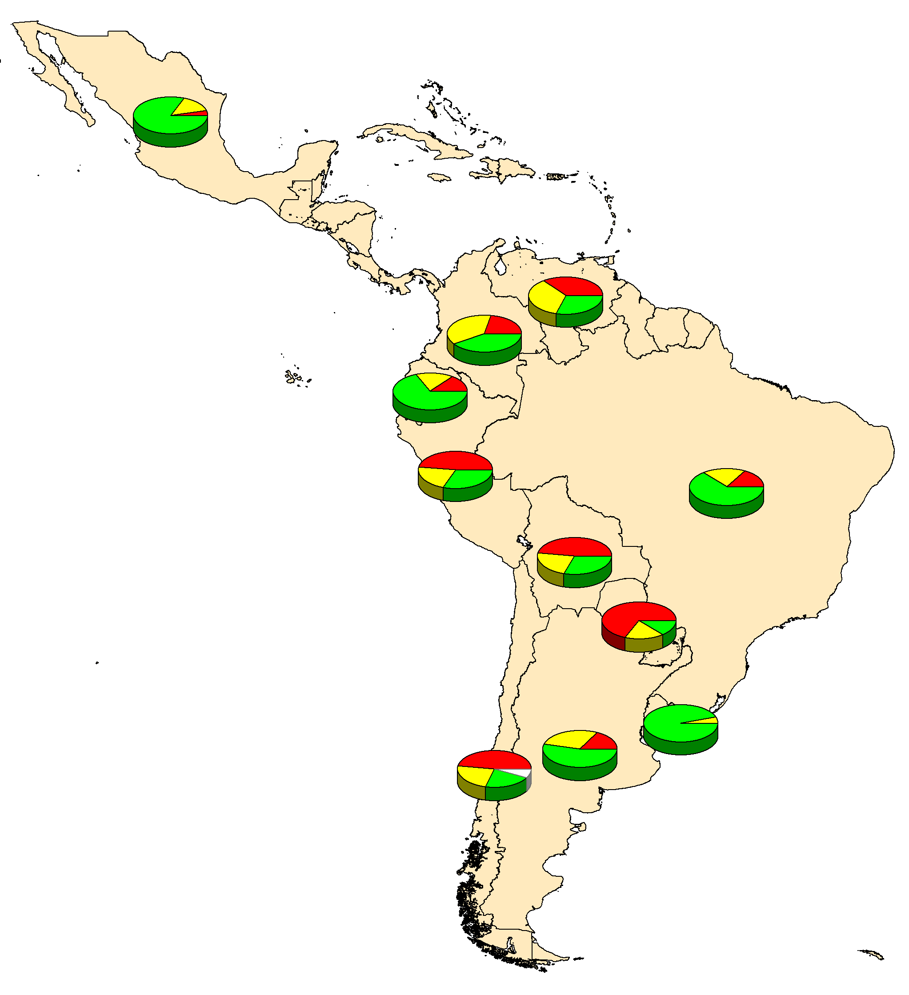
Proportion of municipalities with different
MMR1 coverage levels in children 1 year of age
Latin America* and the Caribbean, 2012
Coverage ranges
≥95%
80-94%
<80%
% non-reporting municipalities
Source: Country reports through the PAHO-WHO/UNICEF Joint Reporting Form (JRF), 2013.
* Mexico data provisional.

