Slide 1
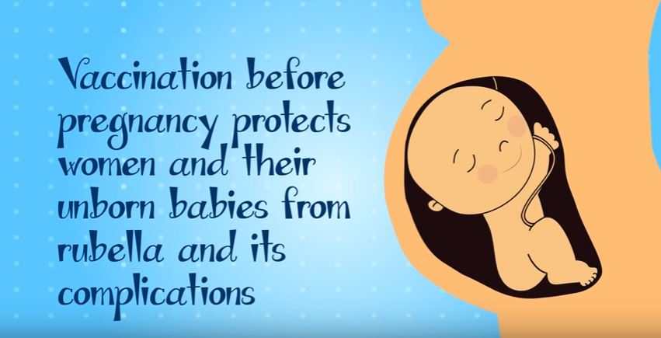
Get protected, not infected!
Continue with the series of animated videos, PAHO is encouraging vaccination against rubella before a women gets pregnant, to ensure the baby would not have congenital rubella syndrome.
You can access the video here:
https://www.youtube.com/watch?v=IY9TUY9u3YU

