Slide 1
System for Event Monitoring (SIME) © Pan American Health Organization, 2013
Background and Overview

Slide 2
Background
To support Member States in fulfilling their commitments under the IHR, PAHO/WHO and the MoHs of Brazil, Canada, Chile, Colombia, and Dominica joined efforts to develop and adapt a software-tool to facilitate the event based surveillance
The tool is named the System for Event Monitoring (SIME, per its acronym in Spanish)
Initial phase: SIME desktop version
In 2012, based on feedback of several countries, the software was developed into a web-based version
By September 2013, the online version was finalized and made available to Member States for use in event-based surveillance

Slide 3
SIME - Overview
The web-based version of SIME:
Is designed for open distribution
Has the flexibility to allow each country to modify it as necessary for national use
Generates a database from the information entered which permits maintaining a historical record and facilitates corresponding analysis
The original design was inspired by the “Event Management System (EMS),” an information management system designed by the World Health Organization (WHO)

Slide 4
SIME - Overview
The web-based version of SIME:
Is secure; access to the system can only be granted by the designated system administrator. Each country is responsible for the designation of their SIME administrator. In addition to featuring universal security standards, each country may incorporate additional security features to the system, in accordance to their laws.
It has different levels of user access according to the needs of each country, the system administrator can grant a variety of different access levels including: full access, viewing only access, data modification access, among others.

Slide 5
SIME - Overview
SIME is a software designed to complement existing national surveillance systems and/or, as needed, is designed to replace them.
SIME is available and may be operated in the following languages: English, Portuguese, and Spanish.

Slide 6
SIME - Overview
This software was designed under a GNU license, which enables adaptation and changes to the system, allowing each country to modify as needed and share the modifications.
For security reasons, only persons authorized with access to SIME by their respective country, will be able to login to the system.

Slide 7
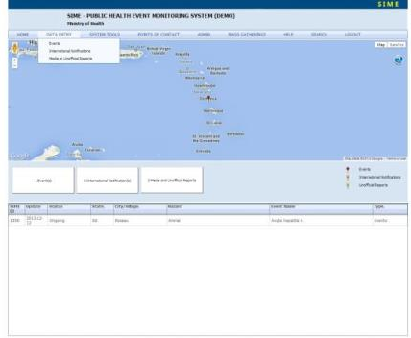
SIME - Overview
While changes to the software are possible, for the purpose of maintaining the ability to compare information between countries, irrespective of the types of adaptations made for national purposes, use of a common terminology in the database and in the evaluation of events is highly encouraged
The User’s Manual includes a glossary of terms, for the purpose of standardizing concepts use and being able to compare data

Slide 8
SIME - Overview
SIME was designed in the context of the IHR and therefore incorporates terminology and concepts therein.

Slide 9
SIME web-base - Overview

Slide 10
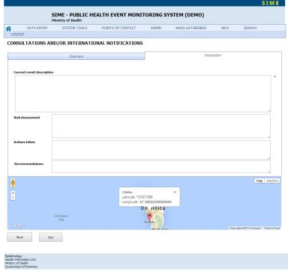
SIME web-base - Overview

Slide 11
SIME - Installation and implementation
The Pan American Health Organization (“PAHO”), World Health Organization (WHO) Regional Office for the Americas holds all intellectual property rights in the SIME Software. PAHO/WHO will grant permission to use the software with acceptance of the terms and conditions.
For additional information, installation, and implementation inquiries, please contact:
ihr@paho.org

Slide 12
Situational Awareness within Canada’s Health Portfolio The Global Public Health Intelligence Network (GPHIN)

Slide 13
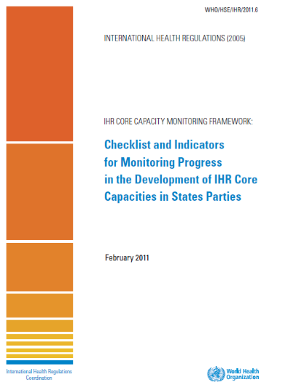
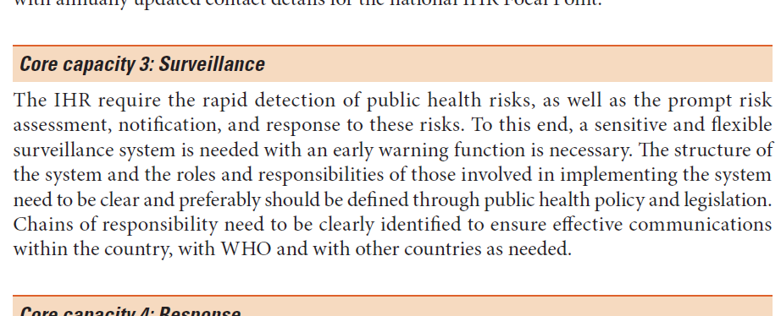
GPHIN & The IHR Core Capacities

Slide 14
The Global Public Health Intelligence Network (GPHIN)
GPHIN started in 1997 in collaboration with the WHO as a global network of public health professionals for situational awareness and early detection of emerging public health threats
It has evolved to become a national & international public health intelligence system which includes event-based surveillance
Unique machine-human interaction
Based on access to a variety of open source media information
Nine working languages
Key source of early-warning information and risk assessment

Slide 15
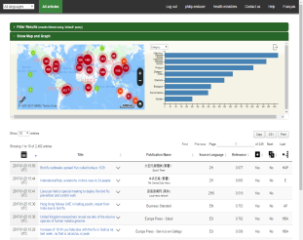
GPHIN – Overview
Detect, verify, assess and communicate
Situational awareness and early warning
Global all-hazards approach
Analysts
Multidisciplinary & Multilingual
Web-based Tool

Slide 16
GPHIN – Data Validation
Media
Web searches
Other systems
Network
Experts
Official Sources
Program Areas
Multidisciplinary team
Multicultural team

Slide 17
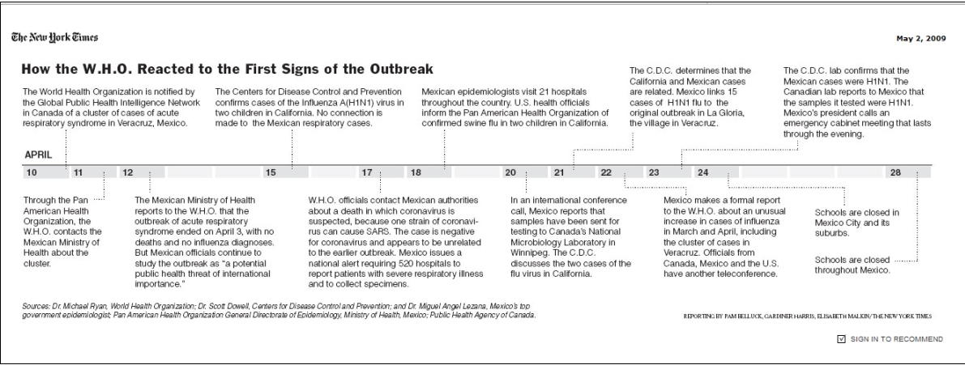
GPHIN – A(H1N1)

Slide 18
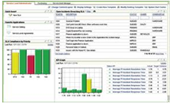
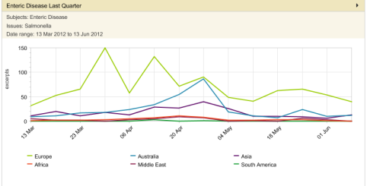
GPHIN – Future Enhancements
Dashboard Reporting
Social Media
Spatial Intelligence
Metrics & Analytics
Improved Algorithms

Slide 19
Thank You
merci – muchas gracias – obrigado
شكرا – مرسي – спасибо – 谢谢 – 謝謝
Health Security Infrastructure Branch
Centre for Emergency Preparedness & Response
Office of Situational Awareness and Operations
Global Public Health Intelligence Network
GPHIN-RMISP@phac-aspc.gc.ca

Slide 20
Pan American Health Organization / World Health Organization. Multilateral IHR NFP Strengthening Workshop Toolkit. June. Washington, DC: PAHO/WHO; 2017

