Slide 1
Monkeypox – UK 2022
Sanjay Bhagani
Royal Free Hospital/UCL, London
EACS

Slide 2
London: 4 men who self-identify MSM – unlinked to each other/previous cases
London/NW: 11 Men, unlinked to each other.
Links to London/Spain
London: Female
Returned from Nigeria
7 May
16 May
21 May
14 May
18 May
23 May
London/NW/Scotland: 32 Men.
Links to London/Spain
London: Family of three
No travel or link to case 1
London: 2 Men,
MSM, via sexual health clinics

Slide 3
UK since May 2022
>500 cases
Almost exclusively GBMSM
Age range 20-60 (median 38yrs)
~20% PLWH
Often multiple partners with links to sex-on-premises venues, sex via dating apps, private sex parties
Concomitant STIs – gonorrhea, syphilis
Presentation via Sexual Health clinics

Slide 4
UKHSA definitions: (https://www.gov.uk/guidance/monkeypox-case-definitions)
Possible case
A person with a febrile prodrome† compatible with monkeypox infection where there is known prior contact with a confirmed case in the 21 days before symptom onset.
Or, a person with an illness where the clinician has a high suspicion of monkeypox (for example, this may include prodrome or atypical presentations with exposure histories deemed high risk by the clinician, or classical rash without risk factors).
Probable Case
A person with an unexplained rash on any part of their body plus one or more classical symptom or symptoms of monkeypox infection¥ since 15 March 2022 and either
-exposure to a confirmed or probable case in the 21 days before symptom onset
-history of travel to West/Central Africa in the last 21 days
-gay, bisexual and other men who have sex with men (GBMSM)
† Febrile prodrome consists of fever ≥ 38°C, chills, headache, exhaustion, muscle aches (myalgia), joint pain (arthralgia), backache, and swollen lymph nodes (lymphadenopathy).
¥Acute illness with fever (>38.5°C), intense headaches, myalgia, arthralgia, back pain, lymphadenopathy.

Slide 5
Current isolation/admission criteria
Cases
Gp A: Admit for management if symptomatic, immunocompromised, pregnant women and pre-school children (<6 years)
Gp B: Admit for isolation: if vulnerable adults/children in household, unable to ‘isolate’ (shared room, facilities, etc)
Gp C: Self-isolate (separate bedroom)
https://assets.publishing.service.gov.uk/government/uploads/system/uploads/attachment data/file/1077329/20220520_monkeypox-contact-tracing-classification-and-vaccination-matrix.pdf

Slide 6
UK– Hospital Admission
Negative (or neutral) pressure side-room
Ideally with ante-room for donning/doffing
Designated HCID centres for symptomatic patients
Staff PPE
FFP3 (or equivalent) and visor
Fluid-repellent long-sleeved gown and disposable apron
Gloves
Dedicated footwear
Category A waste

Slide 7
Clinical experience (RFH) – designated HCID Centre
Mostly mild illness
Febrile prodrome in about 70% but settles very quickly
Very few systemically unwell (secondary bacterial infections, proctatitis, urethritis and UTIs, tonsillitis)
No pneumonitis, encephalitis, multi-organ involvement
Mild-to-moderate elevations in serum aminotransferases
Presentations often to STI/dermatology clinics
?syphilis, ?disseminated GC, ?atypical HSV, ?VZV
Co-infections common
Gonorrhea, chlamydia, Syphilis, HSV re-activation
Many PLWH - but mostly well-controlled
Prolonged appearance of skin lesions and slow healing - ?HIV-associated

Slide 8
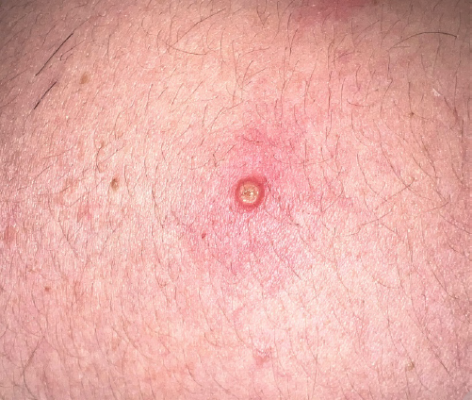
Images: Girometti, et al. Lancet Pre-print

Slide 9
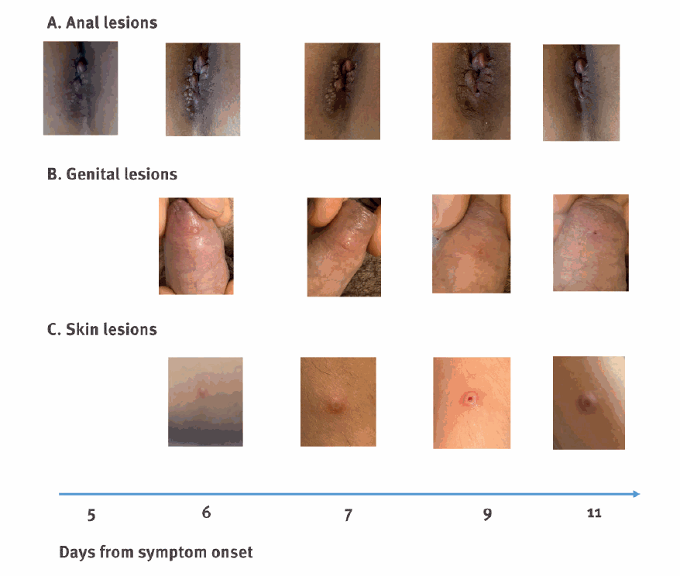
Antinori, et al. Eurosurveillence June 2022

Slide 10
Contact Designation:
Category 3
Direct exposure of broken skin/mucous membranes, body-fluids, contaminated clothing/bedding to a known case (without PPE)
Penetrating sharps injury
Offered MVA vaccine (<14 days), active monitoring, avoidance of close contact with ‘high-risk’ i.e. IS patients, pregnant women, children <6yrs
Cat 2
Not Cat 3, contact within 1 meter without appropriate PPE
Active monitoring, MVA vaccine (<14 days), and avoidance of contact with ’high-risk’ individuals
Cat 1
All others, including HCWs (>1m, or PPE), laboratory staff in appropriate BSL2 or above
Passive monitoring
HCWs with regular contact (ID, HCID staff) – pre-exposure vacconation
https://assets.publishing.service.gov.uk/government/uploads/system/uploads/attachment_data/file/1080878/monkeypox-contact-tracing-classification-and-vaccination-matrix-version-8-6-june-2022.pdf

Slide 11
Tecovirimat and MVA-vaccine
Tecovirimat licensed by the EMA for the treatment of smallpox, cowpox and monkeypox
Oral twice a day inhibitor of envelope-wrapping protein VP37
Good safety profile
Little human data on efficacy (x1 patient UK 2019)
Not licensed for monkeypox in the UK – early access programme
Current use: symptomatic patients, unwell, lesions+++
MVA-BN – non-replicating vaccinia virus vaccine
Licensed by MHRA for smallpox
Licensed by FDA for smallpox and monkeypox
‘Safe’ in PLWH (and other immunocompromised)
UK - pre-exposure prophylaxis for HCWs caring for patients with MPX
UK – contacts in cat 2/3 – ideally within 4 days of exposure (but for up to 14 days)

Slide 12
De-isolation:
De-isolation criteria
Clinical: clinically well, asymptomatic
Lab: negative PCRs in blood (if taken), throat swab and urine
Lesions: no new lesions >48hrs, all scabs fallen off, intact skin underneath
Discharge from Isolation Facility to another Hospital Ward/residential facility
Clinical, Lab and Lesion criteria
Continue isolation at home
Clinical criteria BUT not Lab or Lesion
Must not have contact with IS patients, pregnant women or children
Ending self-isolation at home (i.e. allowed to go out, but avoid contact with IS, pregnant women, children)
No new lesions for >48 hrs
No oral mucous membrane lesions
Skin lesions in exposed areas crusted, fallen off and with intact skin underneath
Other lesions need to be covered
Full de-isolation at home
Clinically well
No new lesions >48hrs, all scabs fallen off, intact skin underneath

Slide 13
Pertinent questions (discussion)
How do we engage our community to come forward for testing (and isolation) without stigmatization?
Do we need special measures for PLWH? (i.e. early treatment, prioritization for post-exposure vaccination?)
How do we protect our frontline HCWs (i.e. what PPE)
Is there really ‘sexual transmission’
i.e. seminal fluid/vaginal secretions once rash has resolved
Is there asymptomatic transmission?
Is efficacy of MVA-vaccine preserved in PLWH?
Will community tecovirimat reduce duration of Sx/infectiousness?

