Slide 1
PAHO's performance monitoring tool for national EPI teams
Template
Annex 1. Presentation for the National Coordination Committee

Slide 2
Agenda
Current status of immunization
Aim and objective of the tool
Different parts of the tool
Rating questions on a maturity scale
Key points to consider
Guide to conducting the assessment
Expected outputs

Slide 3
Current status of Immunization in Country xxx
DTP3 coverage rates, Country xxx
96%
-17%
Multiple factors have changed since the last EPI evaluation
COVID-19 pandemic
Introduction of the _ vaccine
Government structure
The health system’s legal framework
79%
2012
2022
Source:https://immunizationdata.who.int/compare.html?COMPARISON=type1__WIISE/MT_AD_COV_LONG+type2__WIISE/MT_AD_COV_LONG+option1__DTP_coverage+option2__DTP_PLUS_coverage&CODE=GTM+PER&YEAR=

Slide 4
The tool’s objective is to…
Self-assess performance of the national immunization program in the country across 13 EPI components using a comprehensive performance management tool to identify successes and gaps and set priorities for the program

Slide 5
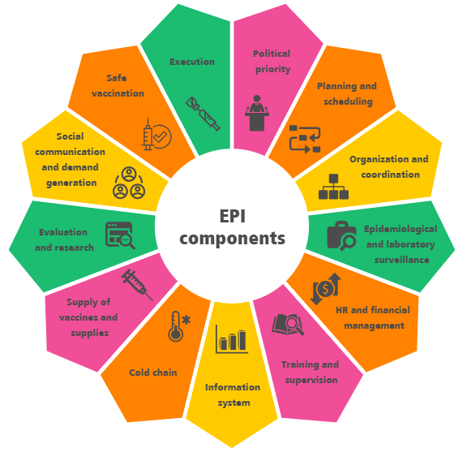
And it aims to…
í
To self-assess the performance of each component of EPI (as shown in the diagram)
Develop a national action plan for the improvement of EPI and to:
Prioritize the recommendations that require immediate intervention
Define the timeline for activities and budget required.
Determine if further assessment or support is required to address gaps in a specific component.

Slide 6
Purpose of the tool at the sub-national and local level
This tool aims to self assess the performance of national EPI and identify achievements and gaps in the program and promote improvement
At the sub-national and local level, the tool serves as means to validate the claims made at the national level
It allows to review local implementation, helping to confirm and supplement the national-level findings
The scores generated at the sub-national and local level do not contribute to the final assessment. They play a crucial role in informing and refining the national-level score by providing a more granular understanding of the program's performance

Slide 7
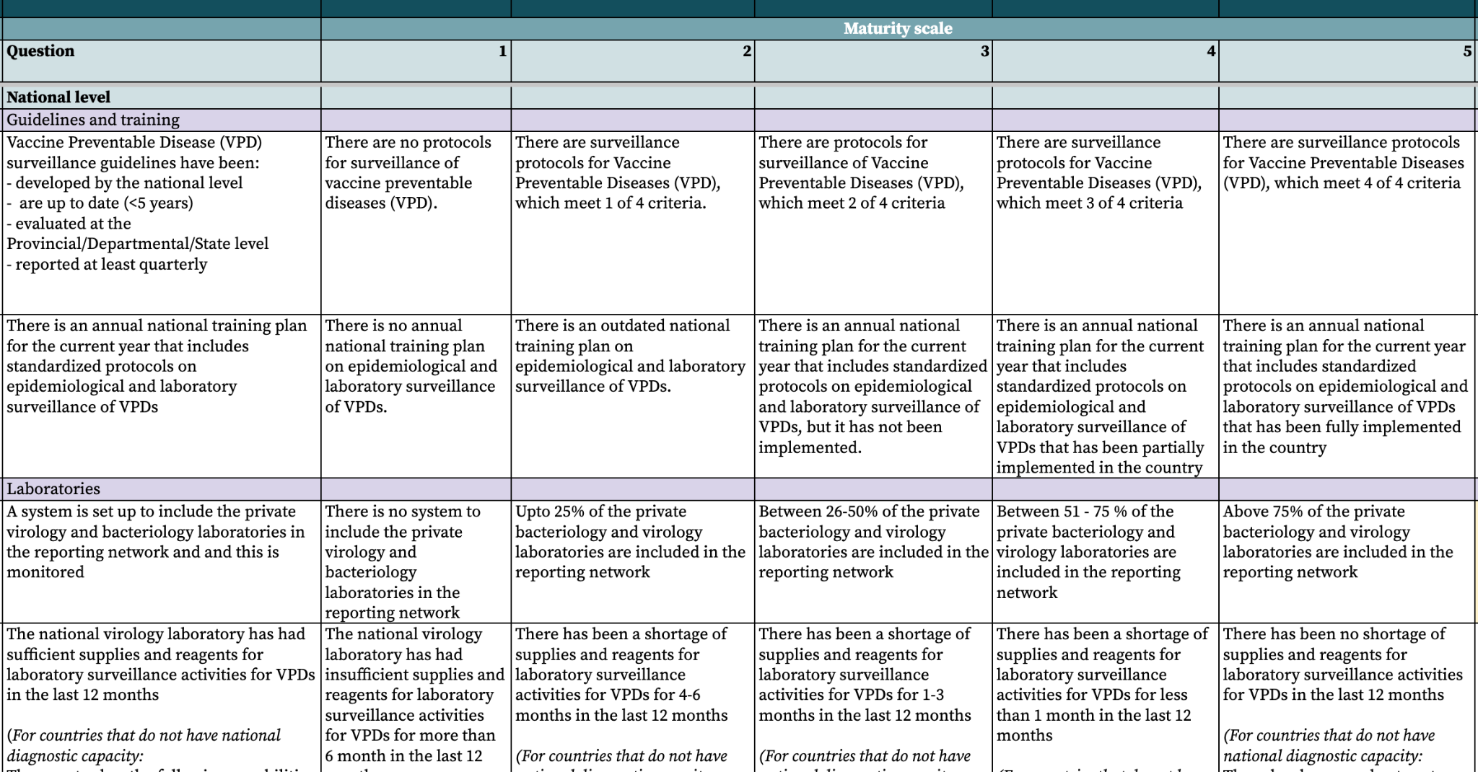
The tool has different four main parts to it
2. Five-point maturity scale
1. Questions
3. National/sub national level
4. Sub sections

Slide 8
And a total of…
196 questions across all components:
109 at the national level
67 at the subnational level
20 at the local level

Slide 9
The five-point scale helps to assess maturity across each question
LEVEL 1: INITIAL
LEVEL 3: DEFINED
LEVEL 5: OPTIMIZED
The available elements are implemented with the functionality of a routine system. Biases or problems are not recognized.
All elements are available, reliable, complete, up-to-date and implemented in a standardized and efficient way.
Insufficient or unavailable elements.
1
2
3
4
5
LEVEL 2: MANAGED
LEVEL 4: QUANTITATIVELY MANAGED
The available elements present problems of completeness, updating, their use is not appropriate.
All items are available, reliable, complete, up-to-date. And some biases/problems are known that can be improved.

Slide 10
There are four key points to consider when conducting the self-assessment
The tool is self-administered by the country
PAHO CIM advisors only provide support and technical clarifications. They do not provide recommendations to select a final rating
The tool is designed for self-assessment EPI and promoting improvement in the program. It is not intended to evaluate or pass judgment on the country's performance.
The maturity scale rating is not the primary focus; identifying the underlying causes of bottlenecks and achievements is what will aid the country's improvement.

Slide 11
The self-assessment will be implemented in three phases
Phase 1: Preparation
Nominate and onboard the members of the National Coordination Committee (NCT), with the PAHO consultant and the CIM focal point from the PAHO Country Office acting as secretariat
Draft and estimated budget for the EPI self assessment and finalize a date to conduct it
Conduct desk review by reaching out to stakeholders from different departments of EPI collecting relevant documents from the last 5 years
4. Review and match relevant documents to questions on the tool
5. Fill out the EPI situation analysis report to provide an overview of existing situation of EPI in the country
6.Present final situation analysis report to National EPI and PAHO
7. Prepare a situation analysis presentation based on the report
8. Adapt the self-assessment tool to the country context

Slide 12
The self-assessment will be implemented in three phases
Phase 2a: Implementation at sub-national and local level
Select three sub-national areas where the self-assessment can be conducted
Select three health facilities in each sub-national area for the field visit
Coordinate with the EPI officers of the three sub-national areas to gauge willingness to receive the field visits
Finalize dates of the field visits
Identify 1-2 persons from the national level to travel to the sub-national level to support the implementation of the assessment
Review components 2-13 with the sub-national level participants on the excel version of the tool.
Score each question and write brief notes detailing the reasons behind the scoring
Conduct field visit to self-assess component 14
Compile the scores for each question at the sub-national and local level into a single excel version of the tool. These findings will be used to inform the national-level self-assessment
Note: It is at the sub-national level's discretion to determine how many sub-national levels and health facilities can be visited

Slide 13
The self-assessment will be implemented in three phases
Phase 2b: Implementation at national level
Schedule the national-level self-assessment over five days - each component will be reviewed in a separate workshop
Identify participants to invite to each workshop and establish Workshop Facilitation Teams to lead the sessions
Conduct a simulation activity for the Workshop Facilitation Team to prepare for leading the workshops
Host an opening ceremony to introduce the tool to all participants
Conduct each workshop by engaging in discussions around the scoring for each question. Enrich the discussion by drawing on scoring and discussion points from the sub-national self-assessment
Conduct a debrief session with workshop facilitation teams and consolidate scores from each workshop into one excel file by the end of each day
Host a closing ceremony and summarize the key findings from the workshops

Slide 14
The self-assessment will be implemented in three phases
Phase 3: Follow up
Since finalizing the action plan may take a while, prioritize the identification of actions that can be implemented immediately
Present the final report with immediate actions to be taken to the national authorities
Develop an action plan for priority areas using actions discussed in the workshops
Present action plan to national authorities for approval
Implement the action plan
Finalize scores for each component using only the national level scores
(for countries where national level assessment happens before the sub-national assessment, finalize scores for each question after reviewing sub-national scores first. If there is a major discrepancy between the two, discuss the final national level score with NCT and include this insight in the final report)
Develop a final report based on insights and notes from the workshops
Identify priority areas from the different components for the country

Slide 15
This self assessment will yield five main outputs
1
Desk review:
To gather data on the performance of each component of the EPI over the last 5 years.
Situation analysis:
To provide a situation overview of EPI before the self-assessment is conducted
Performance Monitoring Tool:
Self-administered at the national and sub-national level and through field visits at the local level
Final report and presentation:
Description of the current status of each EPI components and recommendations.
Action plan
A plan to close the most urgent gaps of the national EPI.
2
3
4
5

