Slide 1
PAHO's performance monitoring tool for national EPI teams
Template
Annex 8B. Presentation for the subnational level

Slide 2
Agenda
Aim and objective of the tool
Different parts of the tool
Rating questions on a maturity scale
Key points to consider
Guide to conducting the assessment

Slide 3
The tool’s objective is to…
Self-assess performance of the national immunization program in the country across 13 EPI components using a comprehensive performance management tool to identify successes and gaps and set priorities for the program

Slide 4
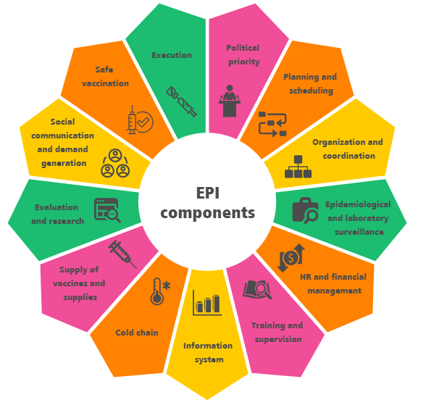
And it aims to…
í
To self-assess the performance of each component of EPI (as shown in the diagram)
Develop a national action plan for the improvement of EPI and to:
Prioritize the recommendations that require immediate intervention
Define the timeline for activities and budget required.
Determine if further assessment or support is required to address gaps in a specific component.

Slide 5
Purpose of the tool at the sub-national and local level
This tool aims to self assess the performance of national EPI and identify achievements and gaps in the program and promote improvement
At the sub-national and local level, the tool serves as means to validate the claims made at the national level
It allows to review local implementation, helping to confirm and supplement the national-level findings
The scores generated at the sub-national and local level do not contribute to the final assessment score. They play a crucial role in informing and refining the national-level score by providing a more granular understanding of the program's performance

Slide 6
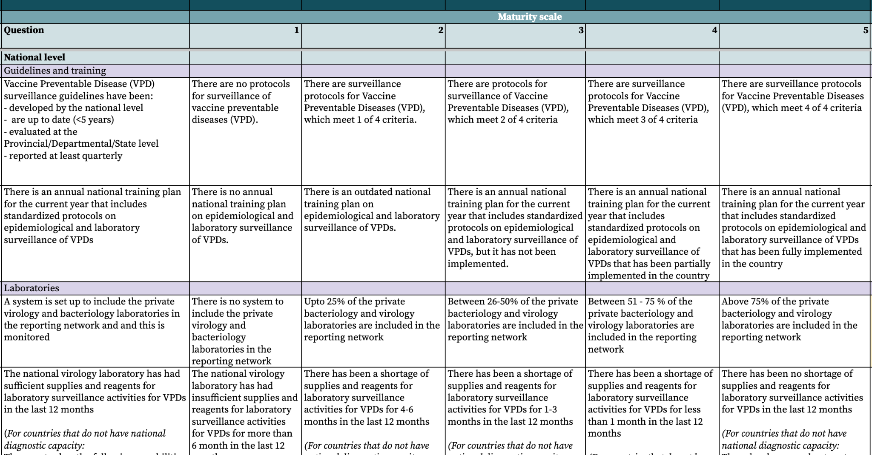
The tool has different four main parts to it
2. Five-point maturity scale
1. Questions
3. National/sub national level
4. Sub sections

Slide 7
And a total of…
196 questions across all components:
109 at the national level
67 at the subnational level
20 at the local level

Slide 8
The five-point scale helps to assess maturity across each question
LEVEL 1: INITIAL
LEVEL 3: DEFINED
LEVEL 5: OPTIMIZED
The available elements are implemented with the functionality of a routine system. Biases or problems are not recognized.
All elements are available, reliable, complete, up-to-date and implemented in a standardized and efficient way.
Insufficient or unavailable elements.
1
2
3
4
5
LEVEL 2: MANAGED
LEVEL 4: QUANTITATIVELY MANAGED
The available elements present problems of completeness, updating, their use is not appropriate.
All items are available, reliable, complete, up-to-date. And some biases/problems are known that can be improved.

Slide 9
There are four key points to consider when conducting the self-assessment
The tool is self-administered by the country
PAHO CIM advisors only provide support and technical clarifications. They do not provide recommendations to select a final rating
The tool is designed for self-assessment EPI and promoting improvement in the program. It is not intended to evaluate or pass judgment on the country's performance.
The maturity scale rating is not the primary focus; identifying the underlying causes of bottlenecks and achievements is what will aid the country's improvement.

Slide 10
The tool will be implemented in three phases. Phase two is related to the sub-national level
Phase 2a: Implementation at sub-national and local level
Select three sub-national areas where the self-assessment can be conducted
Select three health facilities in each sub-national area for the field visit
Coordinate with the EPI officers of the three sub-national areas to gauge willingness to receive the field visits
Finalize dates of the field visits
Identify 1-2 persons from the national level to travel to the sub-national level to support the implementation of the assessment
Review components 2-13 with the sub-national level participants on the excel version of the tool.
Score each question and write brief notes
detailing the reasons behind the scoring
Conduct field visit to self-assess component 14
Compile the scores for each question at the sub-national and local level into a single excel version of the tool. These findings will be used to inform the national-level self-assessment
Note: It is at the sub-national level's discretion to determine how many sub-national levels and health facilities can be visited

