Slide 1

OVERVIEW OF
NONCOMMUNICABLE DISEASES
IN THE AMERICAS
Dr. Anselm Hennis
Director, Noncommunicable Diseases & Mental Health
Regional NCD meeting
24 March 2025

Slide 2

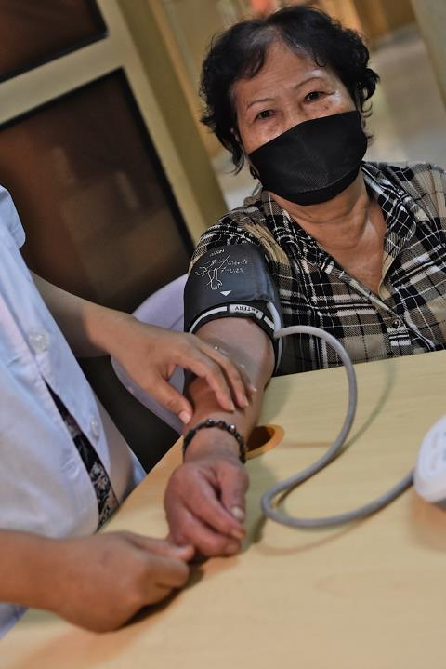


NCDs and mental health conditions remain an urgent crisis
NCDS
Globally:
Over 2 billion people living with NCDs
43 million deaths
Americas (2021):
240 million live with at least 1 NCD
Overall mortality (9.2 million deaths)
6 million due to NCDs; 38% premature

Slide 3


MENTAL HEALTH
Globally:
Nearly 1 billion people living with a mental health condition
700,000 lives lost per year due to suicide
Americas:
Reduced life expectancy
Increasing Suicide rates: +17.4% (2000-2021)​

Slide 4
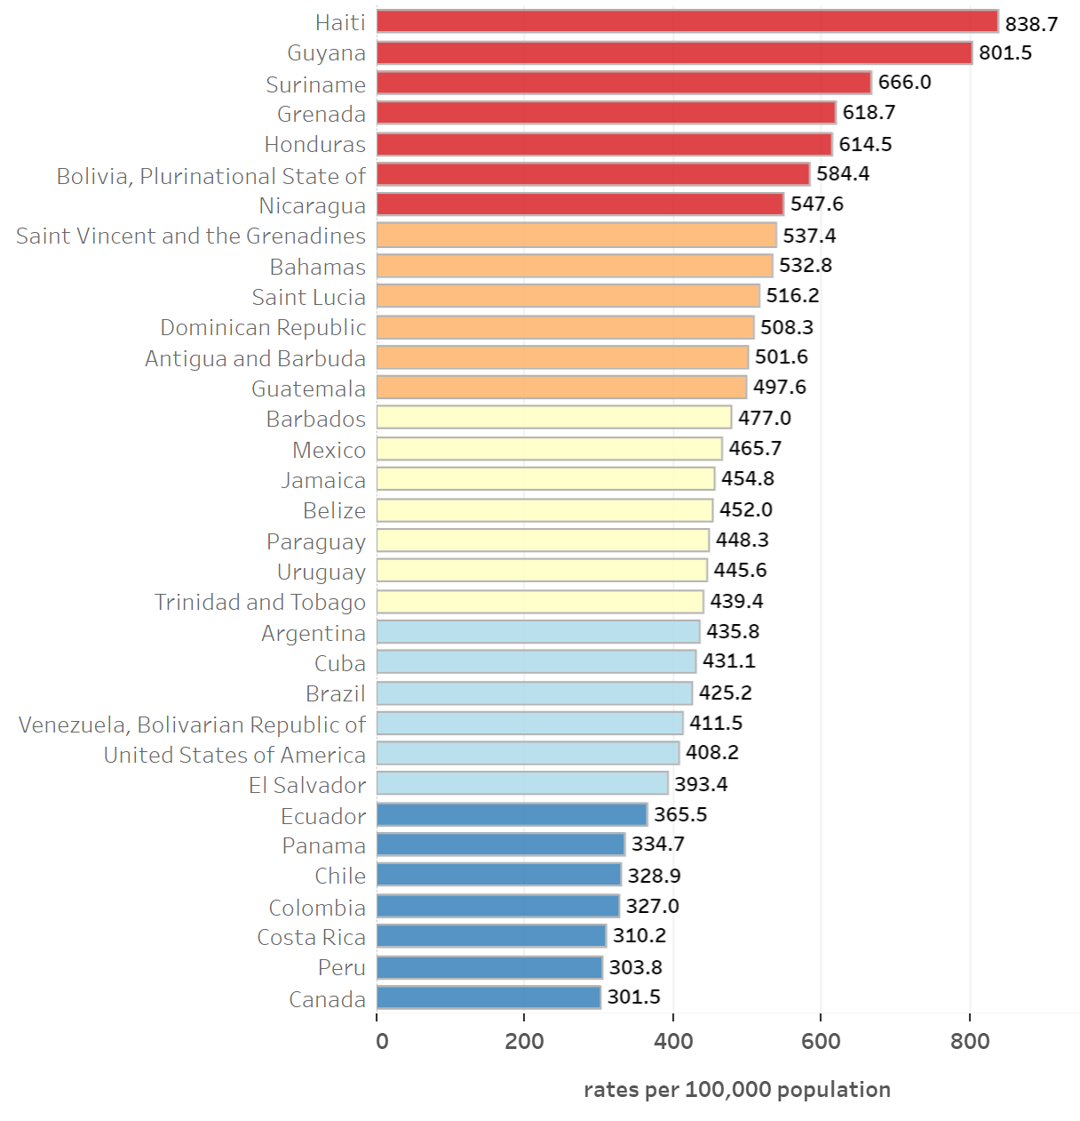
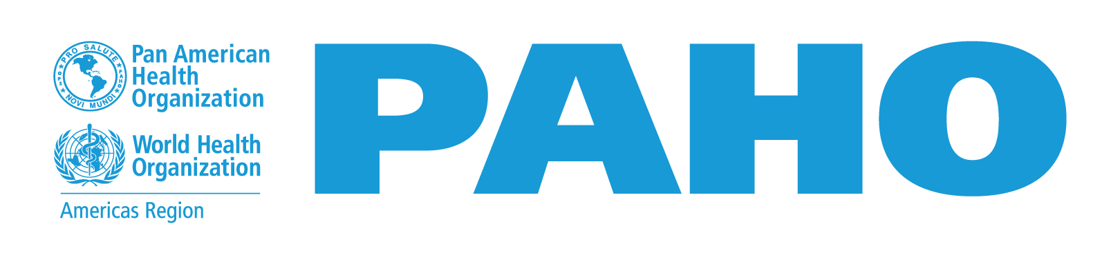
NCDs are the leading causes of ill-health and death in the Americas
6 Million NCD deaths (65% of all deaths)
38% of NCD deaths are premature
Main diseases:
  Cardiovascular diseases (36%)
  Cancer (23%)
  Chronic respiratory diseases (7%)
  Diabetes (5%)
  240 million persons live with at least one NCD in the Americas
Source: PAHO ENLACE data portal, 2023

Slide 5
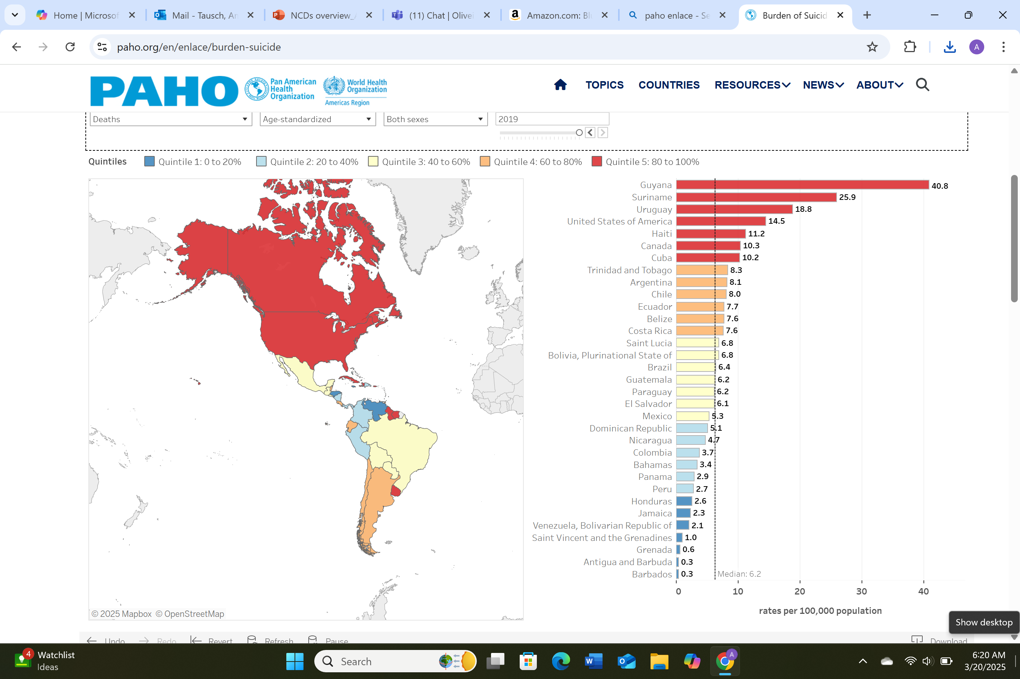
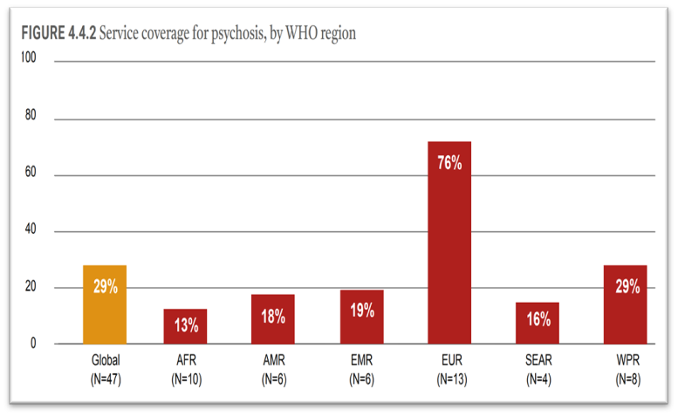
MENTAL HEALTH | Regional prespective
Approximately 1 in 6 people in the Region lives with a mental health condition.
Treatment coverage is extremely low.
More than 100,000 people die by suicide each year.
  The regional suicide rate increased by 17% between 2000 and 2019.

Slide 6
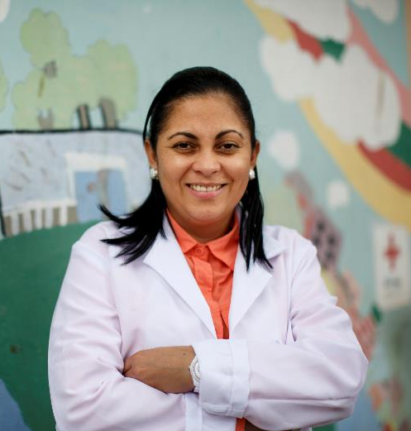
Why do NCDs Matter?
Most NCDs can be prevented or delayed
86% of CVD deaths could be prevented or delayed through prevention and treatment.
44% of cancer deaths could be prevented or delayed by eliminating risks and increasing screening, early detection and treatment.
NCDs have a substantial economic impact
Estimated global cost of US$ 30 trillion during 2011 to 2030.
44% of all spending on health is out of pocket.
Threat to societal wellbeing, human capital, and economic development

Slide 7
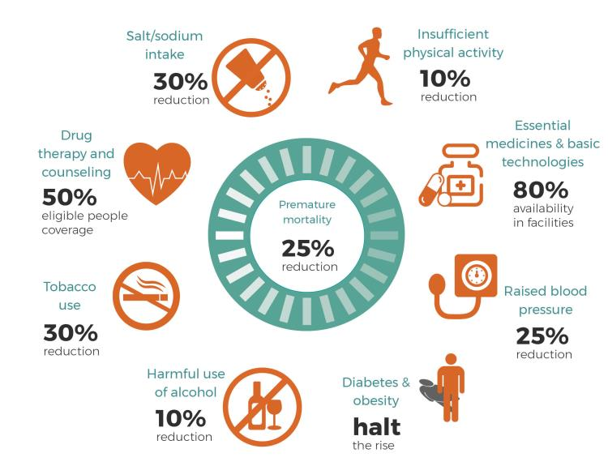
Global NCD Targets for 2030

Slide 8
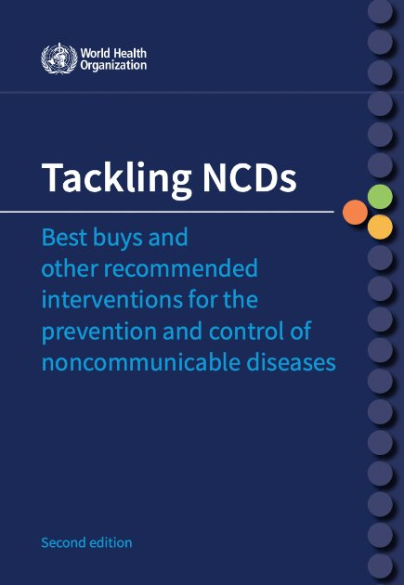




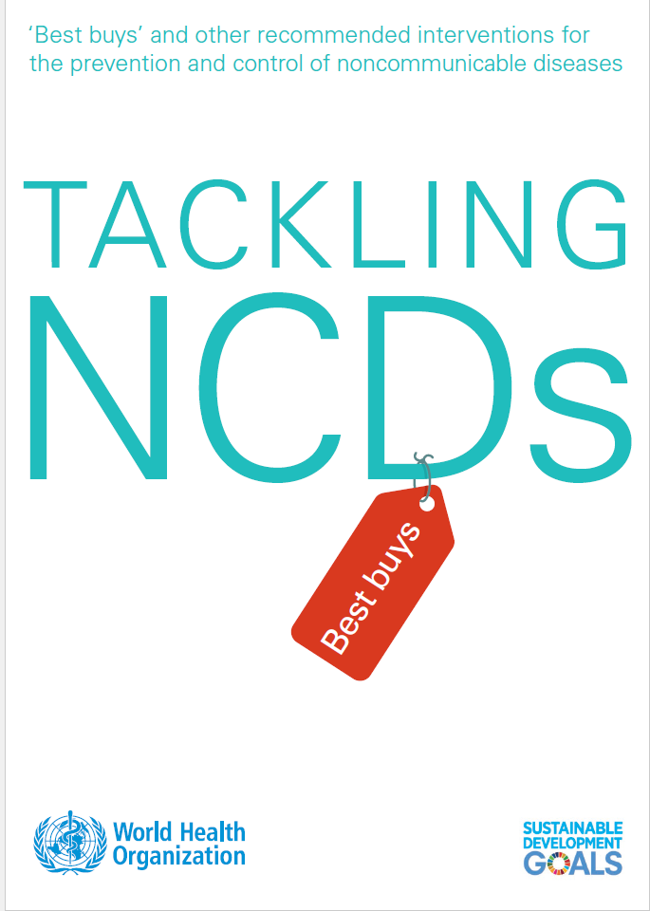

Cost-effective NCD Interventions
Tobacco: tax, smoke free environments, plain packaging, ban advertising
Alcohol: tax, restrict/ban advertising, restrict availability, drink driving laws
Diet: lower sodium, tax sugar sweetened beverages, ban trans fats, front-of-pack labeling, restrict marketing unhealthy foods and beverages
Physical activity: Communication campaigns, Brief intervention in PHC
Primary care: screening [cervical; breast; colorectal], diagnosis and treatment - [hypertension; asthma; diabetes]; medication, counselling, foot care, retinopathy screening, self-monitoring, HPV vax and HPV testing
Source: WHO NCD Cost-effective Interventions, 2017 and updated 2023

Slide 9
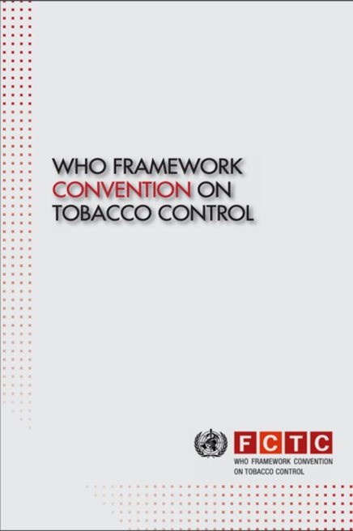
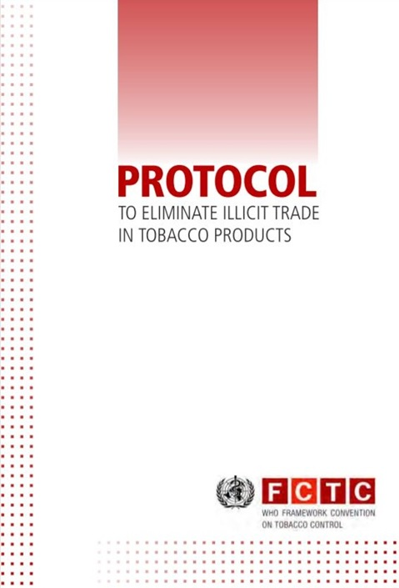
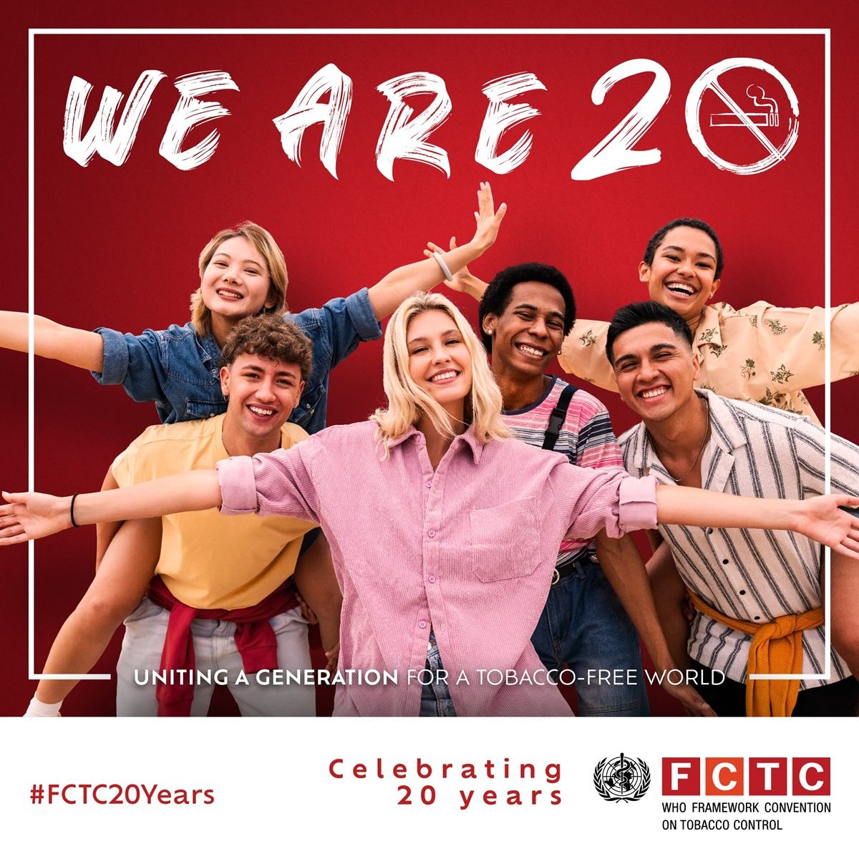
Cost-effective Tobacco Control Interventions
First global public health treaty, was negotiated under the auspices of the WHO.
MPOWER package: entry point for full implementation of the FCTC
M: monitor tobacco use and prevention policies;
P: protect people from tobacco smoke;
O: offer help to quit tobacco smoking;
W: warn about the dangers of tobacco;
E: enforce bans on tobacco advertising, promotion and sponsorship; and R: raise taxes on tobacco
FCTC, 183 Parties
Protocol, 69 Parties

Slide 10
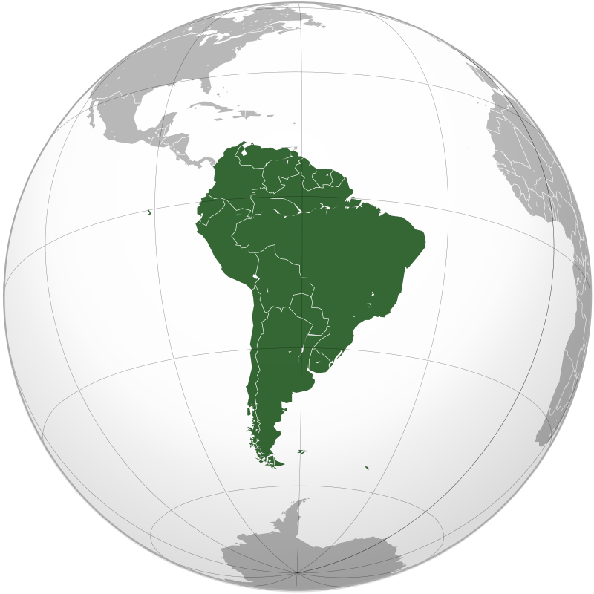
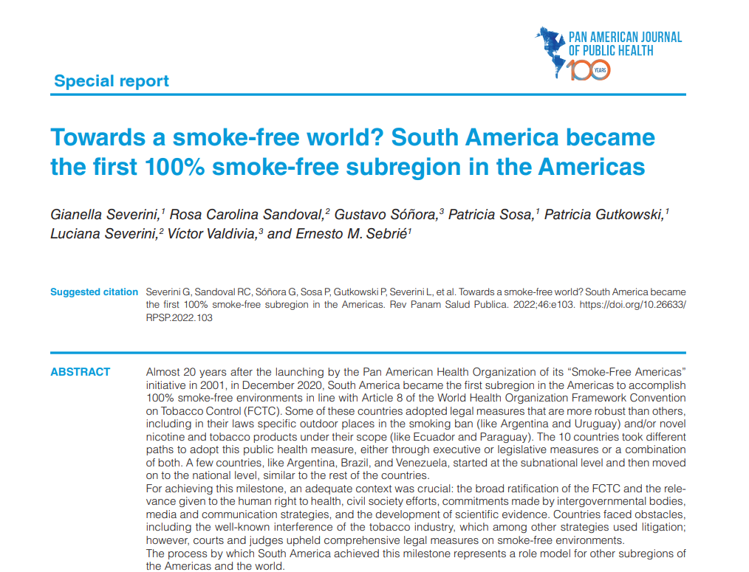


Recent achievements in Tobacco Control in the Americas
(E) Peru 2024: law amendment to include a comprehensive prohibition of TAPS on tobacco products, including HTP, making Peru the 10th Member State in the Americas to implement this measure in line with the WHO FCTC.
(E) Colombia 2024: new law includes HTP, ENDS/ENNDS, and nicotine pouches under its prohibition of TAPS.
(W) Canada 2023: mandated warning labels on individual cigarettes.
(P) México 2022 law amendment: ban exposure to smoke and other emissions in indoor workplaces, public places, and on public transport.
The Bloomberg Initiative to Reduce Tobacco Use
MPOWER policies in Latin America: Mexico and Brazil priority countries and coordinated work with partners in Costa Rica, Colombia, Bolivia, Peru and Guatemala.​​
Latin-America Free of Tobacco Smoke and Other Emissions: Belize, Nicaragua and Dominican Republic. ​
Resource mobilization!
2.7Million USD for 2025-2026
  1.2M for 2025
  1.5M for 2026
Notes:
(P) México: Decree Amending the General Law on Tobacco Control (published on February 17, 2022) prohibited smoking in indoor workplaces, public places, and on means of public transport.
(W) Canada: Tobacco Products Appearance, Packaging, and Labelling Regulations, SOR/2019-107, mandated warning labels on individual cigarettes, becoming the first country in the world to require these warnings.
(E) Colombia: Law No. 2354/2024, includes HTP, ENDS/ENNDS, and nicotine pouches under its prohibition of TAPS.
Peru: 2024, Law No. 32159 includes a comprehensive prohibition of TAPS on tobacco products, including HTP, making Peru the 10th Member State in the Americas to implement this measure at the highest level—in line with WHO best practices.

Slide 11
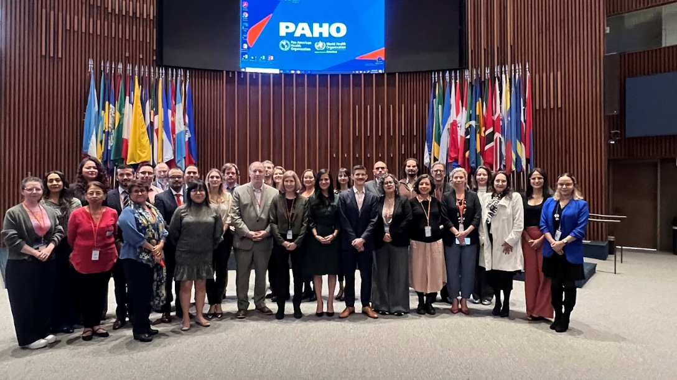
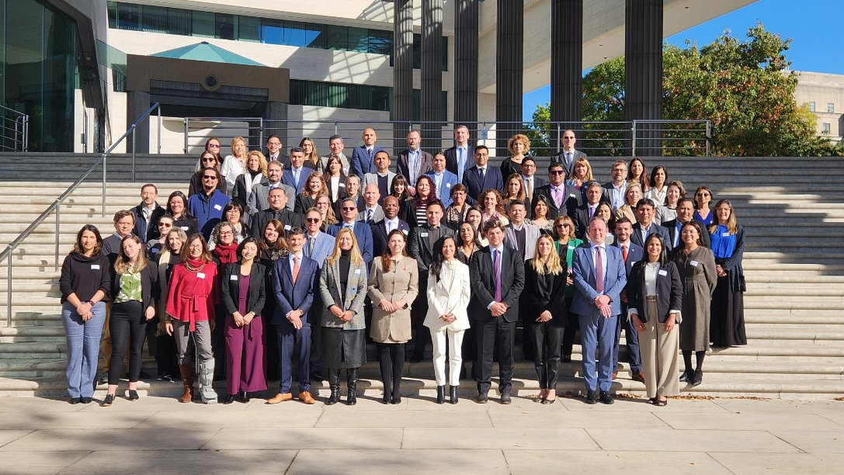
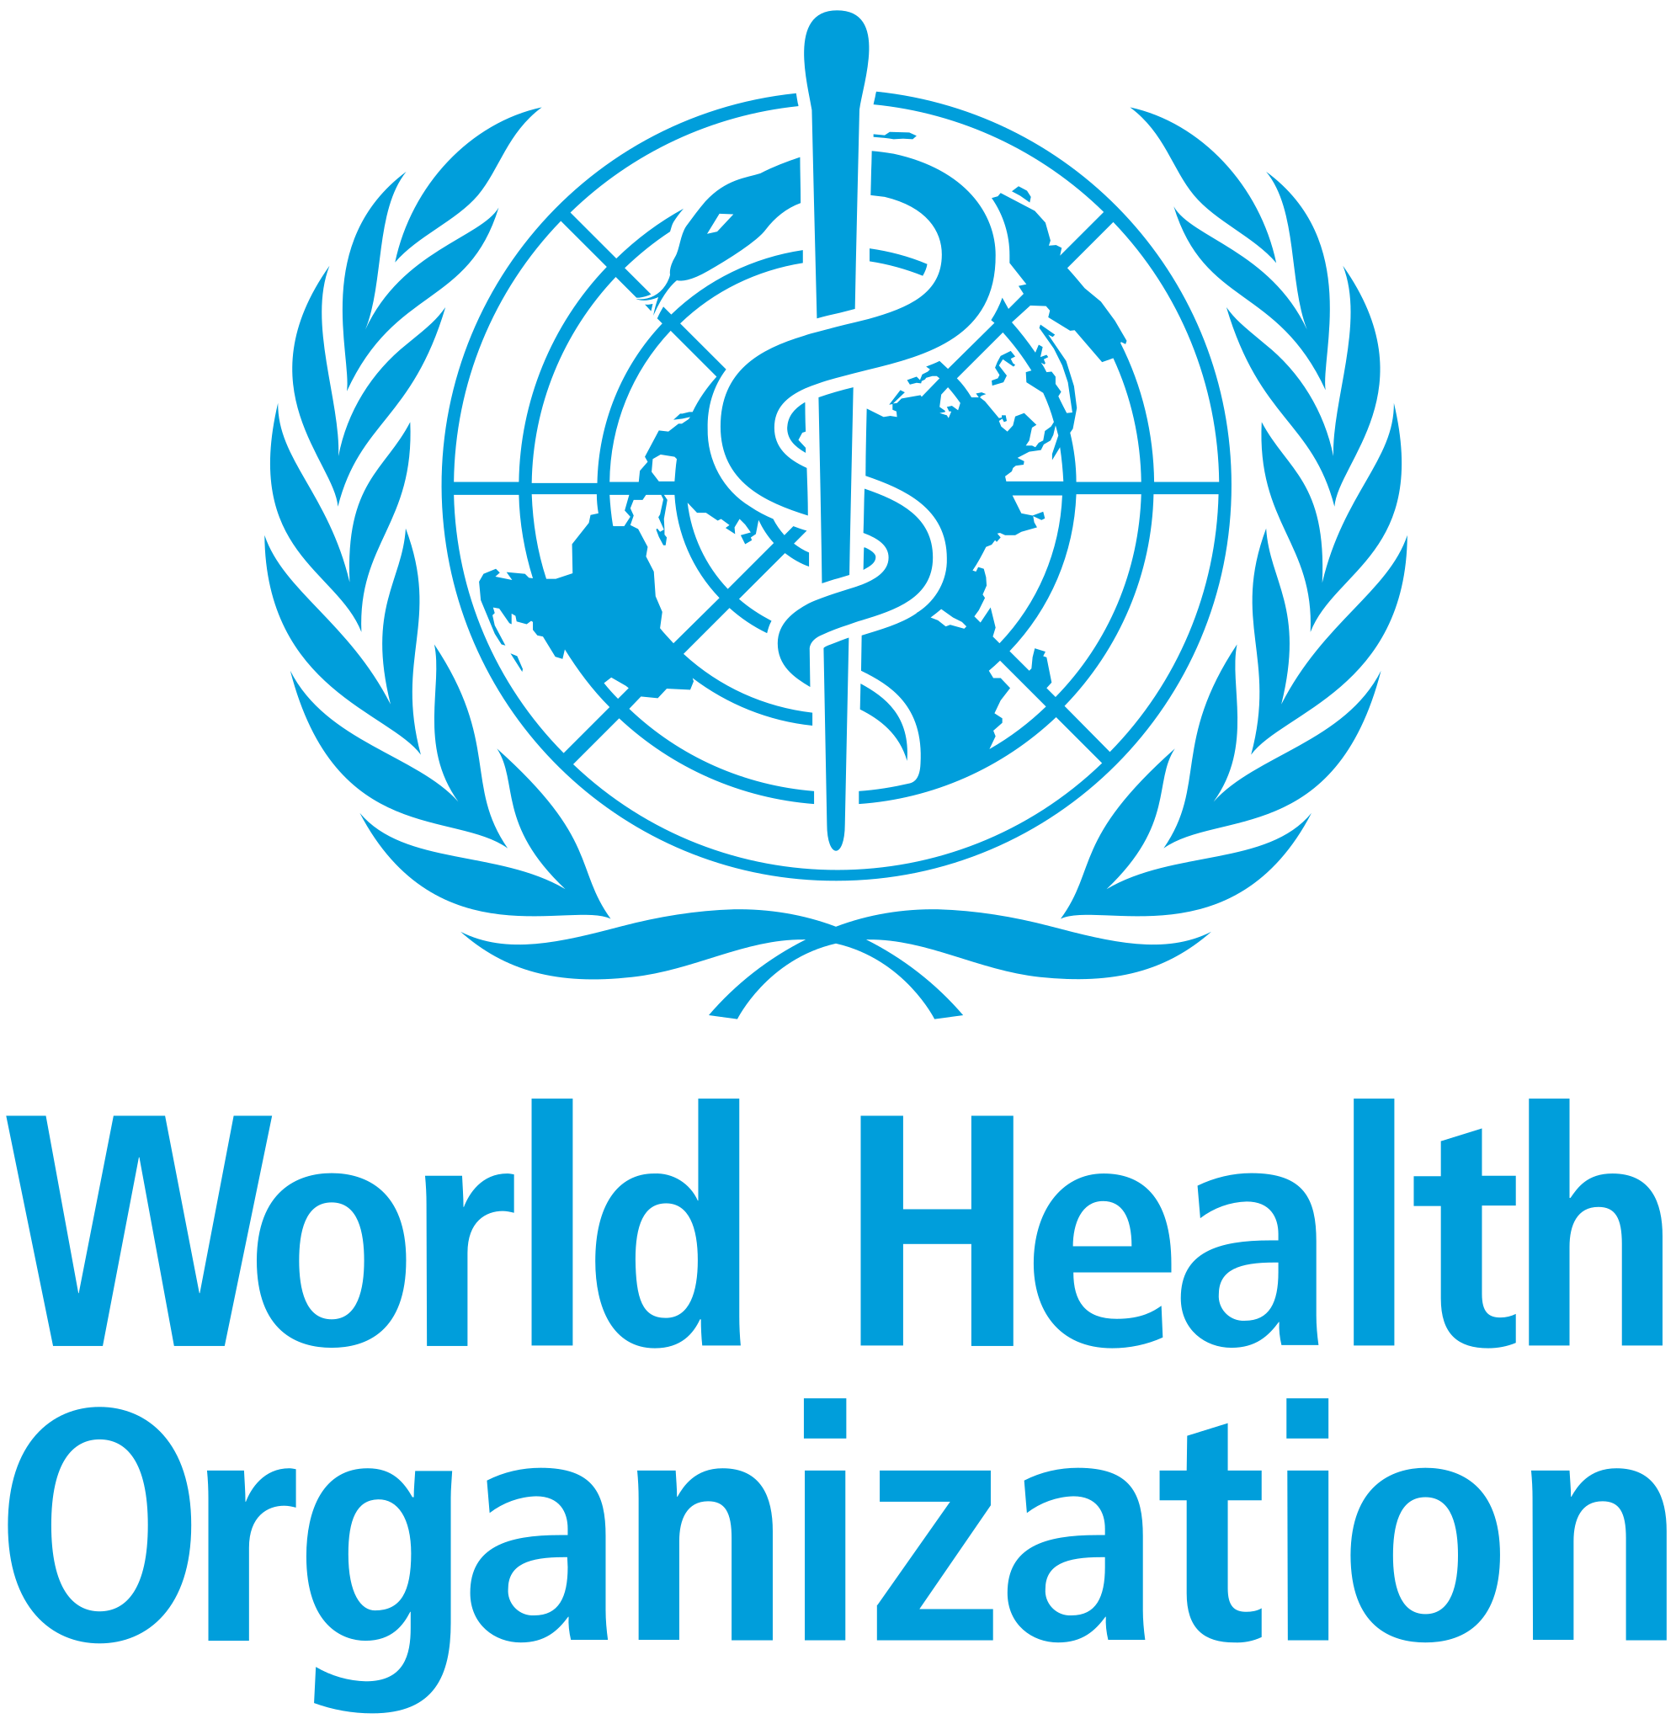
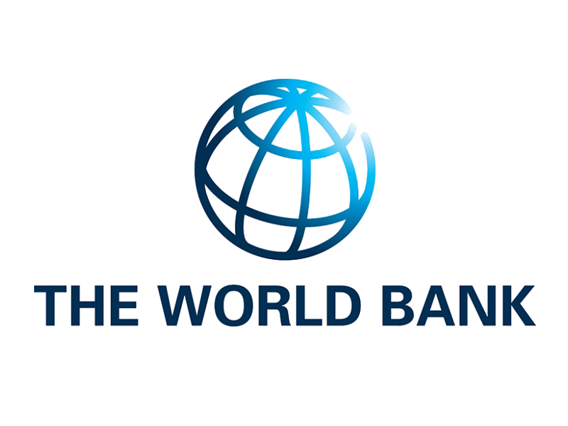




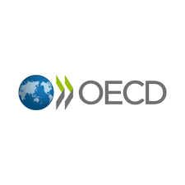
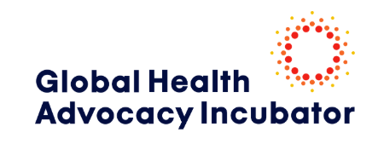
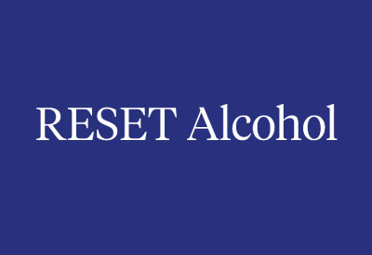
Cost-effective NCD Interventions: Health taxes
Why health taxes?
Reduce consumption of unhealthy products,
generate additional tax revenue
reduce long-term health care costs
increase long-term labor productivity
What does PAHO do?
Technical support:
Facilitate dialogue:
Generate evidence:
Monitoring and evaluation:
Recent Achievements:
  Brazil 2024: Complementary Law No. 68 included excise taxes on tobacco, alcohol and SSB.
  Colombia 2025: Bill introducing taxes to e-cigarettes and increasing tobacco taxes. Bill approved in the House of Representatives and sent to the Senate.
Multisectoral action in collaboration with Partners:
Notes:
UNDP WHO tax programme - por eso n conjunto con OMS y UNDP
UNDP ejecuta el dinero y empezó contratando algunos IC, entre ellos entraron Peru y Jamaica
Dallas Webb el que inicio RTI para pagar el IC
2019 WHO paso ondos de un grant para islas pequeñas o algo así
Ese gran calificaba el Caribe
Suriname y Guyana – Caribe an ACP Grant – RTI – pidieron disponibilidad de UNDP para hacer el Context análisis
Primera sesión fue en abril 2020 pero virtual
En Guyana se lanzo presencialmente el año pasado
El año es el qu se lanza – Guyana 2023 – Grant Caribe

Slide 12
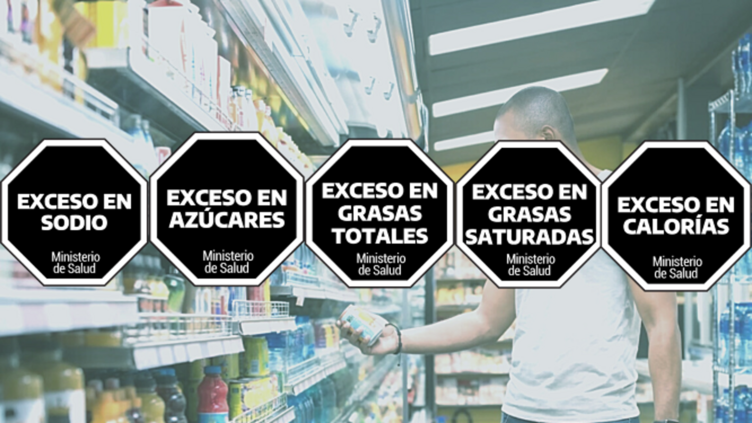
Regulation of unhealthy food commodities (1)
Achievement highlights (1)
Interventions:
Front of package labeling (FOPL)
Marketing restrictions
School Food regulation Taxation
PER, ECU: public consultation to update labeling legislation to align with PAHO recommendations and best practices on FOPL and protection of breastfeeding.
COL: adopted taxation for sugar sweetened beverages and other ultra-processed products.
BAH, COR: and GUT: drafted integral healthy eating laws, including warning labels, marketing restrictions and school food regulation.
DOR: issued a draft decree for public consultation on the adoption of warning labels as well as marketing restrictions following PAHO best practices and recommendations.
Notes:
(P) México: Decree Amending the General Law on Tobacco Control (published on February 17, 2022) prohibited smoking in indoor workplaces, public places, and on means of public transport.
(W) Canada: Tobacco Products Appearance, Packaging, and Labelling Regulations, SOR/2019-107, mandated warning labels on individual cigarettes, becoming the first country in the world to require these warnings.
(E) Colombia: Law No. 2354/2024, includes HTP, ENDS/ENNDS, and nicotine pouches under its prohibition of TAPS.
Peru: 2024, Law No. 32159 includes a comprehensive prohibition of TAPS on tobacco products, including HTP, making Peru the 10th Member State in the Americas to implement this measure at the highest level—in line with WHO best practices.

Slide 13
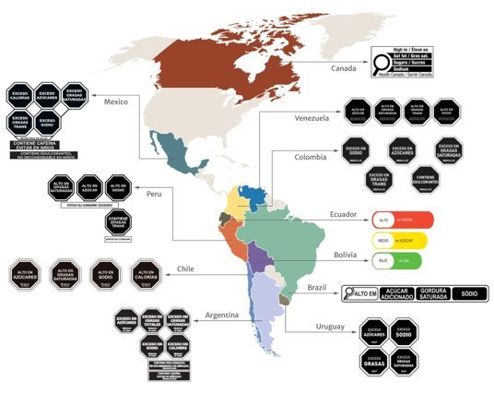
Regulation of unhealthy food commodities (2)
Achievement highlights (2)
The Americas leads the world on the adoption of FOPL policies:
  12 countries have adopted front-of-package labelling (most of them using warning labels or are in the process of upgrading the policy to use warnings): ARG, BRA, BOL, CAN, CHI, COL, ECU, MEX, PAR, PER, URU, VEN.
ARG, CHIL, COL, MEX and PER: included provisions on for marketing restrictions of products carrying warning labels.
ARG and CHI: link the required warning labels to the regulation of the school food environment.
Notes:
(P) México: Decree Amending the General Law on Tobacco Control (published on February 17, 2022) prohibited smoking in indoor workplaces, public places, and on means of public transport.
(W) Canada: Tobacco Products Appearance, Packaging, and Labelling Regulations, SOR/2019-107, mandated warning labels on individual cigarettes, becoming the first country in the world to require these warnings.
(E) Colombia: Law No. 2354/2024, includes HTP, ENDS/ENNDS, and nicotine pouches under its prohibition of TAPS.
Peru: 2024, Law No. 32159 includes a comprehensive prohibition of TAPS on tobacco products, including HTP, making Peru the 10th Member State in the Americas to implement this measure at the highest level—in line with WHO best practices.

Slide 14
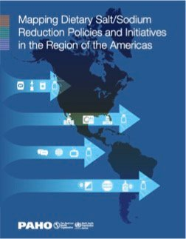
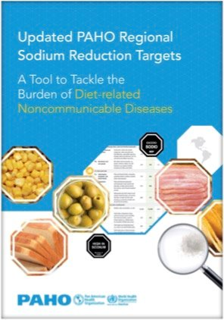
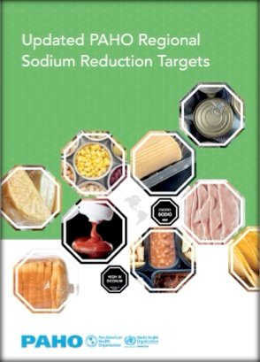
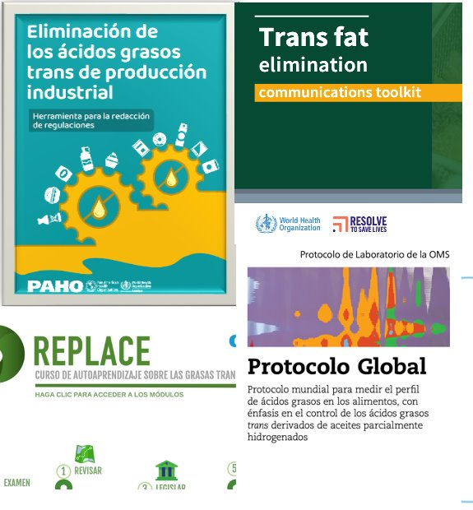
Sodium/salt reduction
Elimination of Industrially produced trans-fatty acids (iTFA)
Achievement highlights
Sodium - 6 countries have implemented multiple mandatory measures for sodium reduction, (ARG, BRA, CHIL, COL, MEX, URU); 3 include sodium reduction targets (ARG, COL, PAR).
iTFA Elimination - In the past four years the populations living in countries with iTFA elimination policies have increased by 68%, covering 80% of the region’s population in 2024.
Example of impact of resources
Social marketing virtual course for public health supported campaigns for sodium reduction in Aruba, Costa Rica, Panama, Puerto Rico, Sint Maarten.
Regulatory Drafting Tool and Workshops to support the elimination of iTFA have reached more than 1000 users (policy makers, civil society, public health advocates) within a year.
Notes:
(P) México: Decree Amending the General Law on Tobacco Control (published on February 17, 2022) prohibited smoking in indoor workplaces, public places, and on means of public transport.
(W) Canada: Tobacco Products Appearance, Packaging, and Labelling Regulations, SOR/2019-107, mandated warning labels on individual cigarettes, becoming the first country in the world to require these warnings.
(E) Colombia: Law No. 2354/2024, includes HTP, ENDS/ENNDS, and nicotine pouches under its prohibition of TAPS.
Peru: 2024, Law No. 32159 includes a comprehensive prohibition of TAPS on tobacco products, including HTP, making Peru the 10th Member State in the Americas to implement this measure at the highest level—in line with WHO best practices.

Slide 15


STOP Obesity plan
The WHO Acceleration Plan to Stop Obesity: designed to stimulate and support multi-sector country-level action across the globe. The Plan offers a step change in delivery and impact in the effort to tackle the growing crisis of obesity.
Achievement highlights
The Region of the Americas hosts the largest number of front-runner countries (9): ARG, BAR, BRA, CHI, MEX, PAN, PER, TRT and URU – several developed roadmaps.
Progress in Breastfeeding
Sustained support for national implementation of BFHI in Member States: ​
  Capacity building ​
  Dissemination of information​
  External assessments ​
  Improved access to tools & training​
  ​BFHI subregional networks​
  Meetings and sharing of updated information​
Increase in the exclusive breastfeeding rate in infants 0 – 5 months, from 32.7% in 2016 to 37% in 2022.
15
Notes:
(P) México: Decree Amending the General Law on Tobacco Control (published on February 17, 2022) prohibited smoking in indoor workplaces, public places, and on means of public transport.
(W) Canada: Tobacco Products Appearance, Packaging, and Labelling Regulations, SOR/2019-107, mandated warning labels on individual cigarettes, becoming the first country in the world to require these warnings.
(E) Colombia: Law No. 2354/2024, includes HTP, ENDS/ENNDS, and nicotine pouches under its prohibition of TAPS.
Peru: 2024, Law No. 32159 includes a comprehensive prohibition of TAPS on tobacco products, including HTP, making Peru the 10th Member State in the Americas to implement this measure at the highest level—in line with WHO best practices.

Slide 16
PAHO Regional Strategy for NCD Prevention and Control
MULTISECTOR POLICIES
PRIMARY PREVENTION
NCD MANAGEMENT
SURVEILLANCE
Legal, fiscal, trade and regulatory policies that promote health and address health determinants
Advocacy and community mobilization
Healthy living, health education and counselling, and self- management
Health system strengthening, to improve NCD screening, diagnosis, treatment and continuous care
Monitoring NCDs as part of routine health services and through population-based surveys
PAHO NCD Strategy, 2013
16
Notes:
(P) México: Decree Amending the General Law on Tobacco Control (published on February 17, 2022) prohibited smoking in indoor workplaces, public places, and on means of public transport.
(W) Canada: Tobacco Products Appearance, Packaging, and Labelling Regulations, SOR/2019-107, mandated warning labels on individual cigarettes, becoming the first country in the world to require these warnings.
(E) Colombia: Law No. 2354/2024, includes HTP, ENDS/ENNDS, and nicotine pouches under its prohibition of TAPS.
Peru: 2024, Law No. 32159 includes a comprehensive prohibition of TAPS on tobacco products, including HTP, making Peru the 10th Member State in the Americas to implement this measure at the highest level—in line with WHO best practices.

Slide 17

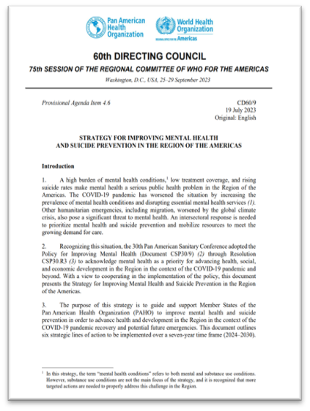
PAHO Regional Strategy for Improving Mental Health
and Suicide Prevention
17
Notes:
(P) México: Decree Amending the General Law on Tobacco Control (published on February 17, 2022) prohibited smoking in indoor workplaces, public places, and on means of public transport.
(W) Canada: Tobacco Products Appearance, Packaging, and Labelling Regulations, SOR/2019-107, mandated warning labels on individual cigarettes, becoming the first country in the world to require these warnings.
(E) Colombia: Law No. 2354/2024, includes HTP, ENDS/ENNDS, and nicotine pouches under its prohibition of TAPS.
Peru: 2024, Law No. 32159 includes a comprehensive prohibition of TAPS on tobacco products, including HTP, making Peru the 10th Member State in the Americas to implement this measure at the highest level—in line with WHO best practices.

Slide 18
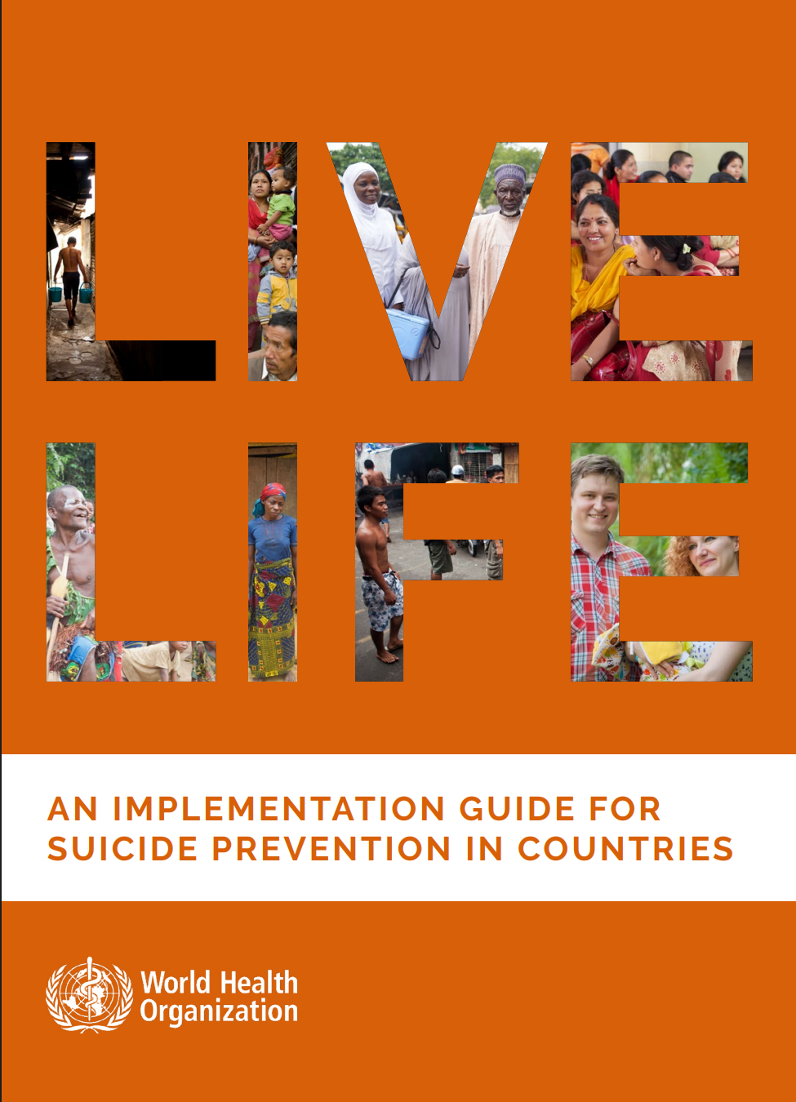
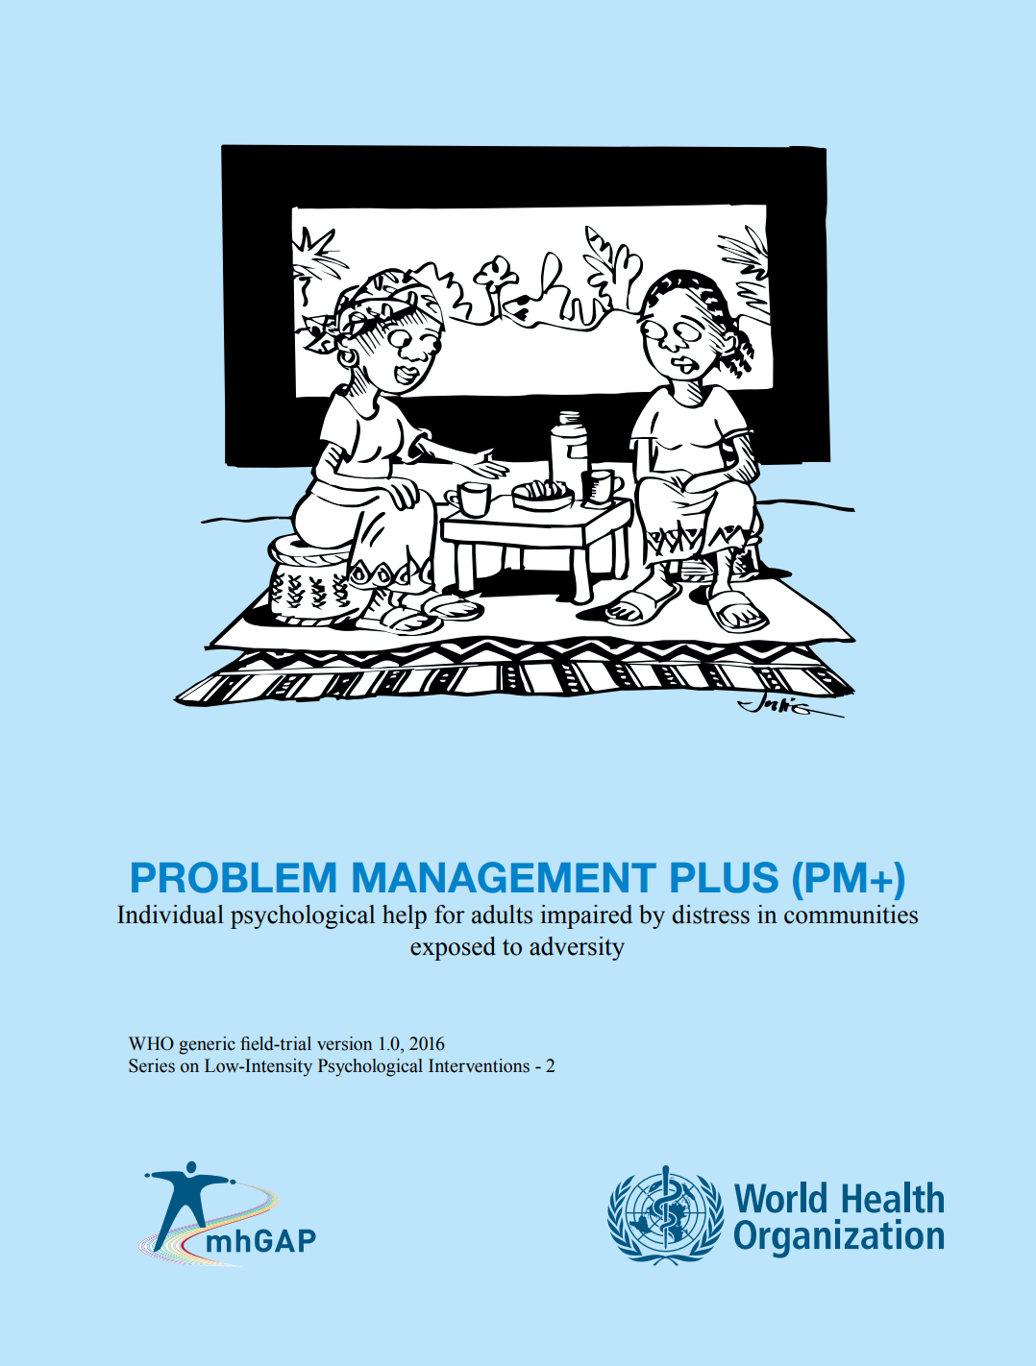
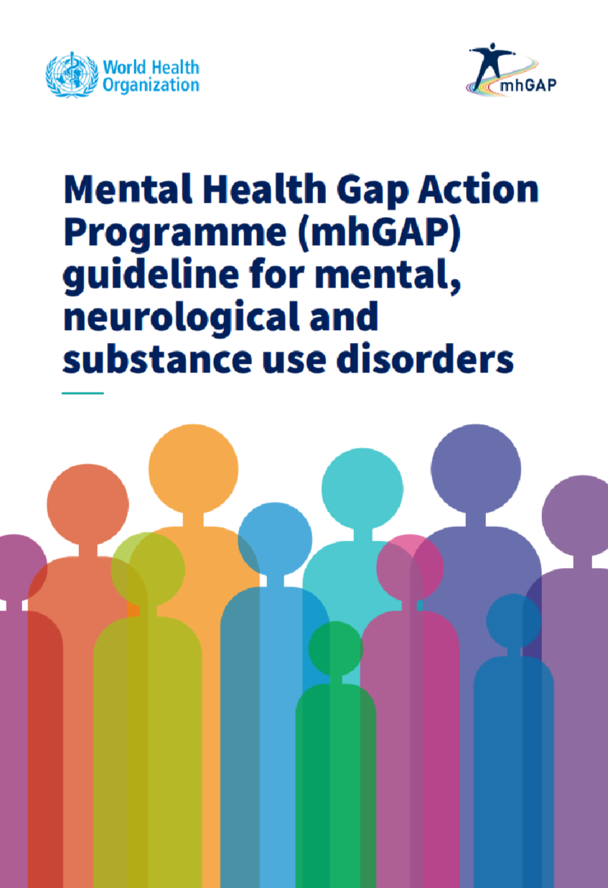
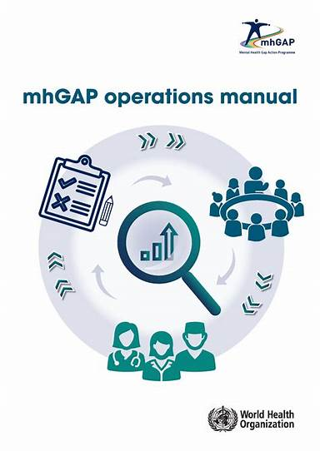


Interventions for Mental Health
and Suicide Prevention
Integrating mental health into primary care and other non-specialist settings
Evidence-based interventions for suicide prevention outlined by the WHO LIVE LIFE Intervention Guide for Suicide Prevention in Countries
18

Slide 19

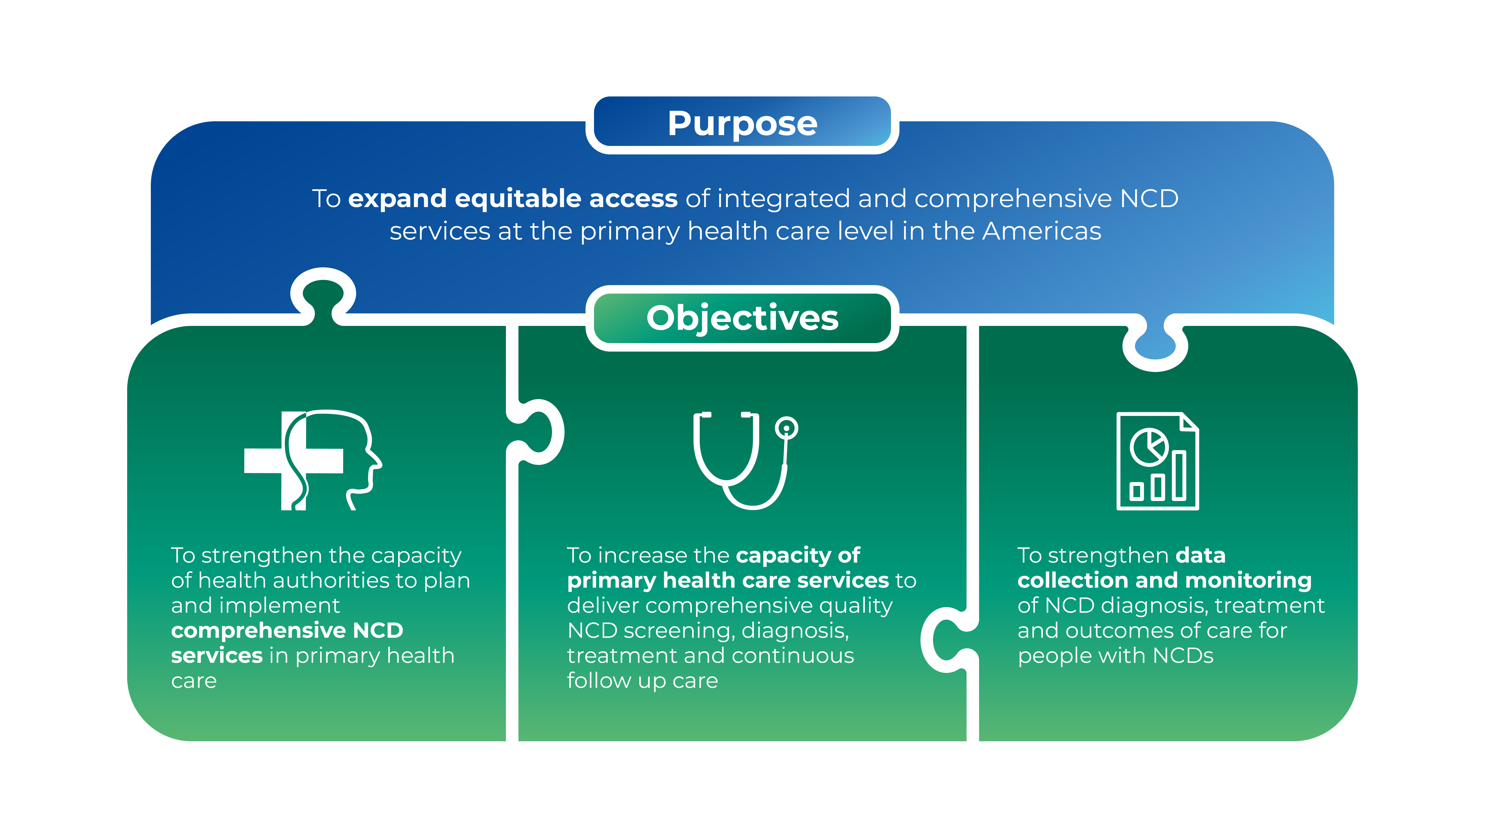
19

Slide 20
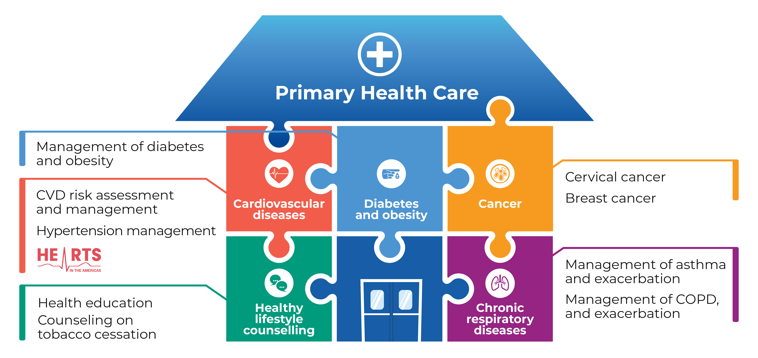
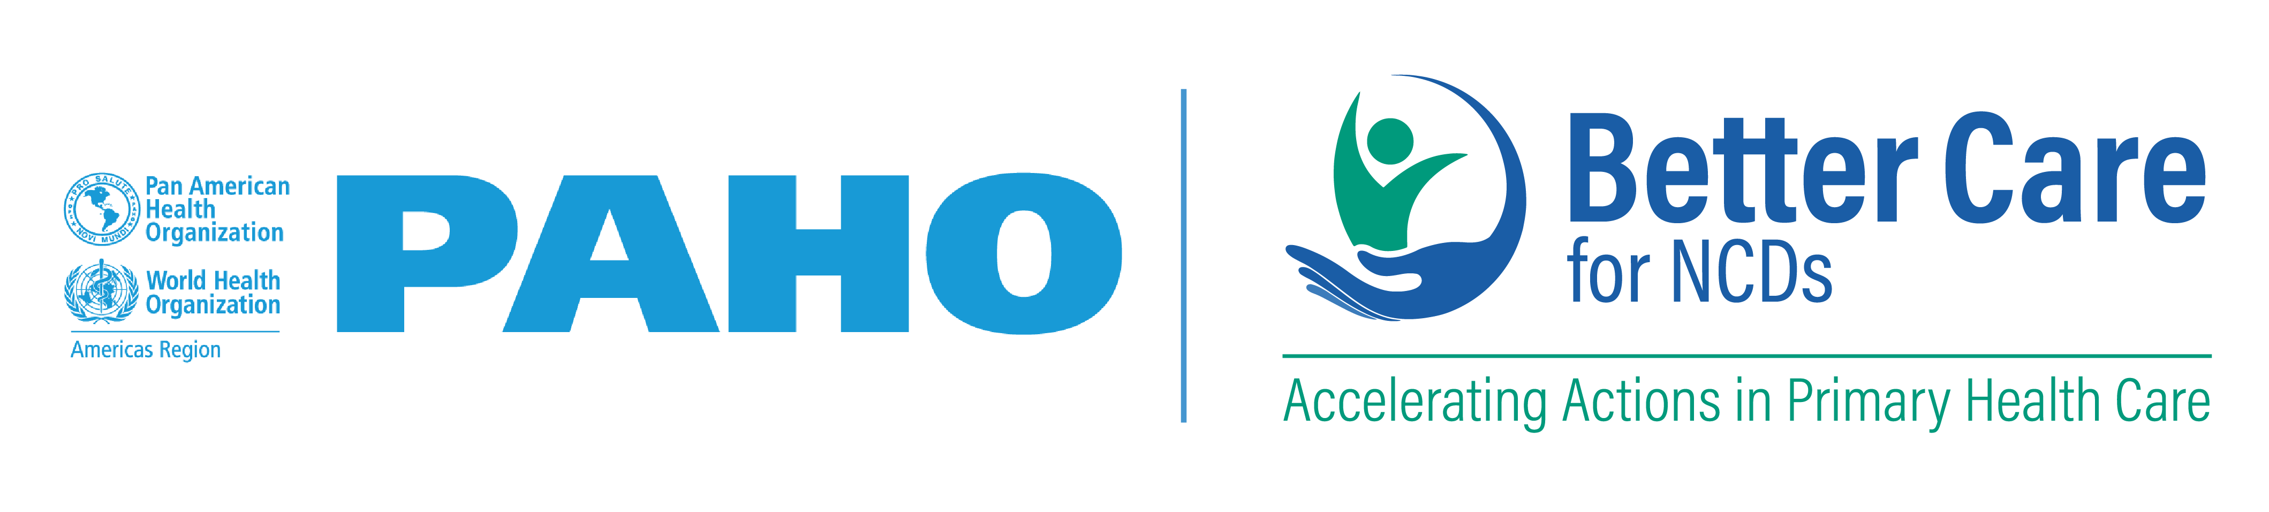
Better Care for NCDs Initiative.
Accelerating Actions in Primary Health Care
and obesity
20

Slide 21
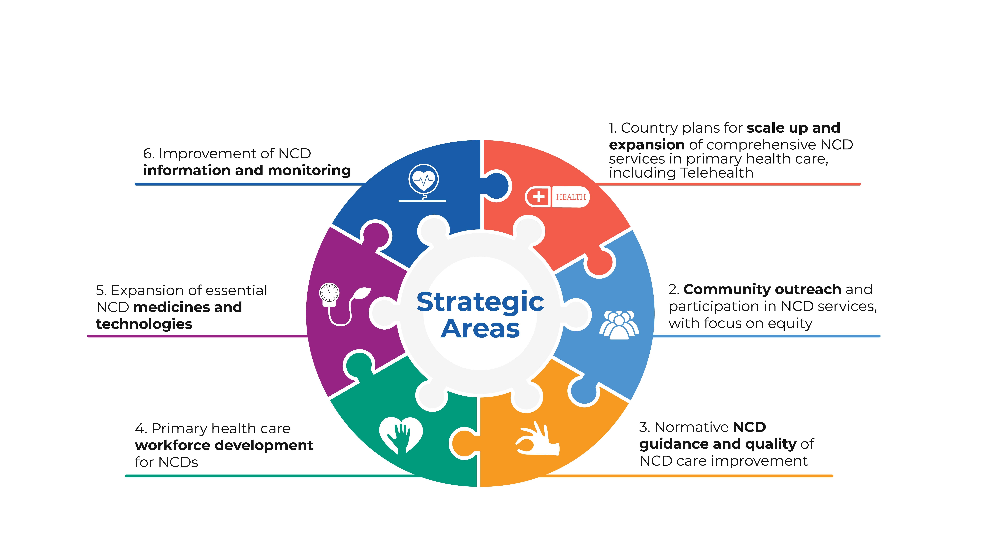


STRATEGIC AREAS

Slide 22
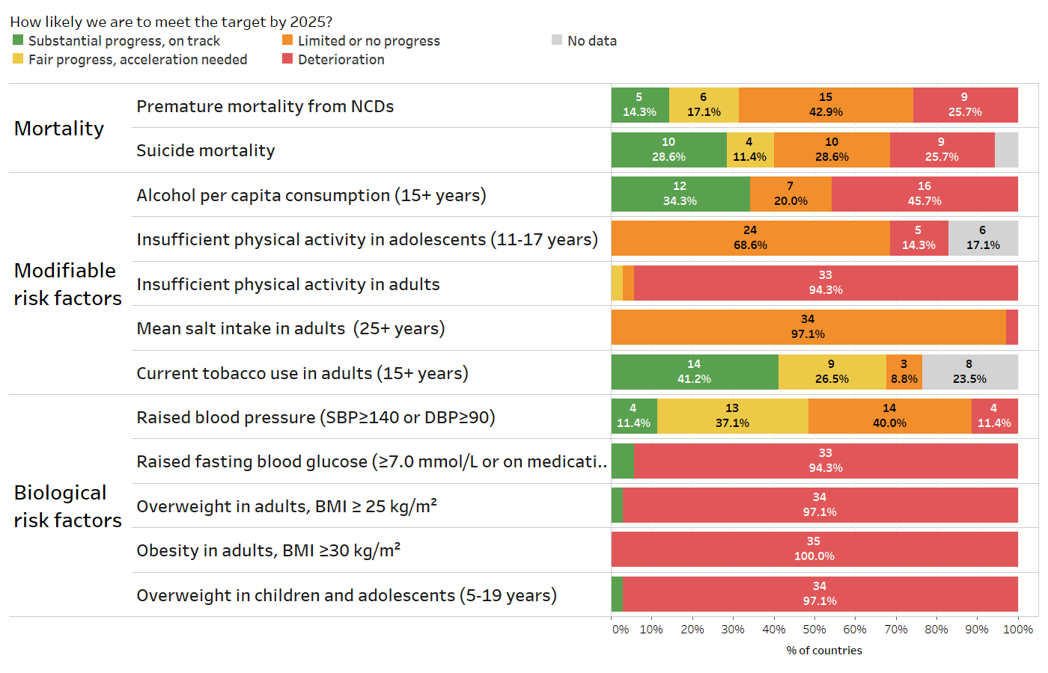
Progress assessment: Americas Overview
22

Slide 23
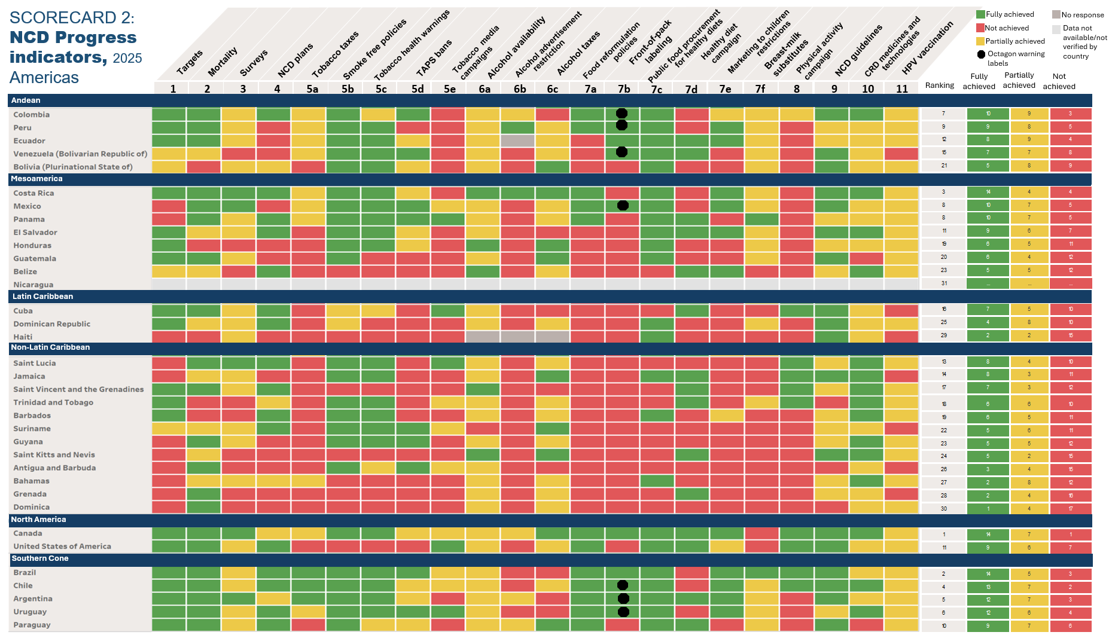
Americas overview
Progress assessment:

Slide 24

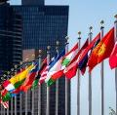
Preparations for the 4th UN High-level Meeting on
NCDs and Mental Health
Key high-level events​
Sep 2022
1st Gathering of Global Group of HoSG for NCDs & mental health
Jan 2023
SIDS High-level technical meeting on NCDs & mental health
Sep 2023
2nd Gathering of Global Group of HoSG for NCDs & mental health
April 2024
1st Symposium on Meaningful Engagement
June (20-21) 2024
International Dialogue on sustainable financing for NCD and mental health
Nov (26-29) 2024
Global Meeting on Oral Health
April 2025
2nd General Meeting of Global Coordination Mechanism on NCDs (GCM)
2022 2023 2024 2025
April 2022
International Strategic Dialogue on NCDs – Global NCD Compact
Dec 2022
Global and regional technical meeting on NCDs in emergencies
June 2023
SIDS Ministerial Conference on NCDs and mental health – 2023 Bridgetown declaration on NCDs and Mental Health in the SIDS
Feb (27-29) 2024
Global Meeting on NCDs in emergencies
May (27-30) 2024
4th Intl SIDS Conference
World Health Assembly
Sep (24) 2024
3rd Gathering of Global Group of HoSG for NCDs & mental health
Jan 2025
Executive Board
Mar (25-27) 2025
2nd Intl. Conference on Air Pollution
May 2025
World Health Assembly
September 2025
4th UN High-level meeting on NCDs and mental health

Slide 25
Technical inputs
Annual reporting to World Health Assembly
Monitoring progress on NCDs
Report of the WHO DG informing the UN Secretary General’s 2025 report to UNGA on NCD progress
View the UNSG’s report online
Zero draft of Outcome document
Outcome Document
negotiated for adoption in September 2025
Technical elements paper to support Co-facilitators

Slide 26
Multistakeholder hearing (2 May 2025)
Participation:
Multi-stakeholder hearing Webcast live on UN WebTV
Inclusive platform for stakeholders to share their perspectives, experiences and best practices while identifying challenges and proposing actionable solutions.
Focus on 2 thematic areas being addressed in HLM4 panels:
  Tackling determinants through multisector action and
  Strengthening health systems to address NCDs and mental health conditions
Regional organizations​ | Ensuring the participation and voices of: women, children, youth, Indigenous Peoples, and people of African descent, representative organizations of persons affected by NCDs and mental health conditions, persons with disabilities, appropriate senior-level representatives of Member States, observers of the General Assembly, parliamentarians, representatives of local governments, and relevant UN entities
NGO in consultative status with ECOSOC - **if no ECOSOC status, will be considered case by case​
Invited CSOs​
Philanthropic foundations​
Academia​
Medical associations​
Private sector​
Broader communities​

Slide 27
What do we need?​​
Political leadership
Enhanced Governance - - multisectoral engagement; national plans; accountability frameworks
Sustainable Financing
Health promoting environments – regulatory frameworks; support for the vulnerable; prevention/control of risk factors
Strengthened PHC management of NCDs {Better Care}; HRH capacity building; access to meds and technologies;
Strengthened data/surveillance; incorporate NCDs into national SDG review processes
Access to Digital Technologies
Address specific Regional challenges - SIDS; NCDs in humanitarian crises; climate change

Slide 28
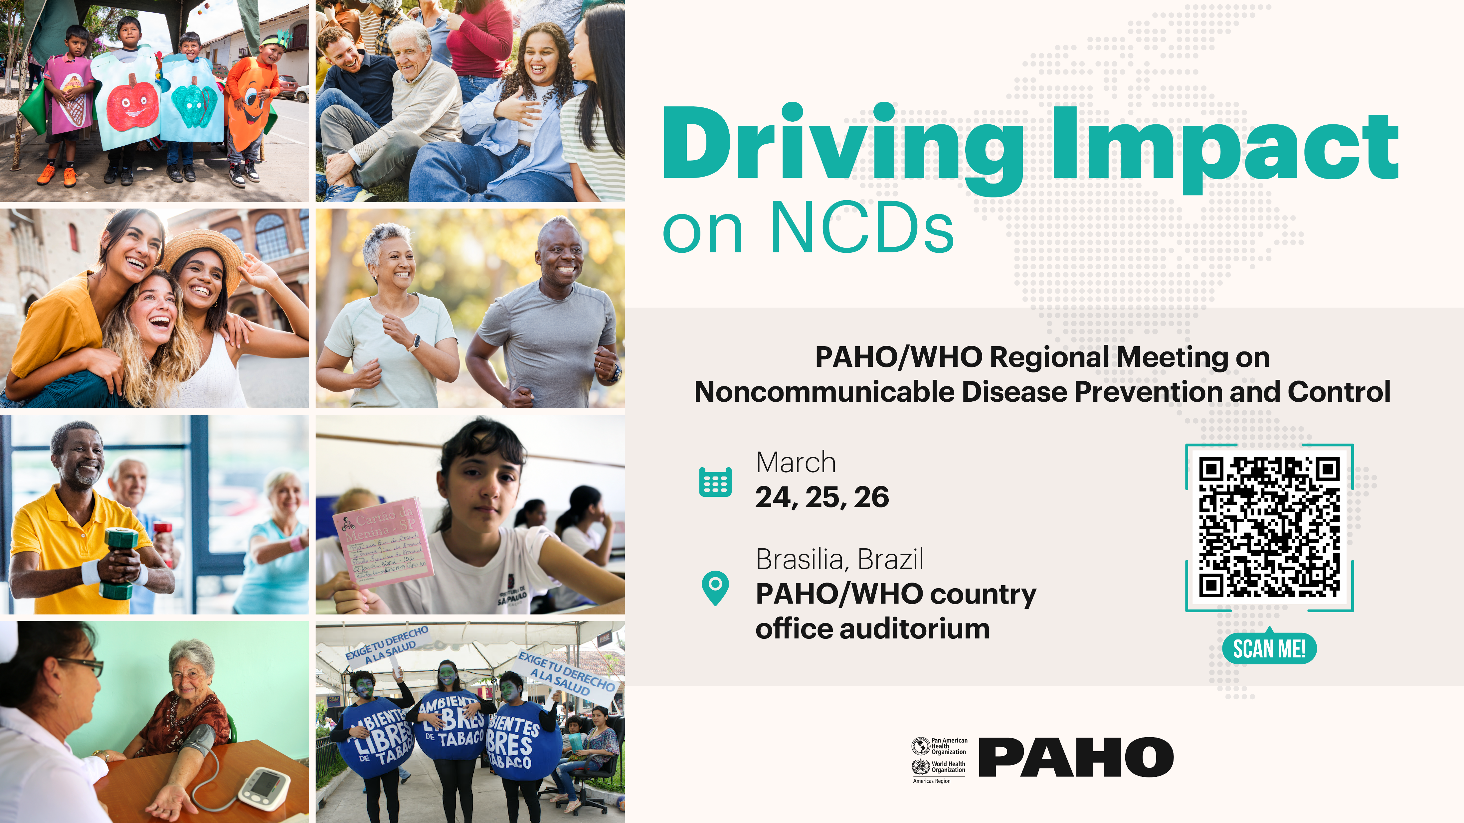

Slide 29
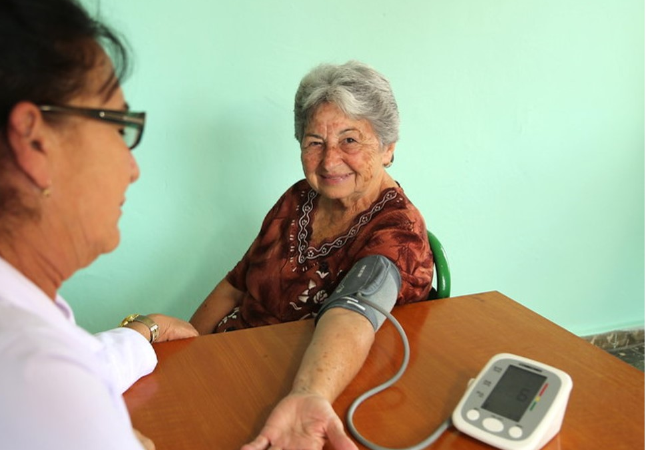
THANK
YOU!

