Slide 1
Adoption of Plain Packaging in the Americas: pending agenda
Benn McGrady, Unit Head, Public Health Law and Policies, WHO HQ
Kritika Khanijo, Technical Officer (Legal), Public Health Law and Policies, WHO HQ

Slide 2
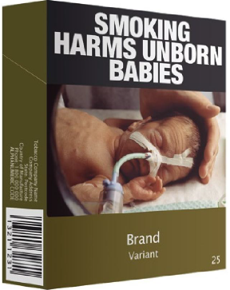
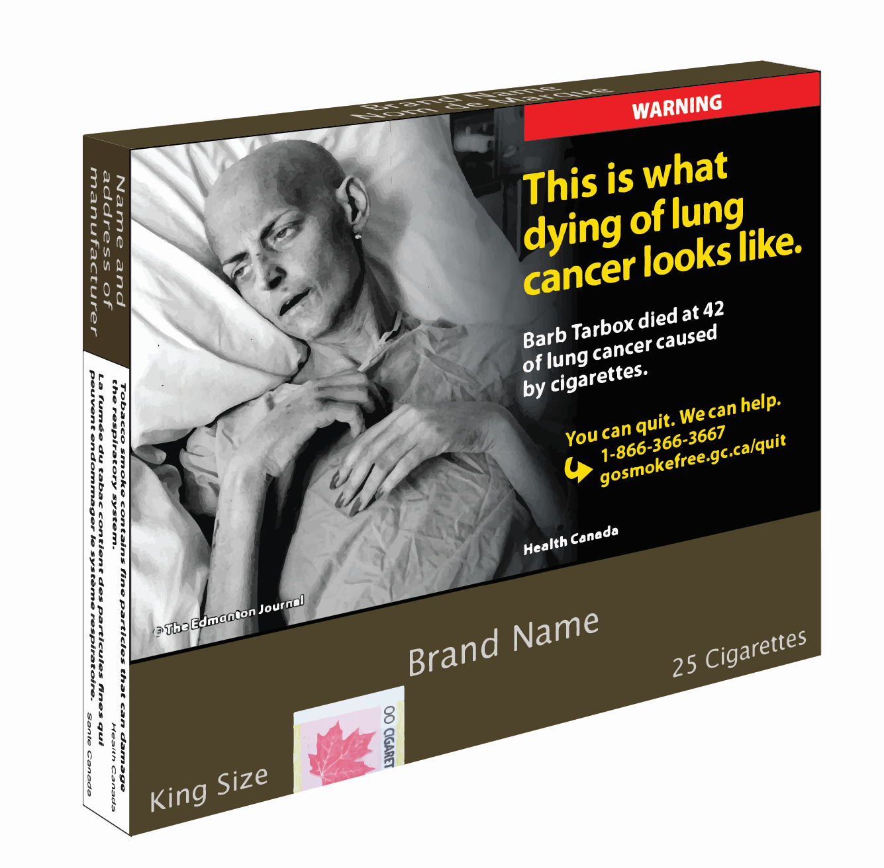

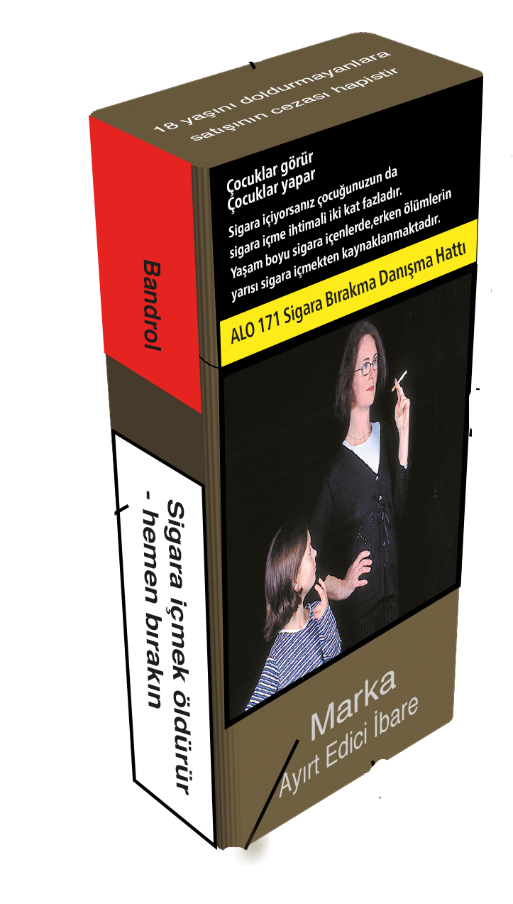
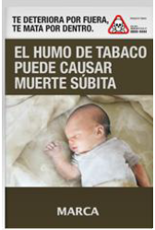

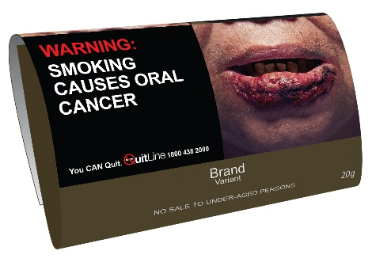
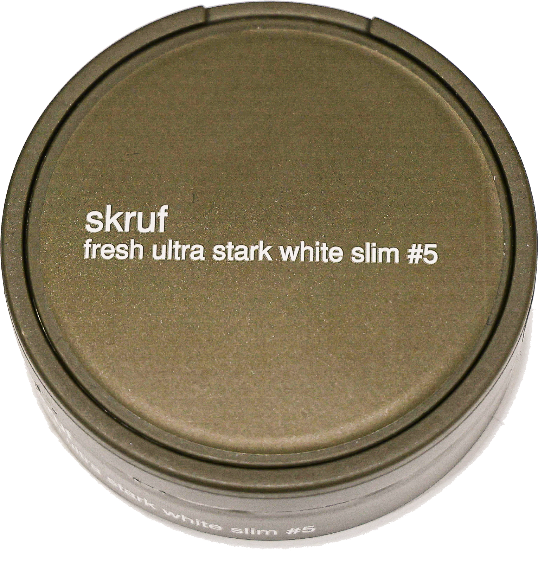
What is Tobacco Plain Packaging?
Source: © Commonwealth of Australia
Source: © Health Canada
Source: © Saudi Food and Drug Authority
Source: © Department of Tobacco and Alcohol,
Ministry of Agriculture and Forestry, Turkey
Source: © Uruguay Decree
Source: © Ministry of Health, Singapore
Roll-your own Tobacco
Source: © Health Canada,
Package of Heatsticks
Source: © Norwegian Ministry of Health and Care Services

Slide 3
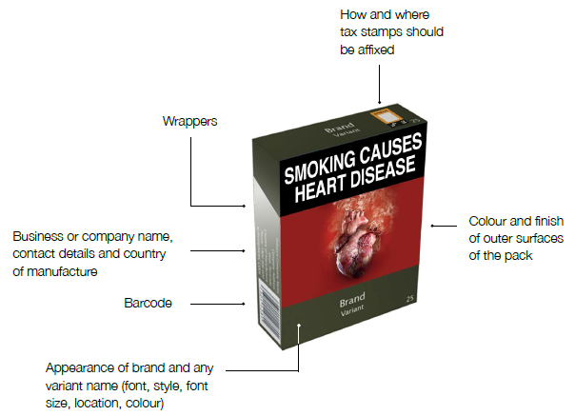
Features of packaging to be standardized

Slide 4
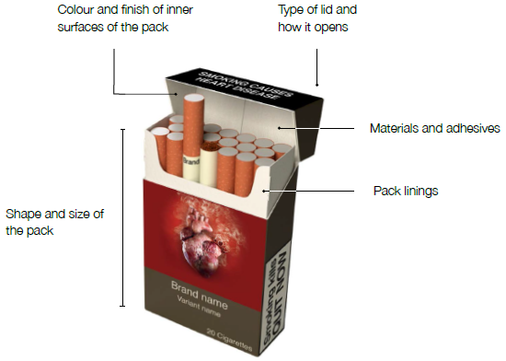
Features of packaging to be standardized
  May apply differently
  to different categories of
  tobacco products (e.g.
  packaging of cigars,
  cigarettes and hand
  rolling tobacco)

Slide 5
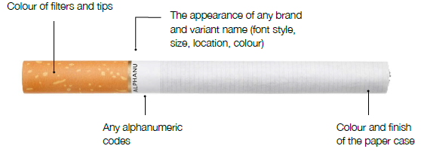
Features of tobacco products to be standardized

Slide 6
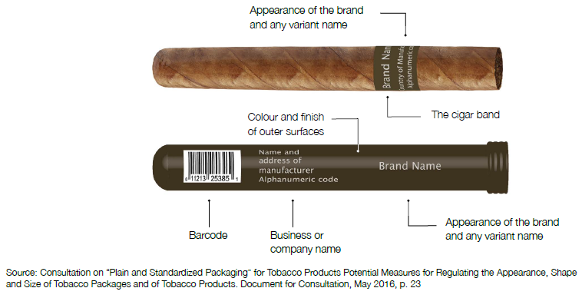
Features of tobacco products to be standardized

Slide 7


Objectives of Plain Packaging
Plain packaging is a demand reduction measure that serves several purposes, including:
  reducing the attractiveness of tobacco products;
  eliminating the effects of tobacco packaging as a form of advertising and promotion;
  addressing package design techniques that may suggest that some products are less harmful than others; and
  increasing the noticeability and effectiveness of health warnings.

Slide 8
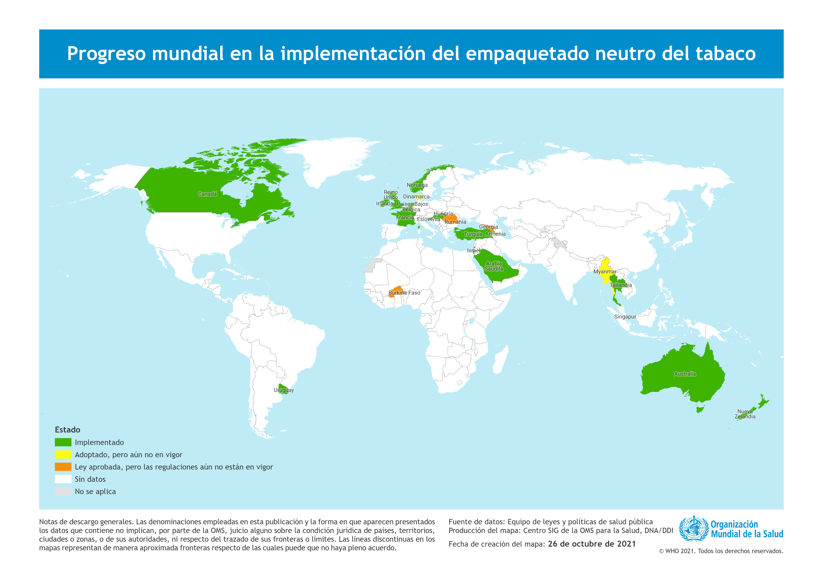
Globally, 18 countries have fully implemented plain packaging of tobacco products, 3 countries have adopted laws which come into force later in 2022 or 2023, and 6 countries have adopted enabling provisions for plain packaging.

Slide 9

Opportunity in the Americas?
Name | Average % of GHWs | Plain Packaging Status
Antigua and Barbuda | 50
Argentina | 50
Barbados | 60
Bolivia | 60
Brazil | 65
Canada | 75
Chile | 50 | Under consideration
Colombia | 30 | Under consideration
Costa Rica | 50 | Under consideration
Cuba | 30
Ecuador | 60
El Salvador | 50
Guatemala | 13
Guyana | 60
Name | Average % of GHWs | Plain Packaging Status
Honduras | 50
Jamaica | 60
Mexico | 65
Nicaragua | 50
Panama | 50 | Under consideration
Paraguay | 40
Peru | 50 | Under consideration
Saint Lucia | 50
Suriname | 50 | Under consideration
Trinidad and Tobago | 50
United States of America | 50
Uruguay | 80
Venezuela | 65
Will the Americas create the Third wave of countries to implement plain packaging?

Slide 10
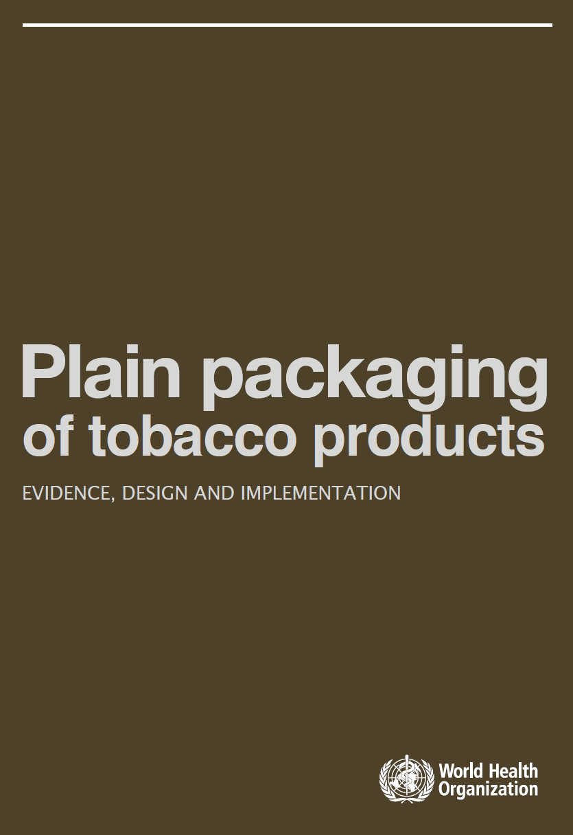
What we have learned on effectiveness
There is a large body of peer-reviewed evidence (surveys, focus groups and experimental studies that support the effectiveness of plain packaging.
Post-implementation evidence tends to confirm the conclusions in the pre-implementation evidence.
In Australia, a post-implementation review quantified that the combined impact of plain packaging and enlarged health warnings reduced average smoking prevalence by 0.55 percentage points.
Other countries:
  France: Smoking prevalence among adults aged 18-75 down from 29.4% in 2016 to 25.4% in 2018. (http://invs.santepubliquefrance.fr/beh/2019/15/2019_15_1.html)
  Increased salience of warnings, thoughts of risks and quitting have been found in the United Kingdom *(Crawford Moodie, Leonie S Brose, et al., ‘How did smokers respond to standardised cigarette packaging with new, larger health warnings in the United Kingdom during the transition period? A cross-sectional online survey’, Addiction Research & Theory 2020, Vol. 28 (1), 53-61)

Slide 11
Modeling in the Americas
Canada’s cost benefit analysis concluded that a “0.03% increase in the annual rate of cessation and a 0.03% decline in initiation rates — would be sufficient to produce public health benefits equivalent to or greater than the estimated monetized costs.”
Researchers through modeling evaluated the impact of implementing plain packaging in addition to graphic health warnings in Argentina, Bolivia, Brazil, Chile, Colombia, Mexico, and Peru, and found that plain packaging could over 10 years add 4.1 million healthy years of life and save USD 13.6 billion in direct health care expenses of diseases attributable to smoking.* (Alcaraz A, Hernández-Vásquez A, Palacios A, et al., Health and Economic Impact of Health Warnings and Plain Tobacco Packaging in Seven Latin American Countries: Results of a Simulation Model, Nicotine Tob Res. 2020, Vol 22(11), 2032-2040)
Research specific to Argentina concluded that implementation of plain packaging of tobacco products could avert 1880 myocardial infractions, 820 strokes, and 4320 total deaths over the 2015-2024 period.* (Salgado MV, Penko J, Fernandez A, et al., Modelling the impact of plain packaging of tobacco products on cardiovascular disease in Argentina, Tob Control 14 July 2021)

Slide 12

Industry arguments against plain packaging remain unproven
No reliable evidence
Unintended consequences:
  Increases illicit trade
  Leads to lower tobacco prices
  Negative impact on small retailers
Libertarian arguments:
  ‘Nanny state’ and ‘personal freedom’
  Plain packaging of tobacco will lead to plain packaging of other products- the ‘slippery slope’
Impact on local sector:
  Impact on local tobacco farming and tobacco manufacturing

Slide 13
Failed Litigation against Plain Packaging
Governments have successfully defended legal challenges before domestic courts and international courts and tribunals, including the World Trade Organization.
Challenges have focused on:
  Procedural due process
  Protection of property rights (trademarks)
  Free trade / free movement of goods
  Freedom of enterprise and expression
  Proportionality / necessity / reasonableness, including whether plain packaging is effective and whether it has worked in jurisdictions where it has been implemented
Despite successes before domestic and international courts, tobacco companies challenge plain packaging to delay implementation by seeking preliminary injunctions (Belgium and Denmark).

Slide 14
Similar approaches across countries
No need to reinvent the wheel
Many elements of plain packaging laws are adapted from Australia’s approach and common across different countries
Australia, Canada and Singapore each did pre-market testing, reaching similar conclusions
Start with established approaches and consider whether departing from them is necessary for reasons specific to your country

Slide 15
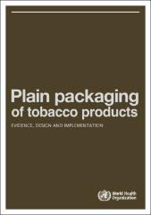
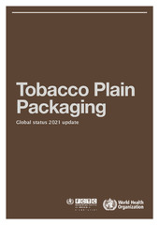

Publications
Guidance on strengthening your legal position What countries have done to date The WTO dispute

Slide 16
Assistance available
Policy development, including policy design, responding to industry arguments, legislative or regulatory drafting support
Post-implementation assistance, whether advice on enforcement, monitoring and evaluation or litigation support
Connecting governments

Slide 17


Benn McGrady, PhD is the Unit Head of the Public Health Law and Policies team in the Health Promotion Department at WHO headquarters. He provides technical assistance to WHO Member States and helps build their legal and regulatory capacity across a variety of issues, including with respect to NCD risk factors.
Benn has led WHO’s work on international legal disputes such as Philip Morris vs Uruguay and Australia – Tobacco Plain Packaging. Benn has taught at Georgetown University Law Center and Sydney Law School and is the author of Trade and Public Health: The WTO, Tobacco, Alcohol and Diet (Cambridge University Press, 2011).
Available at: mcgradyb@who.int
Kritika Khanijo is a Technical Officer (Legal) in the Public Health Law and Policies team in the Health Promotion Department at WHO Headquarters. She provides technical assistance to WHO Member States on tobacco control issues, in particular plain packaging and regulation of novel and emerging nicotine and tobacco products.
Kritika is the co-author of ‘Litigation relevant to regulation of novel and emerging nicotine and tobacco products’, a WHO publication that analyses over 90 legal cases to identify global trends with respect to regulation of novel and emerging nicotine and tobacco products. She has also updated the Global Status Report on Tobacco Plain Packaging, which provides technical details about the global implementation of plain packaging.
Available at: khanijok@who.int

