Slide 1
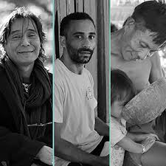
Masculinities and health in the Americas (Paho, 2019)
PAHO - APHA Equity Panel
Benno de Keijzer
Public Health Institute / Veracruz University
PROITH/CIGU/UNAM
June 2022

Slide 2
Yourcenar?
Manbox English?

Slide 3
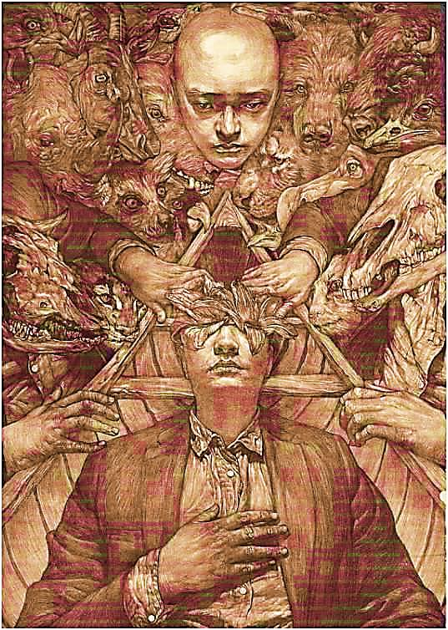
Gender Culture
It´s not in our genes…
With socialization we incorporate (in corpus) mandates through formal and informal educational processes

Slide 4
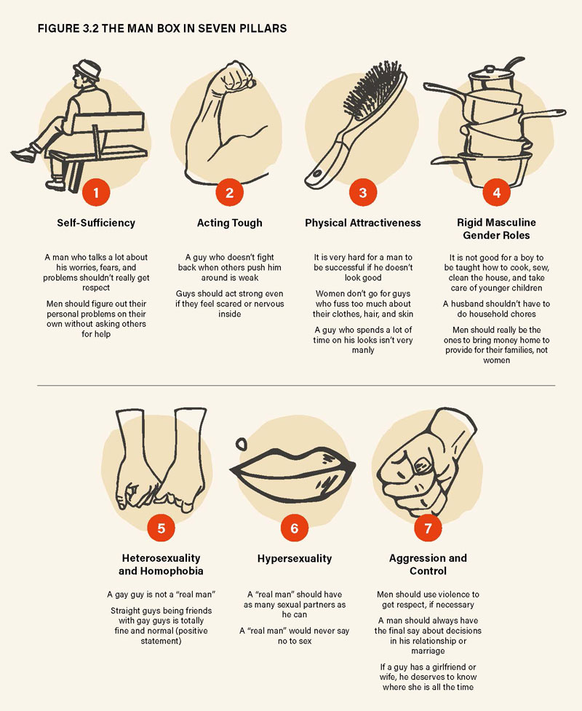
THE MAN BOX
Instituto Promundo

Slide 5

PrivilEDgEs OF MEN
For women
Other men
Ourselves
COSTS
Inspired by the
violence triad
Michael Kaufmann

Slide 6
Percentage distribution of mortality in men and women, according to selected causes that mainly affect men, Region of the Americas, 2011-2015
COVID
5.8 years less life expectancy

Slide 7
Percentage distribution of mortality in men and women, according to selected causes that mainly affect men, Region of the Americas, 2011-2015

Slide 8
Leading causes of years of life lost (YLL) in men throughout the life cycle, `Region of the Americas`, 2015
  Preterm delivery
  Asphyxiation and trauma at birth
  Neonatal infections
  Congenital cardiac anomalies
  Lower respiratory tract infections
  Neural tube defects
  Lower respiratory tract infections
  Congenital cardiac anomalies
  Diarrheal diseases
  Malnutrition
  Preterm delivery
  Road injuries
  Road injuries
  Interpersonal violence
  Drowning
  Lower respiratory tract infections
  Leukemia
  Congenital cardiac anomalies
  Interpersonal violence
  Road injuries
  Suicide
  Disorders due to drug use
  Drowning
  Disorders due to use of opiates
  Interpersonal violence
  Road injuries
  Ischemic heart disease
  Suicide
  Cirrhosis of the liver
  HIV/AIDS
  Ischemic heart disease
  Cirrhosis of the liver
  Stroke
  Respiratory cancers
  Hemorrhagic stroke
  Road injuries
  Ischemic heart disease
  Respiratory cancers
  Stroke
  COPD
  Cirrhosis of the liver
  Hemorrhagic stroke
  Ischemic heart disease
  COPD
  Stroke
  Respiratory cancers
  Alzheimer and other dementias
  Lower respiratory tract infections
1 to 59 months
0 to 28 ias
5 to 1 4 years
50 to 59 years
15 to 29 years
30 to 49 years
60 to 69 years
70 years or more

Slide 9
Intersectionality: Vulnerabilities caused and experienced in relation to masculinities
Being
poor
Increased vulnerability in work and socially
Being a
migrant
Precariousness in work, health, housing, and exposure to illegal drugs and STIs
Being
unemployed
Causes emotional wear and tear, stress, social shame, and social and family detachment
Men
Being
young
Exposure to interpersonal violence, road injuries, and suicide
Risk practices and greater probability of dying prematurely
Hidden morbidity
Lack of self-care, failure to seek help, and inadequate health services
Being
indigenous or Afro-descendent
Not being heterosexual Harassment, stress, and social stigma
Presence of social determinants of health: hegemonic masculinity

Slide 10
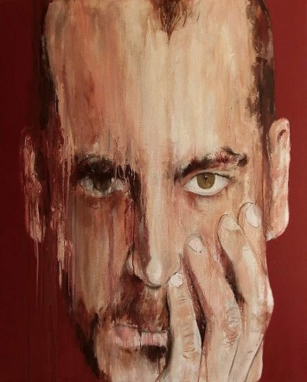
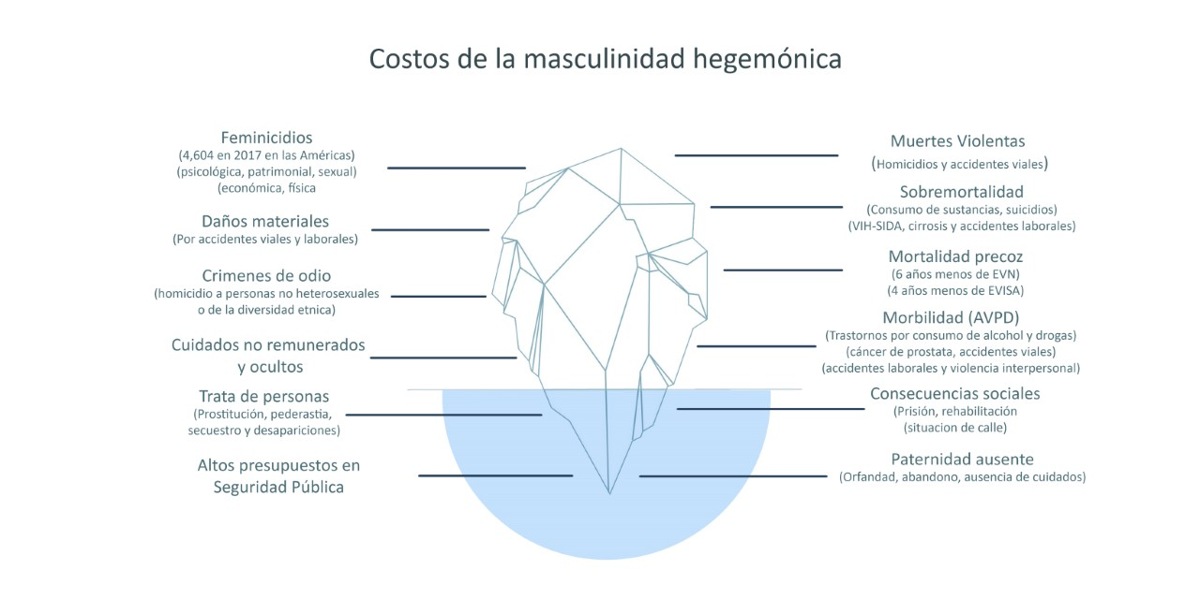
Malestar
Oculto a plena vista (Baker)
Hidden at plain sight

Slide 11
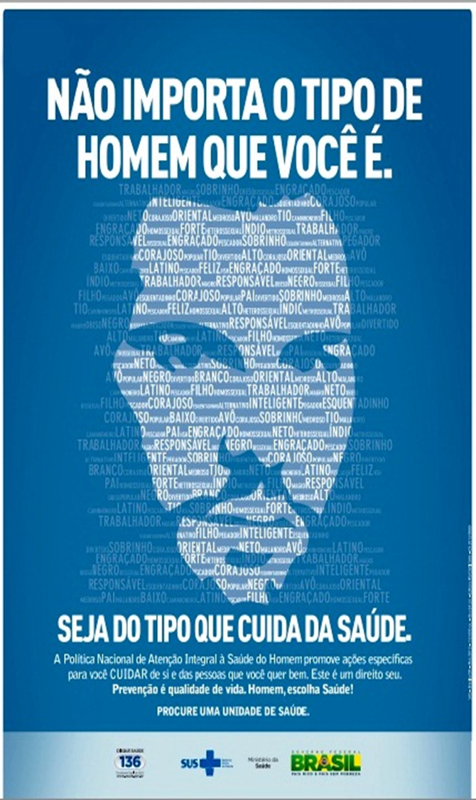
The social response
In most of our countries you have different
programs attending or trying to
prevent problems like
Accidents
Violences
Suicide
Substance abuse
HIV
Sexual and reproductive health
When all these issues are interconnected
Lacking a gender perspective
Programs are:
          Marginal
          Insufficient
          Tardy
MyS Survey- experts of 12 countries

Slide 12
Recommendations: Masculinities and gender equality have to be addressed in multiple levels:
The media
Education system
Health personnel ando our training
Functioning of institutions
Policies and programs
Laws and regulations
From the interseccionality of vulnerabilities
to intersectorial action

Slide 13
Pathogenesis
Public health
Salutogenesis:
men taking care for themselves and others
stopping gender inequalities and violence
Aarón Antonovsky

Slide 14
No victimas sino responsables

Slide 15

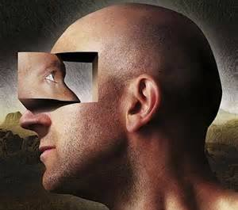




Thank you bennodek@hotmail.com

