Slide 1
Tobacco Industry Interference during the COVID-19 Pandemic in Brazil
Mônica Andreis
Executive Director of ACT Health Promotion
Declaration of conflict of interest
ACT does not receive funds from the following industries: tobacco, food, alcoholic, sugary beverages and pharmaceutical.

Slide 2
According to the Global Index of Tobacco Industry Interference, Brazil increased its score between 2020 and 2021
Activities of Tobacco industry and its allies during the pandemic includes:
misinformation
actions of corporate social responsability to improve public image
promotion of new products
ilegal ads and sales on internet
lobby against tobacco control measures and tobacco control national policy

Slide 3
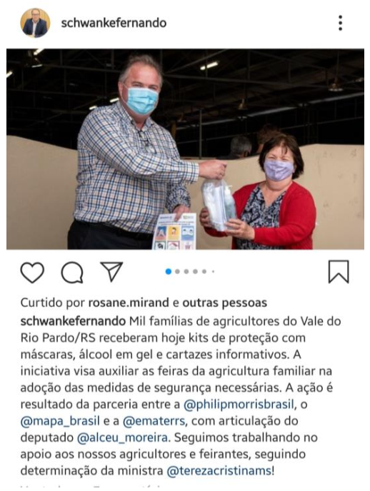
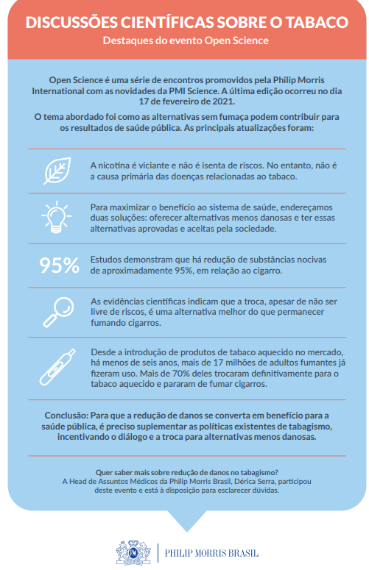
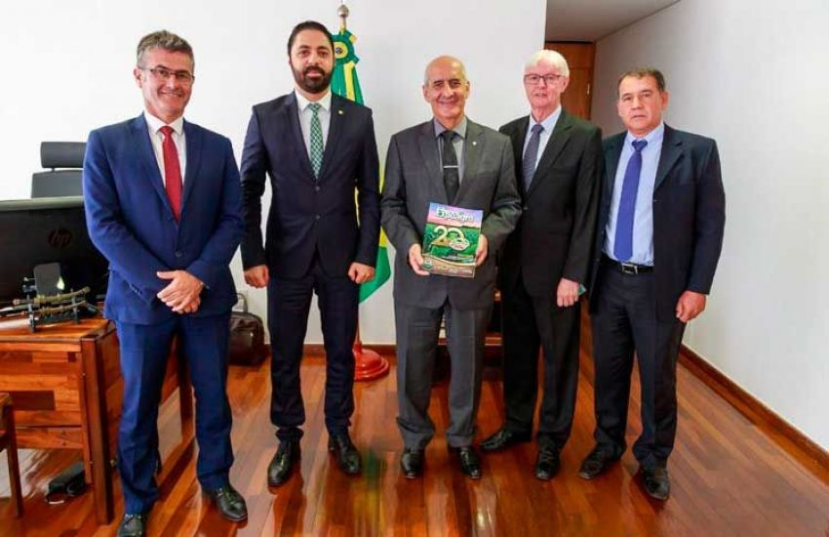
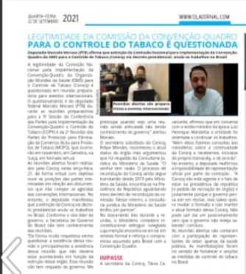
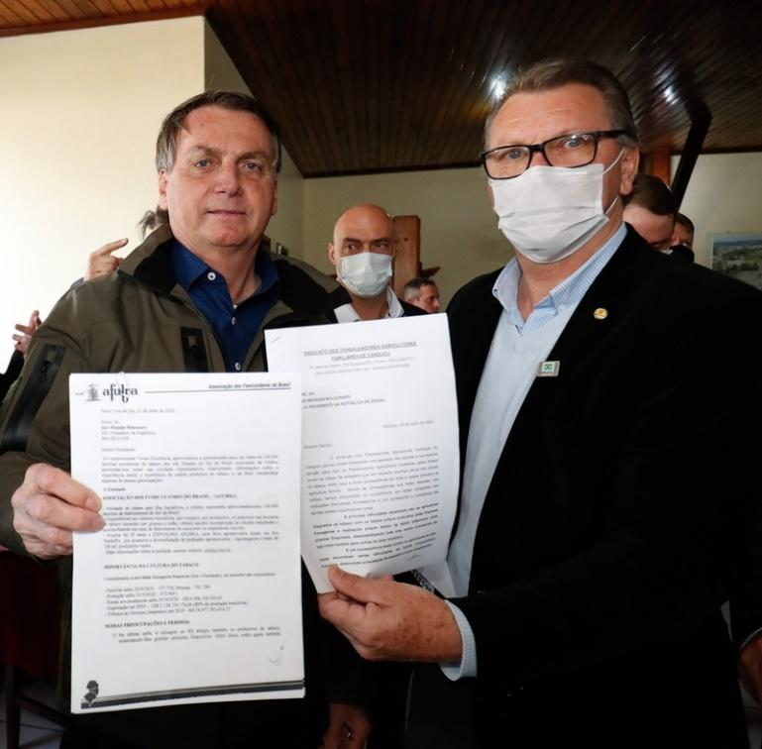

Slide 4
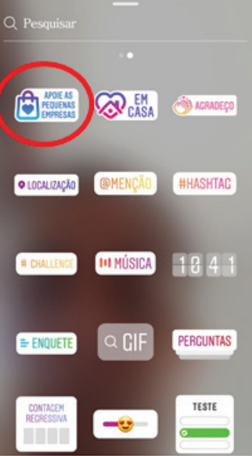
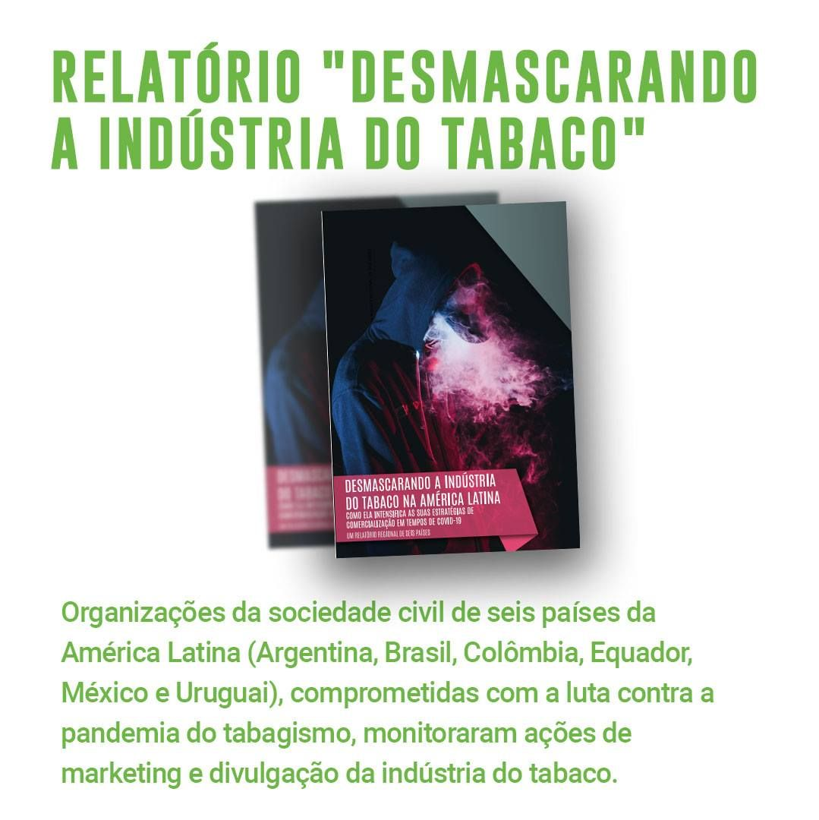
Pinho MCM, Riva MPR, Souza L, Andreis M, A Promoção de Novos Produtos de Tabaco nas Redes Sociais à Luz da Pandemia (Promoting New Tobacco Products in Social Media in Pandemic Times), Revista Brasileira de Cancerologia 2020; 66(TemaAtual):e-1108
doi: https://doi.org/10.32635/2176-9745.RBC.2020v66nTemaAtual.1108

Slide 5
