Slide 1
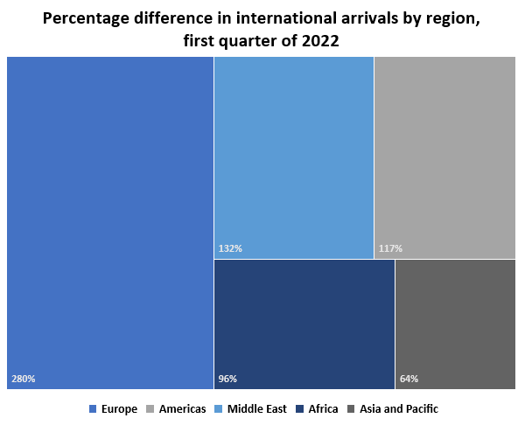
Global tourism recovery by regions, first quarter of 2022*
Global international arrivals increased 182% in the first quarter (Q1) of 2022 (January, February and March) in comparison to Q1 of 2021.
By region, Europe welcomed almost four times as many international arrivals, while in the Americas arrivals more than doubled. The Middle East, Africa and Asia also saw strong growth in Q1 2022 over 2021. In all regions, however, international arrivals remained below 2019 levels.
By subregion, the Caribbean and Southern and Mediterranean Europe showed the fastest recovery towards 2019 levels.
Source: World Tourist Organization. World Tourism Barometer. Volume 20 | Issue 3 | May 2022. Available at: https://webunwto.s3.eu-west-1.amazonaws.com/s3fs-public/2022-06/UNWTO_Barom22_02_May_excerpt.pdf?VersionId=5c9Q9abJCiFcJYyU_.4zmzilL3YBzI7A

