Slide 1
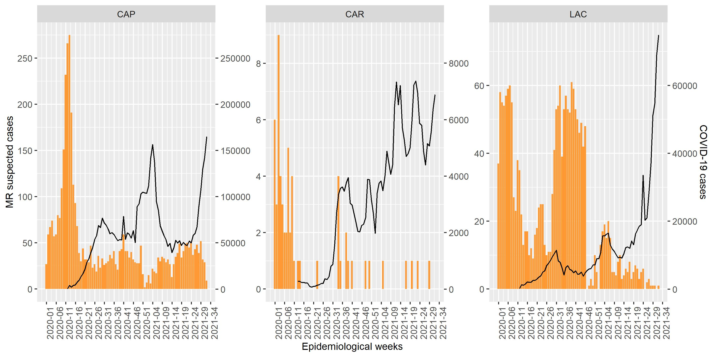
Notification of suspected measles and rubella (MR) cases and COVID-19 cases by epidemiological week and subregions*, 2020-2021**
MR cases | COVID-19
6,154 | 5,417,567
*Central America and Mexico (CAP) = | Caribbean (CAR)| Latin Caribbean (LAC) **Data as of epidemiological week 31, 2021. Source: Surveillance country reports sent to PAHO.

