Slide 1
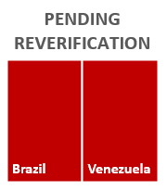
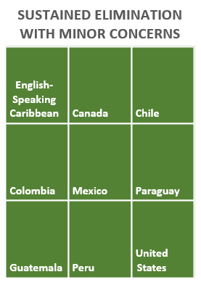
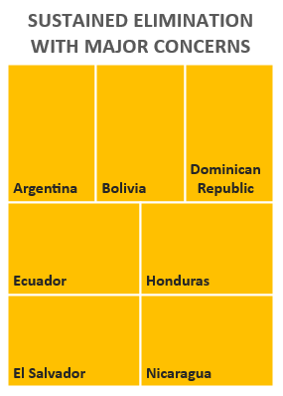
Status of Re-Verifying Measles and Rubella Elimination and Sustainability in the Region of the Americas
The Pan American Health Organization (PAHO) Regional Monitoring and Re-Verification Commission concluded that Member States have sustained rubella and CRS elimination, while Brazil and Venezuela are pending re-verification for measles elimination. The remaining countries were stratified by the Commission in two subcategories. The implementation of a high-quality follow-up vaccination campaigns was a factor to group countries in “sustained with major concerns,” given the impact of the pandemic on routine immunization services and the presence of large pockets of susceptible individuals.
Costa Rica, Cuba, Haiti, Panama, Uruguay and the French Territories did not submit their annual report.
Source: Annual meeting of the Measles and Rubella Elimination Regional Monitoring and Re-verification Commission (virtual session) 30 November, 1-2 December of 2021

