Slide 1
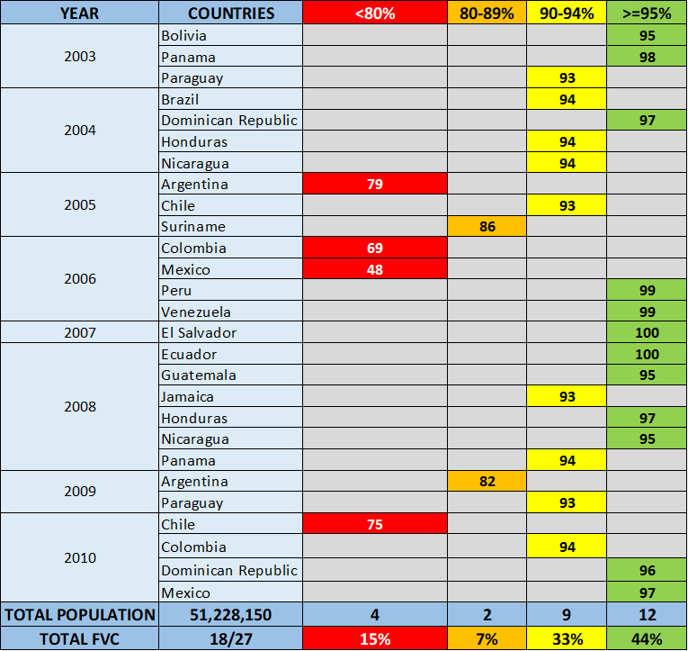
Efficacy of the follow-up vaccination campaigns (FVC) in the Americas, 2003 to 2019
Between 2003 and 2010, 18 countries carried out 27 FVC; 12 campaigns implemented in 11 countries reached coverage > 95%.
Between 2011 and 2019, 16 countries carried out 24 FVC; 10 campaigns implemented in 7 countries reached coverage > 95%.
Between 2003 and 2019, 20 countries implemented 52 follow-up campaigns; 22 campaigns (44%) implemented in 13 countries achieved coverage ≥ 95%.
More than 82 million children aged 1-6 years old were vaccinated between during this period.
Source: Country reports through the PAHO-WHO/UNICEF Joint Reporting Form (JRF).

