Slide 1
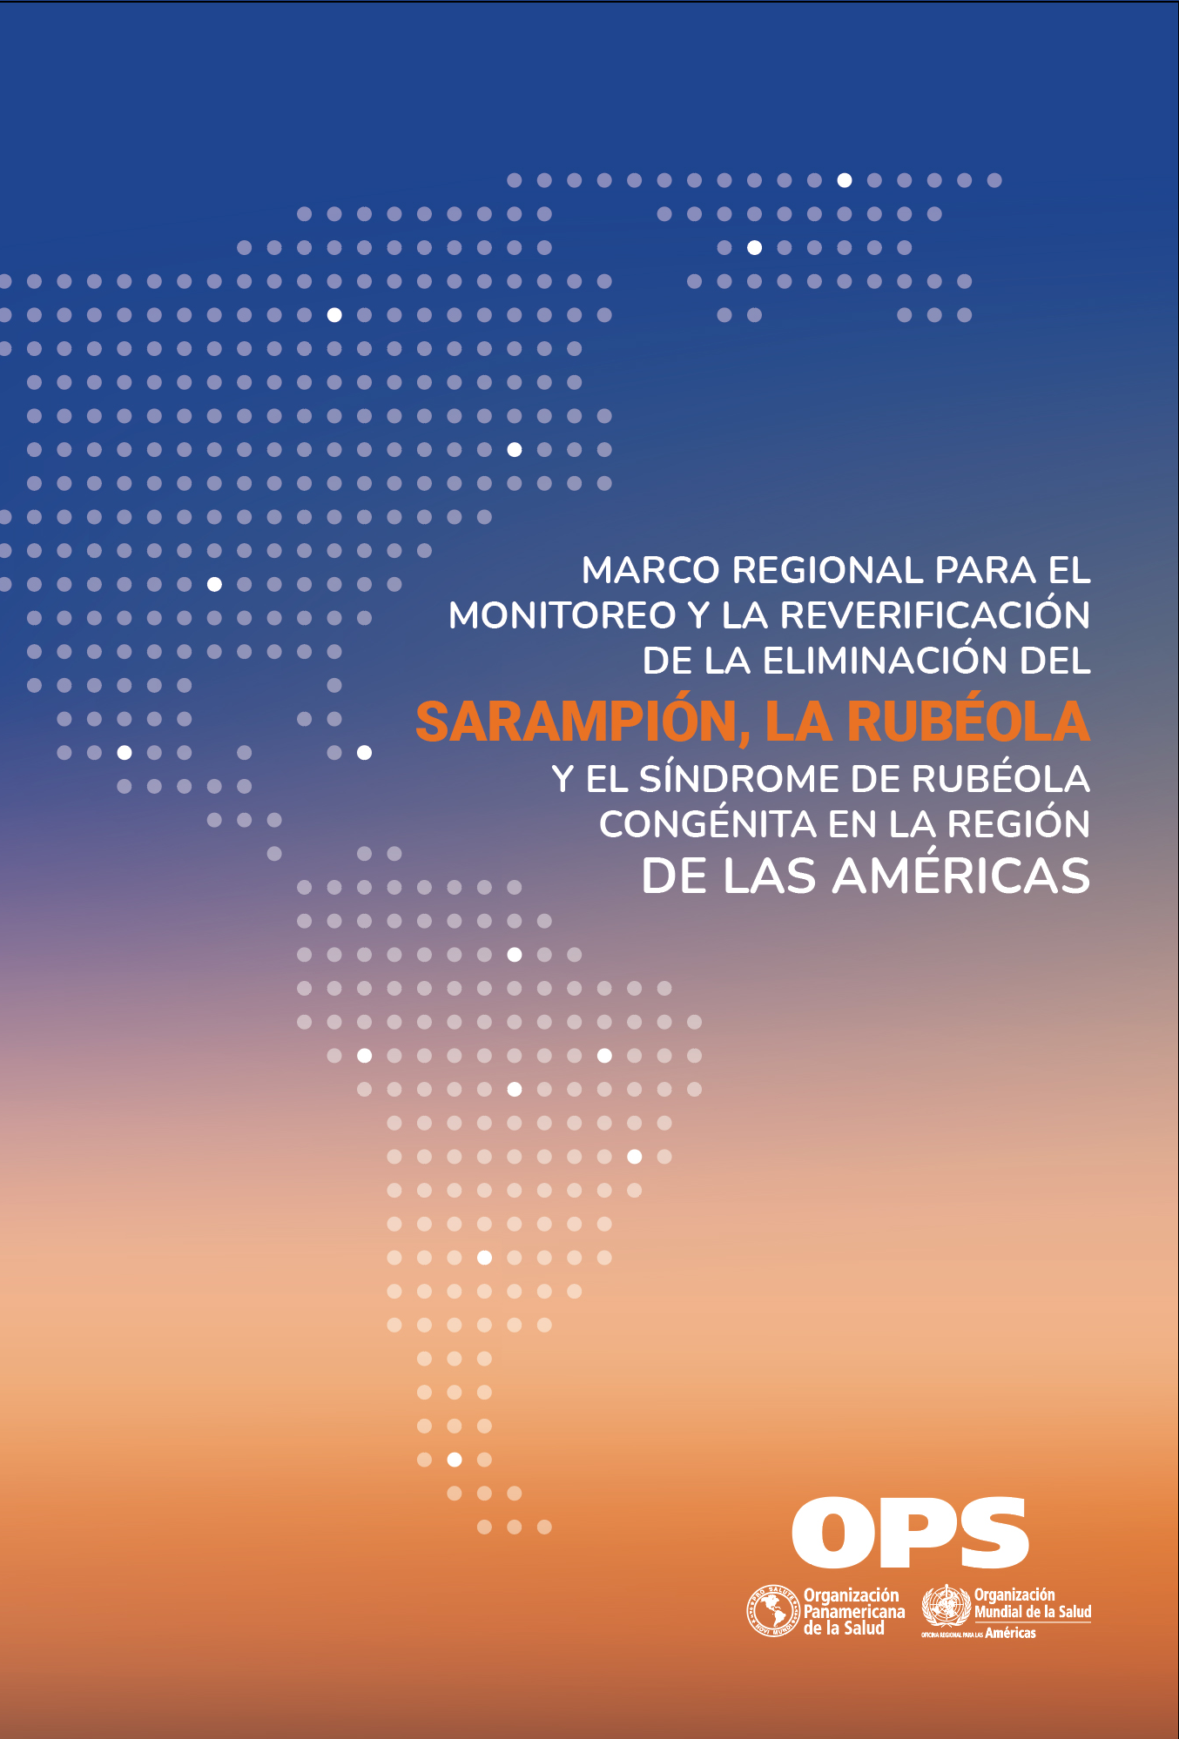
The Regional Framework for the Monitoring and Re-verification of Measles, Rubella, and Congenital Rubella Syndrome Elimination in the Americas is now available in Spanish at the Pan American Health Organization website. The Framework aims to guide PAHO Member States and the National Sustainability Committees on the requirements and procedures for monitoring the sustainability in their territories and re-verifying the measles and rubella elimination. This document was developed and critically reviewed by the Measles and Rubella Elimination Regional Monitoring and Re-Verification Commission a new body of independent experts appointed in 2019.

