Slide 1
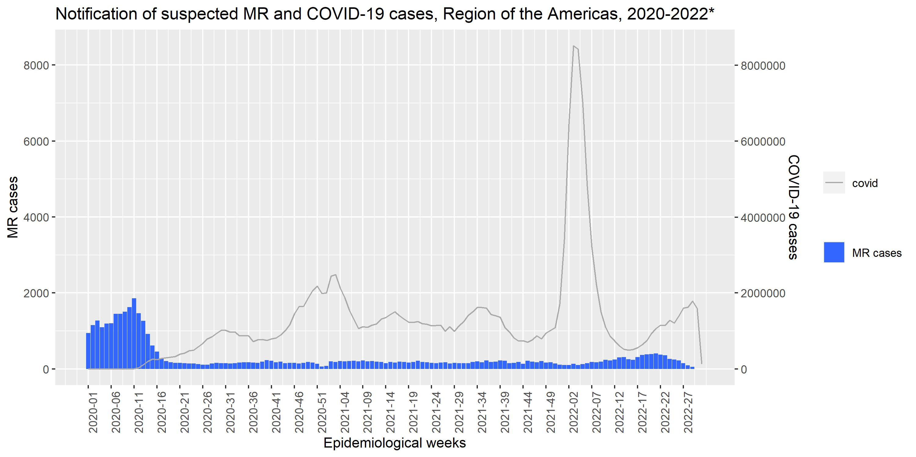
COVID-19 pandemic negatively impacted the notification of suspected measles and rubella cases from 2020 until today*. In 2021, the annual average of cases (n=6.8) was reduced by 61% compared to 2020 (18.4). As of epidemiological week 29, of 2022, the average number of cases is 8.4, reflecting a 49% increase in the number of suspected cases reported compared to 2021. However, this figure is still below the levels seen during the regional surge of 2019.
MR
COVID-19
MR cases= 41,153
COVID-19 cases = 168,912,364
* Data as of epidemiological week 30 of 2022. | Source: surveillance reports sent to PAHO?WHO

