Slide 1
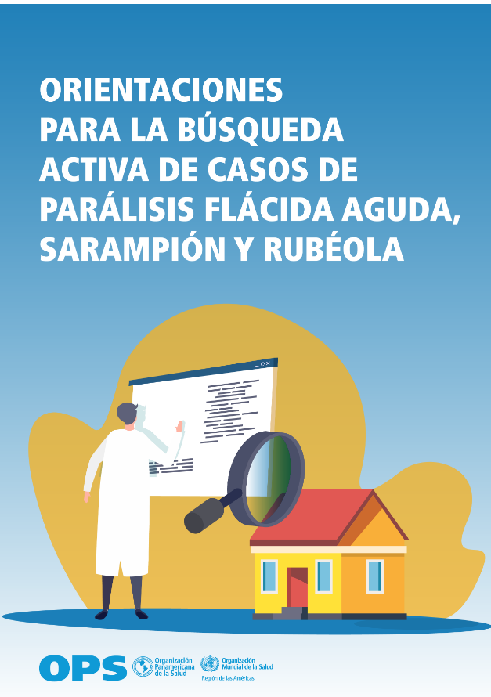
New publication!: Guidance for the active search for cases of acute flaccid paralysis, measles and rubella
What is it about?
The publication outlines updated technical guidance and data collection tools for implementing active search for acute flaccid paralysis, measles and rubella. The joint implementation of active search for these three diseases aims to achieve synergy of human and financial resources, according to disease-specific considerations.
Who is the target?
All health workers involved in surveillance activities for vaccine-preventable diseases at all levels.
The publication is available in Spanish, but soon it would be in English and Portuguese.

