Slide 1
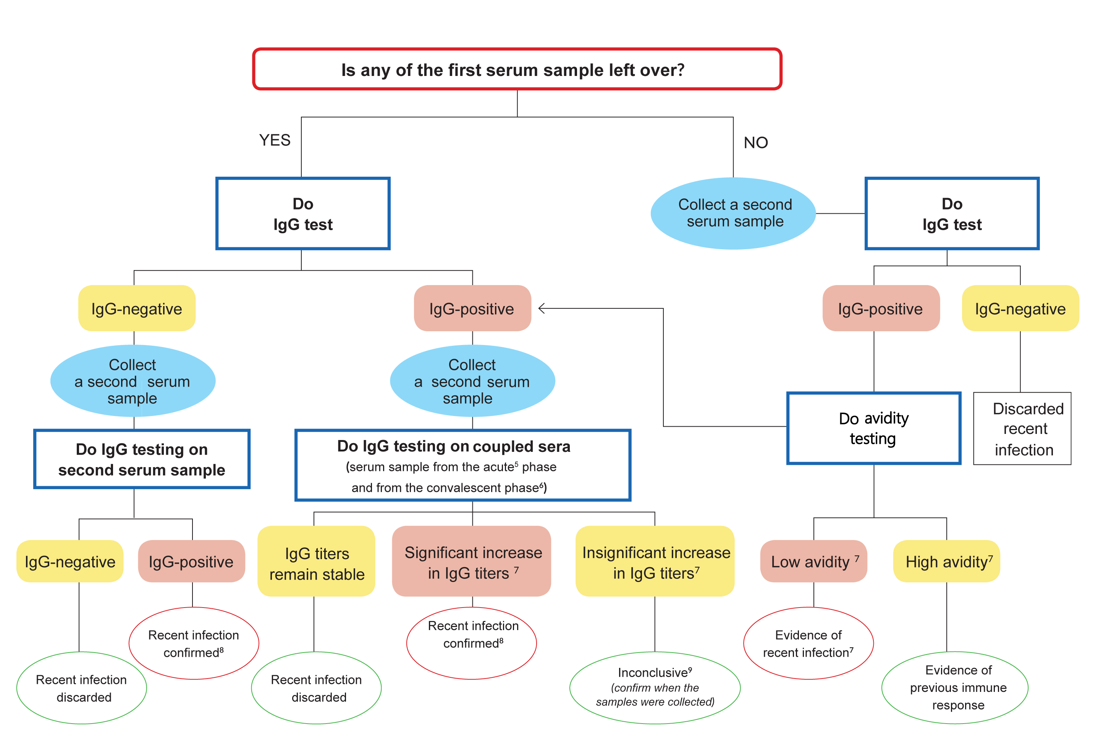
Complementary algorithm for serological testing of specimens with an initial IgM-positive or indeterminate result
5 Collect an adequate serum sample within 7 days of rash onset.
6 Collect an adequate serum sample in the convalescent phase,14-21 days after the sample from the acute phase.
7 Follow the criteria for test interpretation.
8 Evidence indicates an recent infection (either wild type or a vaccine strain).
9 Correlate with IgG avidity results.
Source: Pan American Health Organization. Guidance for testing of measles and rubella in the Laboratory Network of the Region of the Americas. Washington, D.C.: PAHO; 2018. in press.

