Slide 1
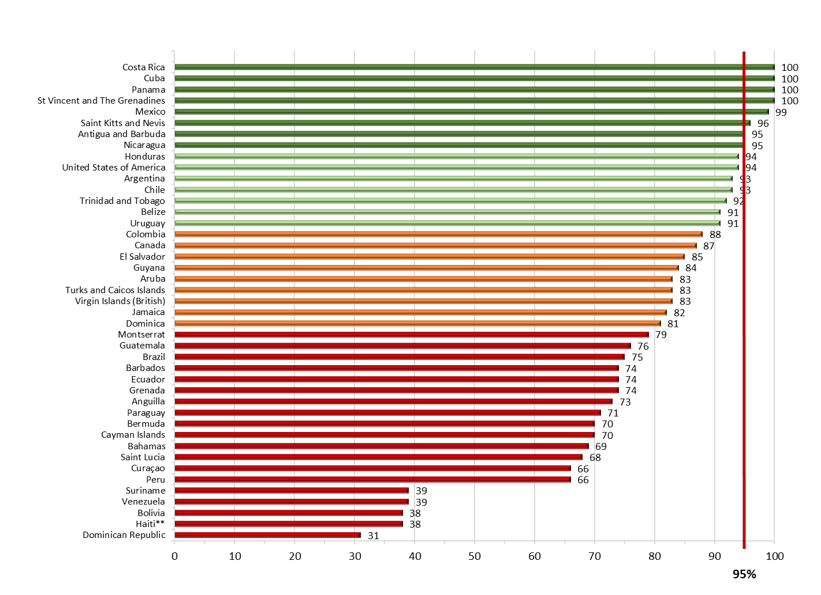
Vaccination coverage of the second dose of MMR* vaccine in the Americas, 2018
MMR2 coverage (%)
Source: Country reports through the PAHO-WHO/UNICEF Joint Reporting Forms (JRF), 2019.
*MMR: measles-mumps-rubella vaccine; **Measles-rubella (MR) vaccine.

