Slide 1
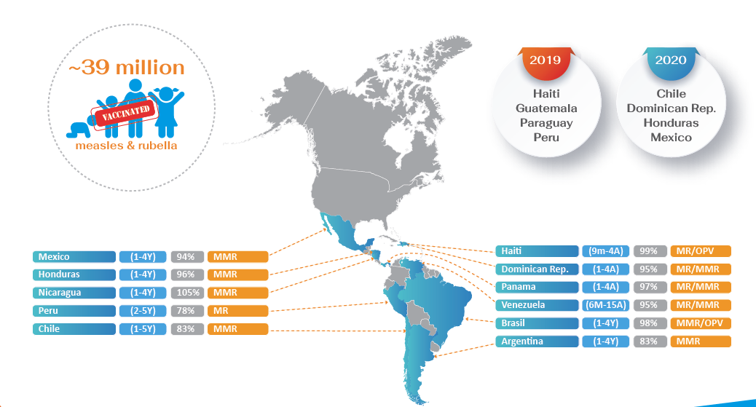
Results of the Follow-up Campaigns Against Measles and Rubella
The Americas, 2015-2018
Source: Country reports through the PAHO-WHO/UNICEF Joint Reporting Form (JRF), 2019.

